Slide 1
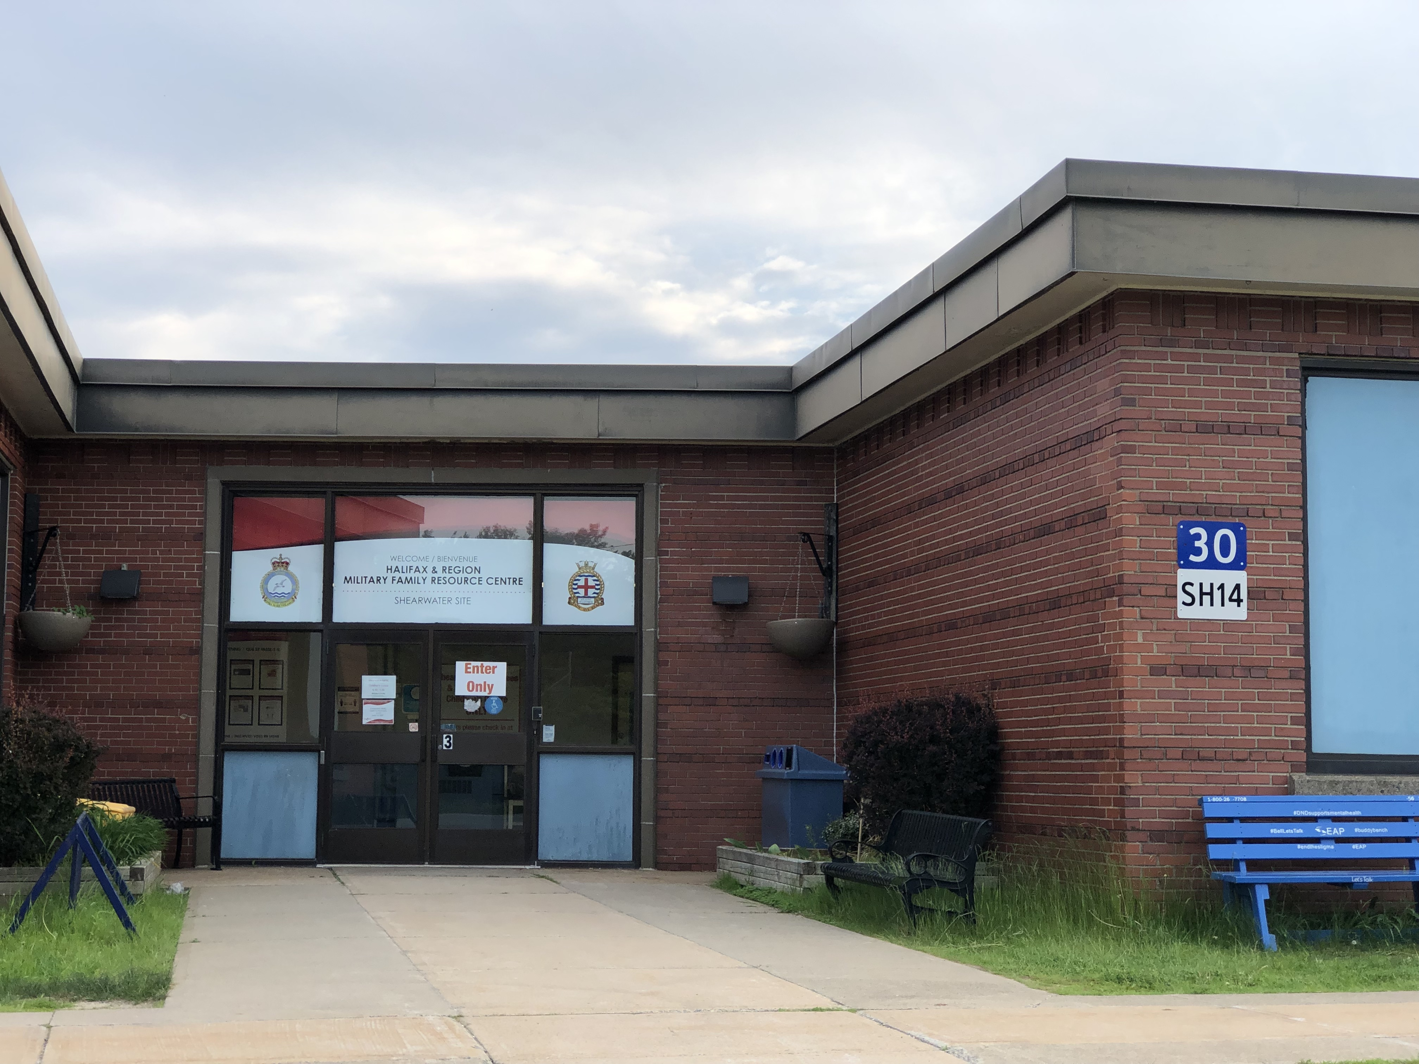
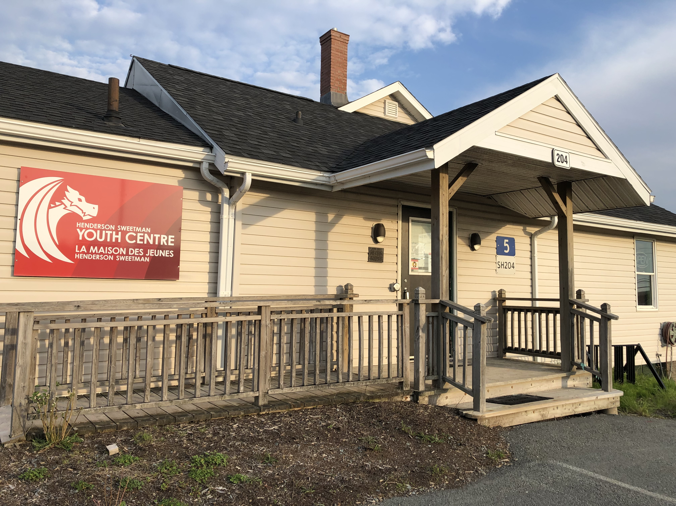
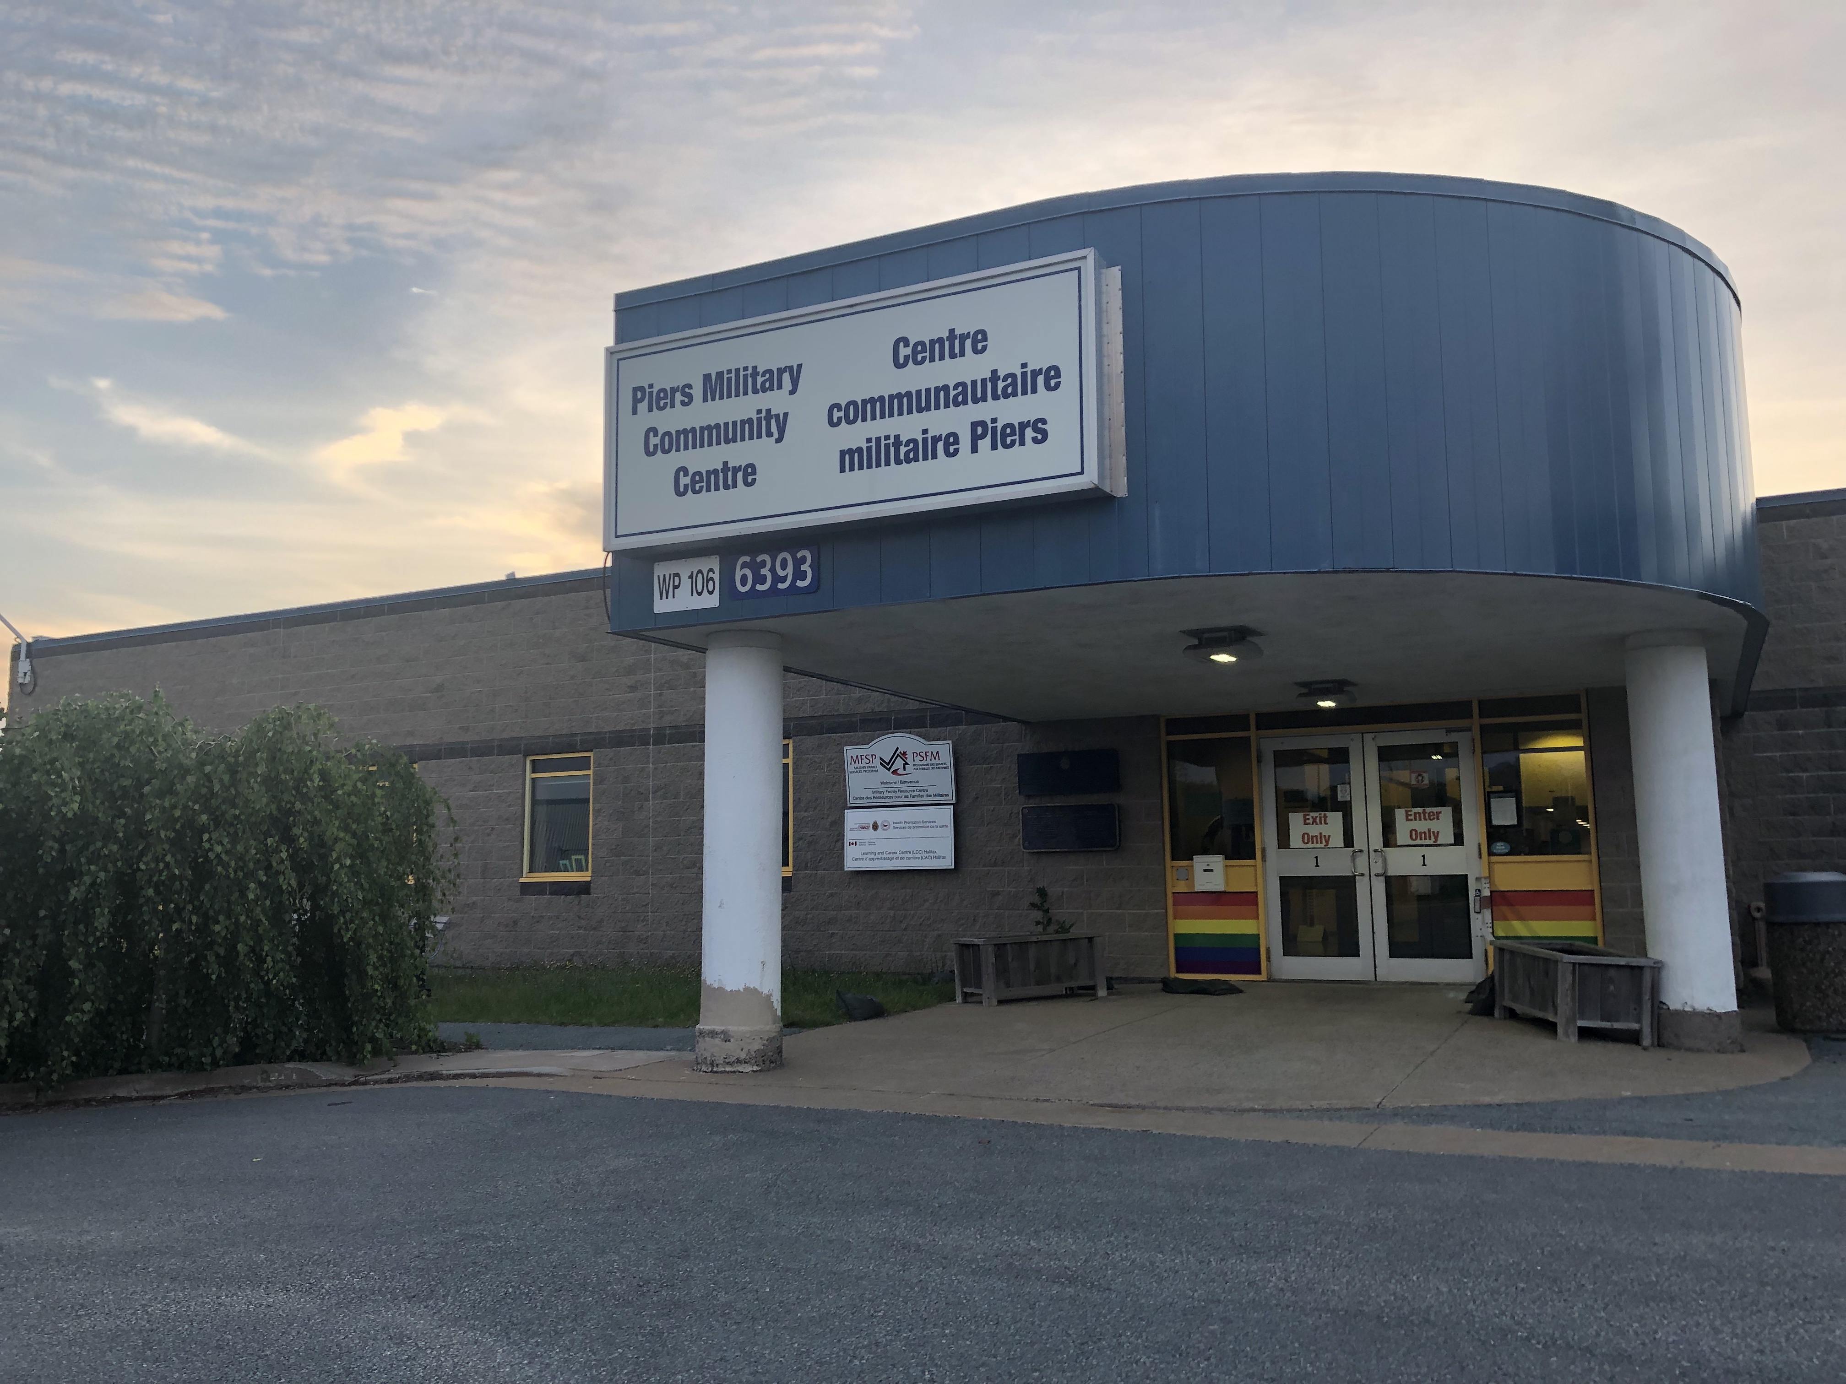
Halifax & Region
Military Family Resource Centre

Slide 2

Indigenous Land Acknowledgment
We would like to acknowledge that we are in Mi’kma’ki (MEEG_MA_GEE), the ancestral territory of the Mi’kmaq people. This territory is covered by the Treaties of Peace and Friendship.
We are all Treaty People.
Land acknowledgments are the beginning place in honoring broken treaty relationships.
Notes:
Land Acknowledgment
Before any workshop virtual or in person and before you introduce speakers.
Before any large group meeting (7+ people)
If you have speakers, ask them if they would like to acknowledge what territory they are speaking from or live in.

Slide 3
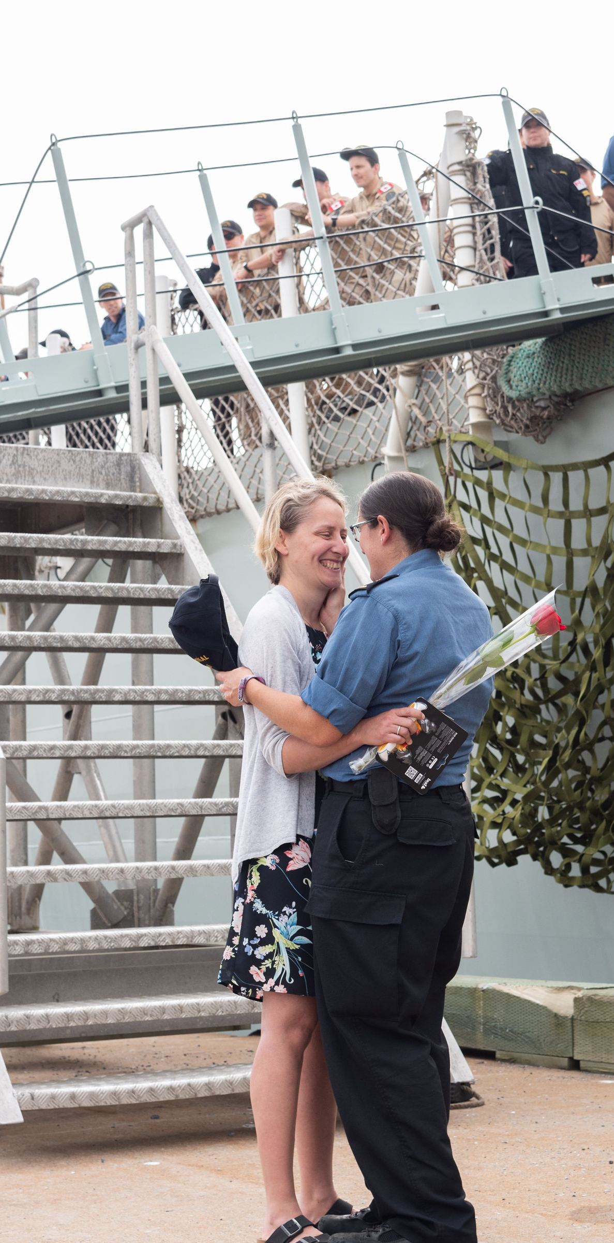
MISSION STATEMENT
To strengthen the well-being
of all those who share the unique experience of
military life.
Notes:
Our purpose is simple: to strengthen the well-being of all those who share the unique experience of military life.
We are responsive to the ever-changing challenges and needs of military families

Slide 4
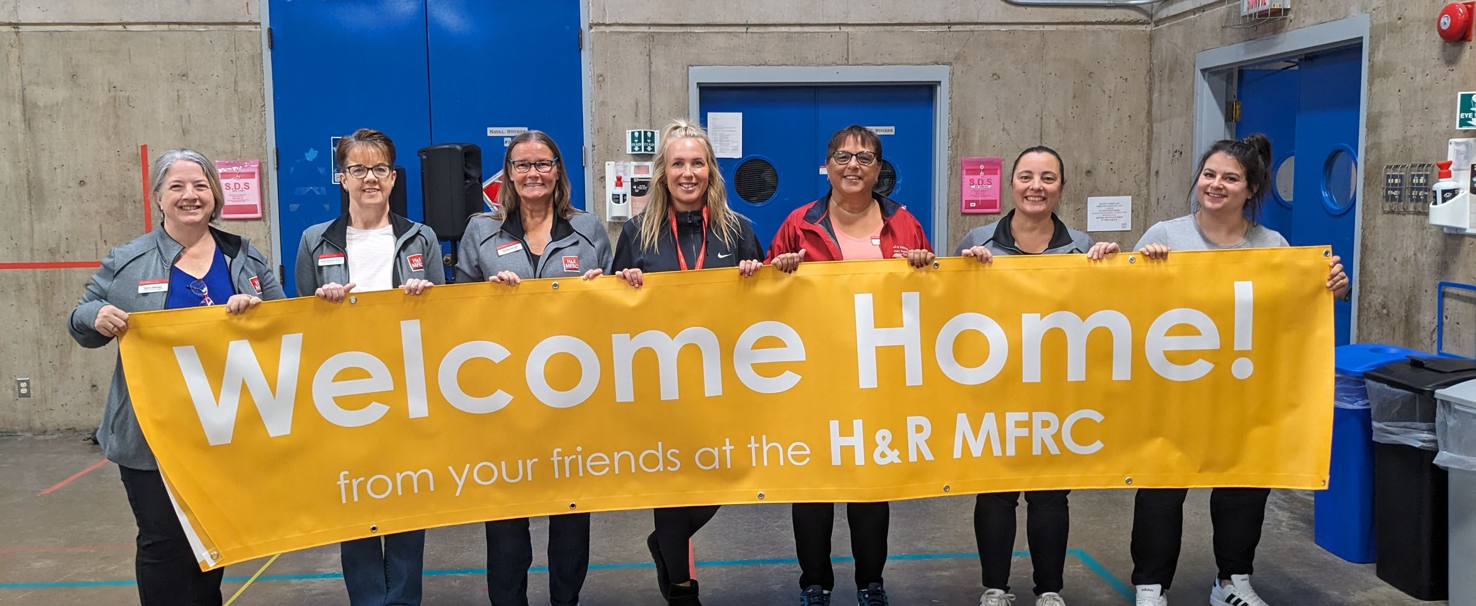
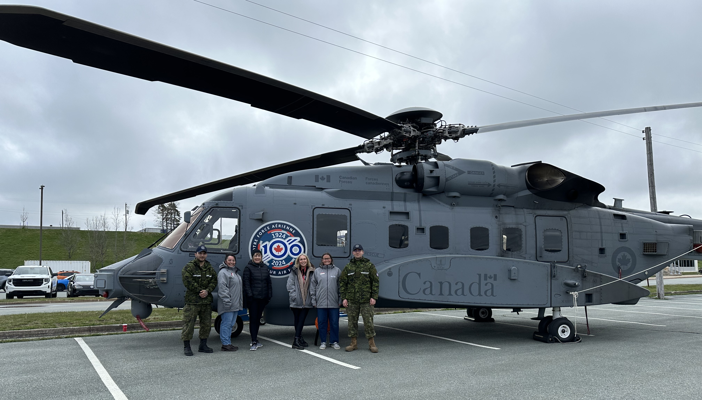
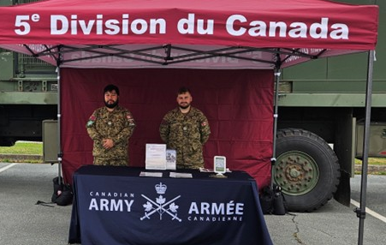
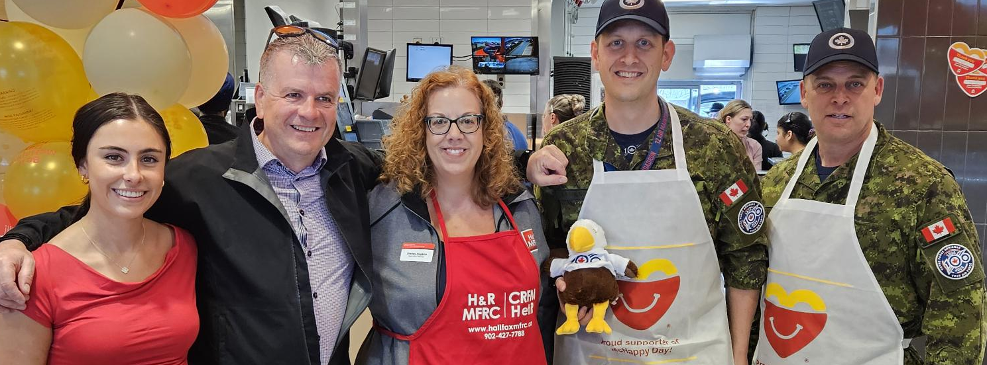
Notes:
The Halifax and Region MFRC was established in 1986 as a non-profit organization
We are one of 32 MFRCs in Canada, serving one of the largest military bases in the country.
We understand the military lifestyle because many of our staff members have lived it. Many of our staff members have served, been the children of serving members or as spouses of the military
Our team has a long history of established relationships in the community
Our Board of Directors is comprised of a minimum of 51% military family members
We have professionally trained subject matter experts, like our Registered Social Workers and a Certified Career Development Professional
Each MFRC offers core services, but what we offer and how it is offered may be different depending on the community needs. MFRCs will navigate and support families to connect to services that best meet their needs and will not duplicate existing services already available in the community.
We are the only MFRC with a 24hr information line and on-site Padre

Slide 5
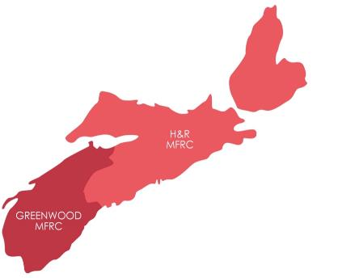


WHERE WE SERVE
SHEARWATER SITE
HALIFAX SITE
Notes:
We serve Central and North Eastern Nova Scotia with facilities located in Halifax (Windsor Park) and Shearwater (12 Wing)
Services are offered in-person, virtually and over the phone

Slide 6
UNIQUE CHARACTERISTICS
Absences
Programs & services that connect families and decrease social isolation.
Relocation
Programs & services that support relocation and community integration
Transitions
Programs & services that ease the process of transition.
Notes:
There are three unique family journey characteristics that Military and Veteran families commonly face. Relocation, absences and transitions.
From recruitment through training and temporary duty, through postings and deployments, and finally through to release we are here as navigators to help families find their way and to feel prepared along their journey.
Halifax and Region has a high operational tempo impacting a large number of families, deployment support can be accessed whenever the member is away, this could be for training, a course, overseas mission, IR etc.

Slide 7

OUR DEFINITION OF FAMILY
The CAF member (Reg Force & Reservist)
Veterans
  Spouse / Partner
Parents
Children
Relatives
Anyone you consider
Notes:
We recognize each family has their own unique situation and experience, and therefore need access to services that address their individual circumstances.
We define family as: the CAF member and anyone of significance: spouse, partner, children, parents, relatives, and anyone they consider family to be.
We honour the diversity of families
The H&R MFRC serves all 3 elements (Air Force, Army and Navy), Regular Force, reservists, medically releasing members and medically-released Veterans.
Services for families may have different eligibility requirements to support those who are most directly affected by military life.
If you are not sure if your family member qualifies for something – just ask us! We're here to help your family find or access support

Slide 8
FAMILY-CENTRED APPROACH
Support is tailored to each situation
Support is collaborative with the family members
We will navigate to local, relevant resources
Our services are confidential, we do not report to the Chain of Command
Notes:
Now that we have an understanding of what we mean by family, here’s how we approach our work to supporting families who live the military lifestyle
Military and Veteran families are unique, each with different needs and strengths.
We take a family-centred approach to service delivery that recognizes the complex and ever-changing needs of families. We strive to operate with a high degree of flexibility and responsiveness.
Our programs and services encourage family-to-family support and connections with one another.
When appropriate, we refer to supports and services in the larger community.
Our services are confidential, we do not report to the Chain of Command. Using our services does not get reported to the CoC With your permission, we can collaborate with the CoC, Padres, and other oganizations to assist your family.

Slide 9
WE SEEK YOUR FEEDBACK
AND TAKE AN
EVIDENCE BASED
APPROACH
Notes:
Our programs and services use an evidence-based approach
We seek input from families by formal and informal surveys, questions, and general feedback. We follow trends and use the latest research in family support
We analyze it and use it to help shape how and what we offer.
Some examples include: Canadian Institute for Military & Veteran Health Research, Military Family Services studies, The Quality of Life Survey, the Community Needs Assessments
When you participate in military family research you have the potential to influence service changes and funding.
Feedback received has helped evolve services, such as Spousal Employment, Mental Health, Maple Virtual Health, support through the release process, and more.

Slide 10

INFORMATION & AWARENESS
24/7 info & referral line, website & social media
Morale mail drop off
Connection programs
Unit Family Representative program
Sending with love.
Notes:
Information and Awareness services are delivered in a way that is easily accessible by all families.
We share information on our website, social media pages and groups as well as our e-newsletter.
We focus on community integration and family awareness and understand the military and family journey challenges and the services available to support you - when, where, and how you need them.
These supports include:
24/7 info & referral line. The 24/7 line is not an emergency service, however, we offer urgent support
Morale Mail drop off and instructions
Programs that offer opportunities for connection
Our Unit family representative (UFR) program is one way we link units to the MFRC
For newly posted families, we help with things like getting to know the area, how to access health and dental benefits, assistance finding a family doctor, housing resources and more
If your family member needs a family ID Card, we provide this service

Slide 11
WE ARE
MILITARY FAMILY NAVIGATORS
Notes:
The role of our family navigators is to support families on their journey, providing peer support opportunities and education in the areas of relocation, absences and transition into the military.
Our Navigators are military family service professionals who know the military lifestyle and its unique challenges, the community, and services/supports available to families.
Navigators will work with families to learn about their military journey, listen to their questions, needs, strengths, and identify the best tools, services and supports available to help them.
We work collaboratively with other agencies to provide relevant navigational support to connect to local and national resources that work best for families.
Expand...
You might be wondering how a family navigator can help you, after all, you can find everything on google!
Our navigators have experience working with community providers and service agencies and we also have knowledge of national supports as well as military specific funding and resources. In other words, we are like the google for military families

Slide 12

NAVIGATIONAL SUPPORT
Relocation
Resources to guide you in your search for health care and housing
Outreach in the community
Career & Employment Support
Diverse Needs and Inclusion
Youth Centre
Notes:
Welcome Event in the Fall
For newly posted families, we help with things like getting to know the area, resources to guide you in your search for health care and housing and more
Career & Employment Support- Our client centered employment assistance program focuses on the individual’s needs and finding solutions for their particular job / life challenges. Our Career & Employment Counsellor is a Certified Career Development Practitioner with over 20 years of experience coaching hundreds of military partners.
Programs and Services for Francophone families
Programs and Services for families with Diverse Needs
The Henderson Sweetman Youth Centre is located in Shearwater and runs drop-in as well as registered programs for youth ages 8-18

Slide 13
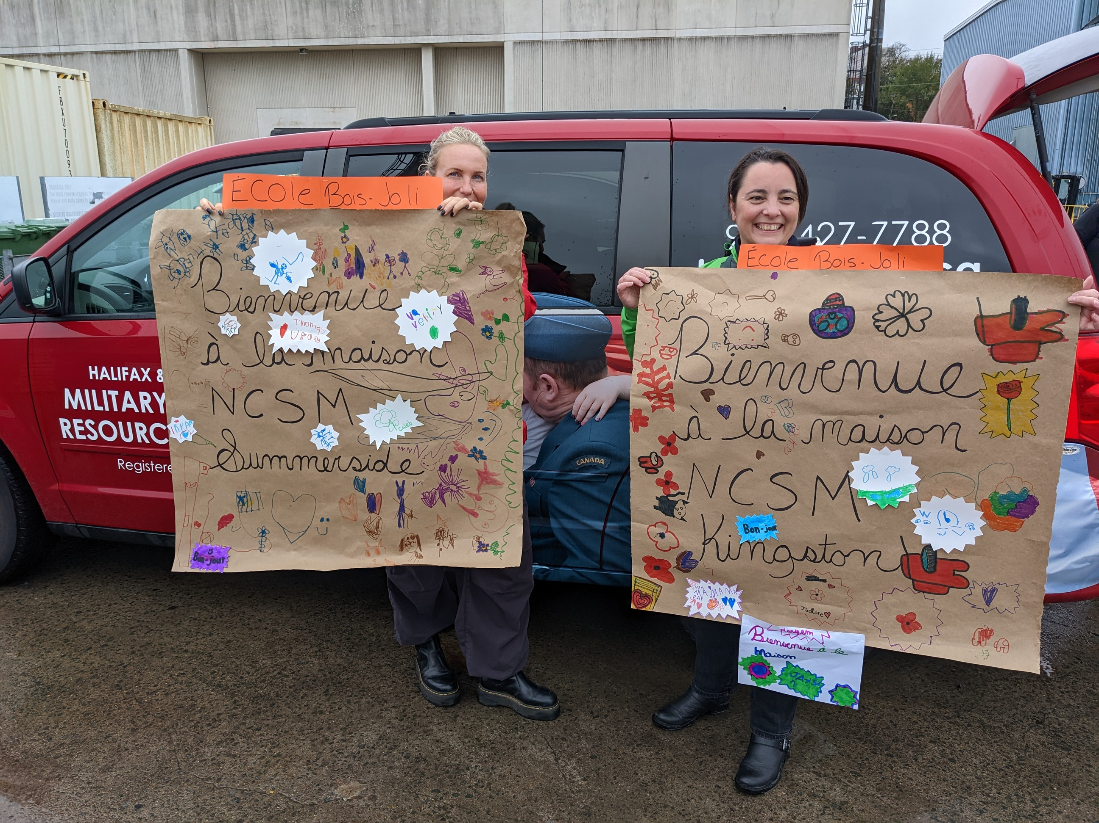
NAVIGATIONAL SUPPORT
Absences / Deployment
Warm-line/check-in call or text
Deployment education
Social activities & connections
Morale Mail
Facebook Groups
Notes:
Support to families experiencing an absences (this can include short and long term deployments, training, Imposed Rand other work-related separations)
Warmline is a phone, text, or email service where we check in on your loved ones to provide a listening ear and offer deployment support
Deployment Education could be our deployment checklist or preparing for deployment/reunion program where we discuss the deployment cycle.
When overseas on an OPERATION your family may be able to access Morale Mail service from their local MFRC. If there is one in their area. The morale mail service is a free one-way mail service.
For each Navy deployment 4 months or longer, our deployment team sets up a Private Facebook group for families to connect with one another.

Slide 14

NAVIGATIONAL SUPPORT
Transitions
Military 101
Parents of CAF Social
Veteran Family Navigator
Family Liaison Counsellor
Notes:
Military 101 – interactive virtual workshop offers an introduction to the military and the military lifestyle. Topics will include: an overview of the Canadian Armed Forces, rank structure, acronyms and more!
Parents of CAF Members Social – online!
Veteran Family Navigator offers information and referral services and transition-focused programming to successfully transition from military to civilian life. Open to: Medically releasing CAF members and their families and Medically released Veterans and their families.
Within the release process we also have a Family Liaison Counsellor who is a civilian Registered Social Worker

Slide 15

INTERVENTION
(Mental Health & Well-Being)
Short-term counselling (16+) & Crisis Intervention
Family and Peer Support
Short-term accommodations
Financial resources/OP Dasher
Francophone Counsellor
Navigator support to families with diverse needs
Emergency Family Care Assistance
Notes:
Our Mental Health & Well-Being team is an inter-disciplinary team, including registered social workers who provide free and confidential short term counselling to military family members, individuals and couples.
The team includes a Military Family Navigator who supports families with diverse needs get connected with community resources and services as well as a Francophone Counsellor to provide one-on-one in-person or virtual short-term counselling and support in French.
Intervention supports and services are individualized to address a complexity of issues
Supports provided may include short-term counselling, family and peer support, crisis intervention and referrals to other community agencies and supports.
Some examples are anxiety from deployments and absences, parenting challenges, relationship issues, separation and divorce, grief and loss, and family violence.
This service can be accessed in person over the phone, by email or virtually. Evening appointments outside of regular business hours can be sometimes accommodated upon request.
There are a range of short-term support resources available to military families during exceptional circumstances. These include Emergency Family Care Assistance, short-term accommodations in Halifax and financial resources including Operation Dasher for Christmas financial support.

Slide 16
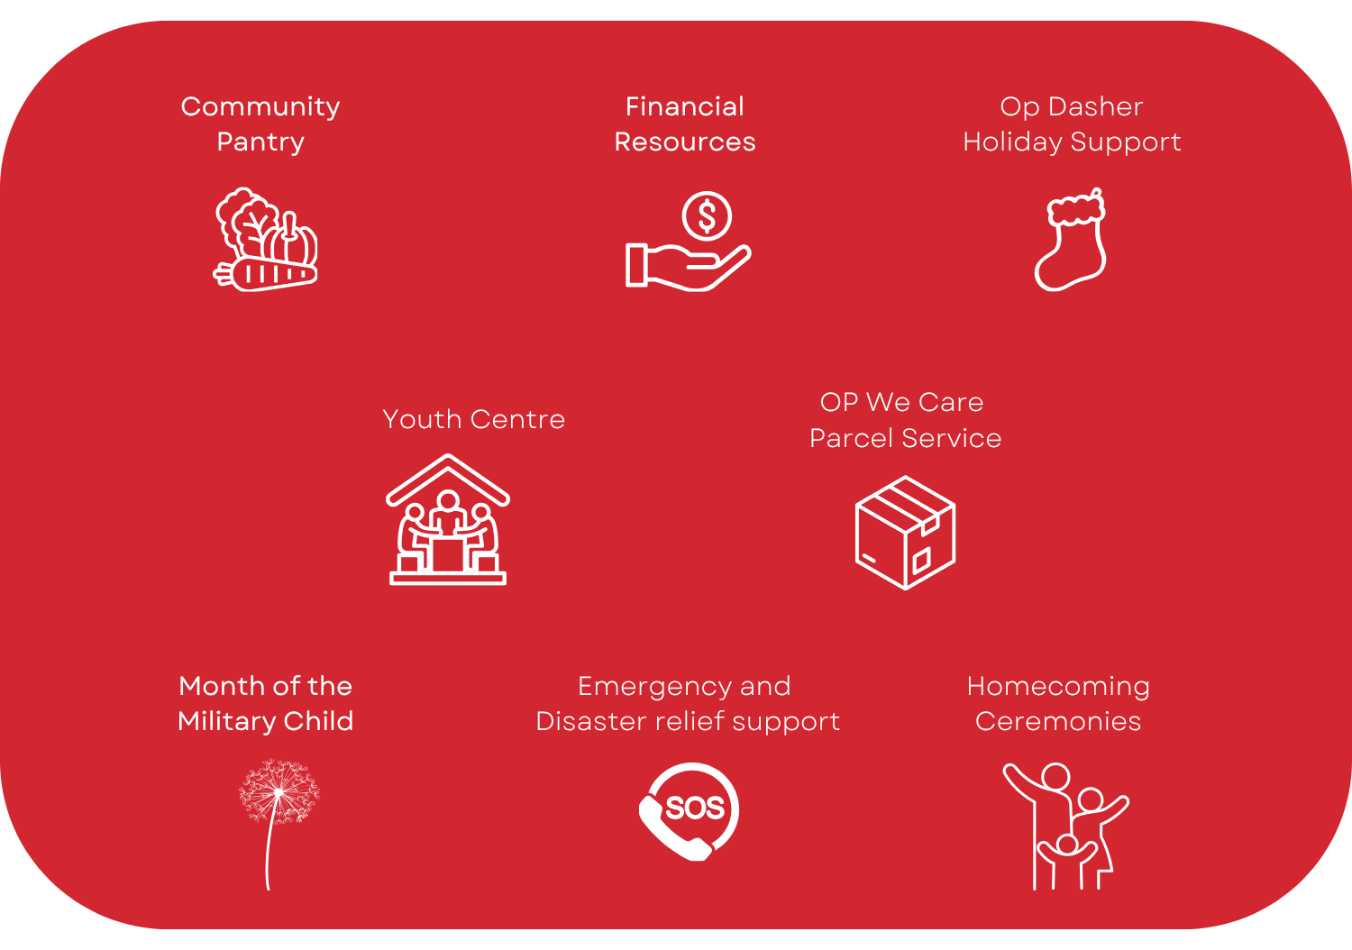
FUNDING
CHARITY OF CHOICE: NDWCC
Independent non-profit with funding through:
Military Family Services (CFMWS)
Base/Wing
Fundraising/Donations and Sponsorship
Program & Service Fees
Notes:
We are a non-profit charity
Receive funding through Military Family Services, Base and Unit Support, Provincial and Federal Funding as well as Program Fees
Only charity to support local military families. Funds raised help us support families over the holidays with financial assistance, operate the community pantries and deliver the Occasional & Respite Child Care Service
We are part of the NDWCC (National Defence Workplace Charitable Campaign) and can be chosen as a charity of choice
Military Family Services: we receive funds from Military Family Services, a division of Canadian Forces Morale Welfare Services for CORE Services of Information & Awareness, Navigational Support and Intervention.
Base/Wing Funds: are used to support local, specific programs, like the 24/7 line, and to augment relocation and absence support services & programs as well as supports like short-term accommodations.
Our Licensed Childcare service is funded solely through provincial funding, grants and user fees. This is an area of transition as Nova Scotia is transforming the delivery of child care through the Nova Scotia Canada-Wide Early Learning and Child Care Agreement

Slide 17
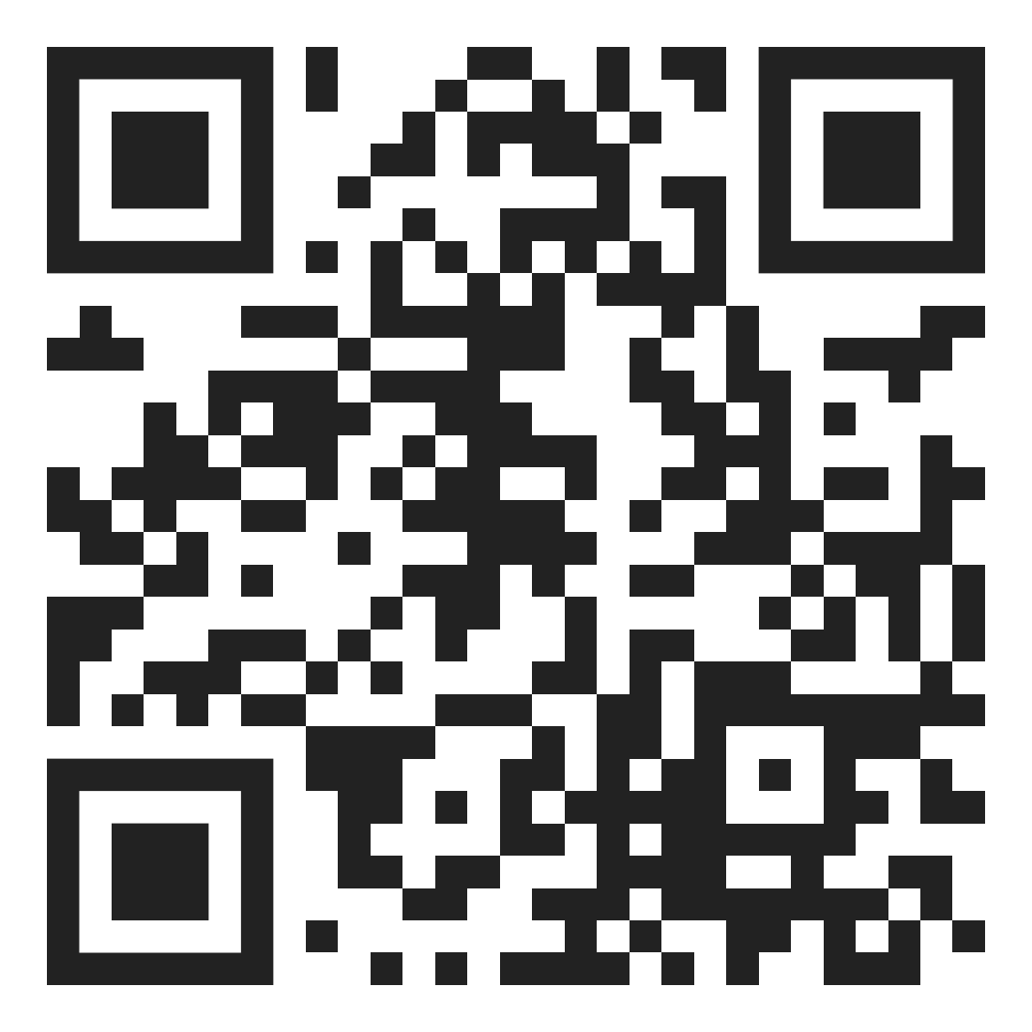
PARTNERSHIPS
Strongest Families Institute
Canadian Forces Member Assistance Program
Health Care
  NS Virtual Health Care
  Maple Virtual Health Care
Notes:
We partner and refer families to local and national agencies to offer support
Maple Virtual Health is available through the province to families without a doctor. Military Family Services also has a free Maple Virtual Care program for all dependents of current serving members as well as veterans who qualify. To use the service and have a virtual doctor consultation, military family members need to have a valid CFOne Card number. Maple will confirm the eligibility, and in a few minutes, you will be connected to a Maple doctor virtually.
Calian offers access to high-quality healthcare for families of serving CAF members through the Military Family Doctor Network (MFDN)
Strongest Families Institute help manage issues affecting your family such as anxiety and depression, temper outbursts, not listening, verbal and physical aggression, difficulties paying attention, separation anxiety
CFMAP is a confidential and short term telephone and face to face counselling service

Slide 18
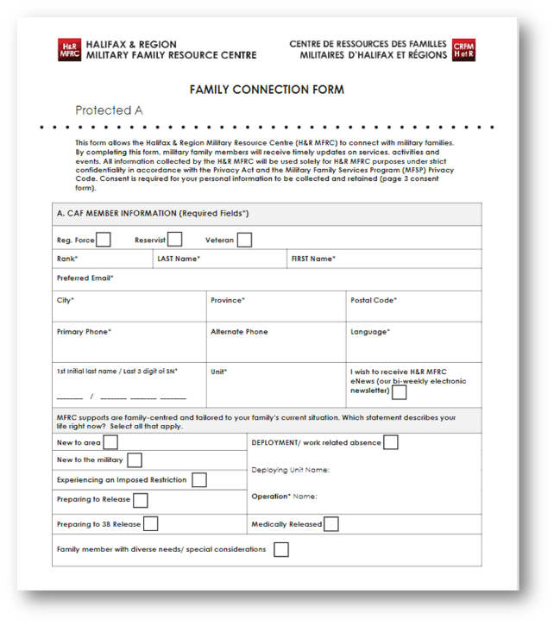
FAMILY
CONNECTION
FORM
IMPORTANT
!
Notes:
PLEASE DON’T ASSUME WE HAVE YOUR FAMILY MEMBERS CONTACT INFO
We do not receive family information from the Chain of Command as we are an optional service
IT IS UP TO YOU to complete our Family Connection Form.
It is the sole place for us to confirm contact information
This form can be filled out in-person at an MFRC or electronically by email
All your personal information is collected and used in accordance with the Privacy Act and the MFSP Privacy Code.
Once we receive the completed form, we begin to start sending emails to all those you have indicated on the form
Expand....
When deploying some of you may not go through a traditional DAG process, if that is the case please add reaching out the MFRC to your list of to-dos
We’ve heard from families saying that they were never contacted by the MFRC. That’s because we didn’t have their contact info.
Filling out this form links your loved ones to us so we can be there for them if and when they need us.
When filling this out, some questions to ask yourself might be: who is relocating with me or who in my family would appreciate a connection to the military?

Slide 19
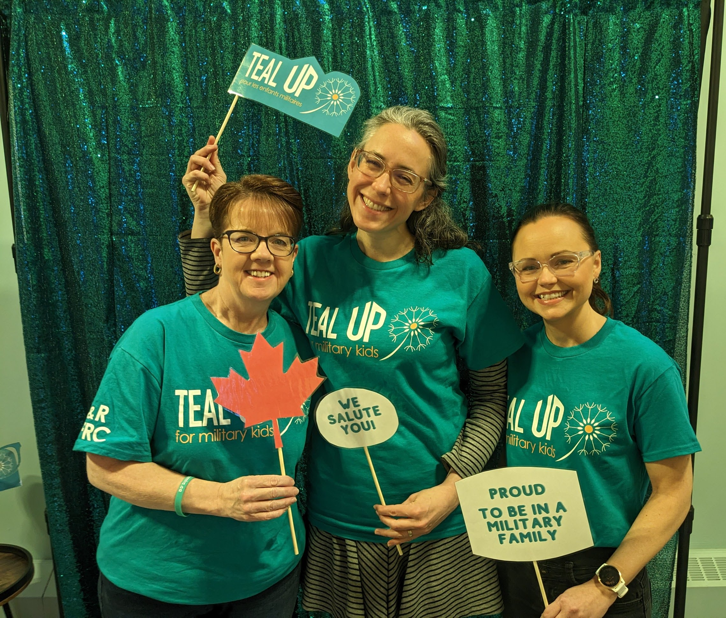
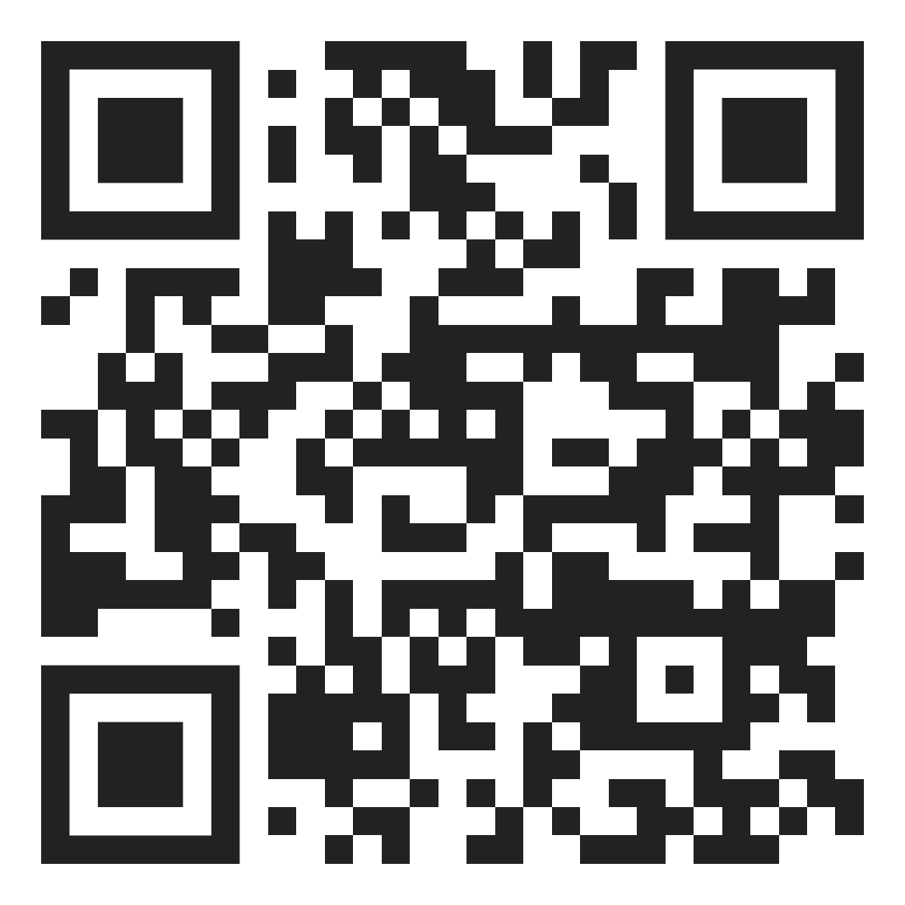
TEAL UP
April is the Month of the Military Child, established to recognize and thank children from military families.
Notes:
Celebrating Children from Military Families". Nationally, a campaign is growing to see April as the Month of the Military Child. We are hoping to raise awareness about the challenges of children from military families while celebrating their strength.

Slide 20


EDUCATOR SUPPORT
New course!
Educators Supporting Military-Connected Children!
School Outreach
Notes:
We launched a new course, Educators Supporting Military-Connected Children!
This course is specifically designed for teachers, early childhood educators, and care providers working with military-connected children.
It is module-based learning and free to enroll! It aims to equip educators with the necessary tools to understand the unique lifestyle of military-connected children and its effect on their academic journey.
We have started to promote this resource to schools in our region.
If you would like us to share this resource with your child’s school, please let us know!
Our School Outreach Team builds collaborative relationships with schools, students, and families to ensure that military connected children have the opportunity to thrive both academically and socially. We offer in-service sessions and resources! We are currently reaching 16 school’s (5 are French)

Slide 21
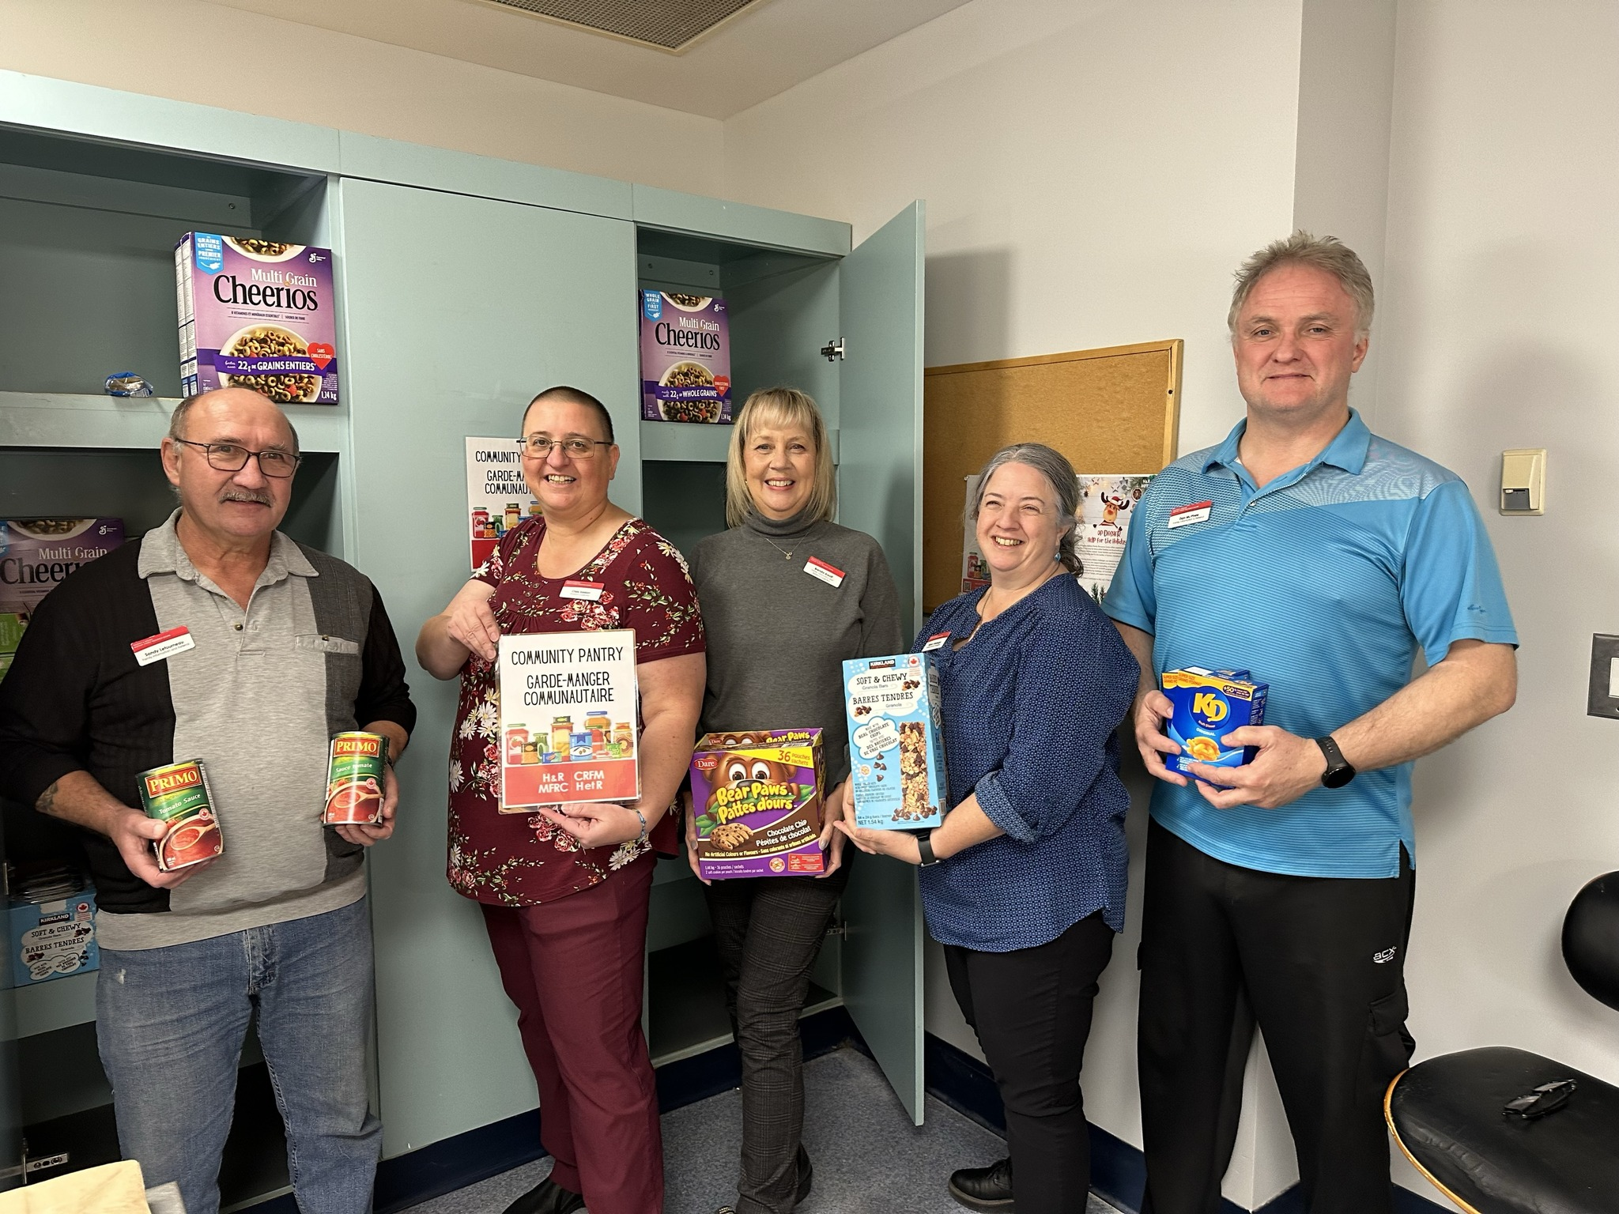
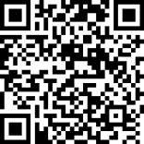
COMMUNITY PANTRY
All military and Veteran families can access the community pantry anonymously.
Notes:
We have launched a community pantry initiative to meet the demand for food insecurity.
Completely anonymous.
Serves around 1-3 individuals daily.
Food donations are welcome drop off with the admin team at either location.
Available in Shearwater through the Language Training Centre doors or our Halifax site. Follow the signage on the floor.

Slide 22
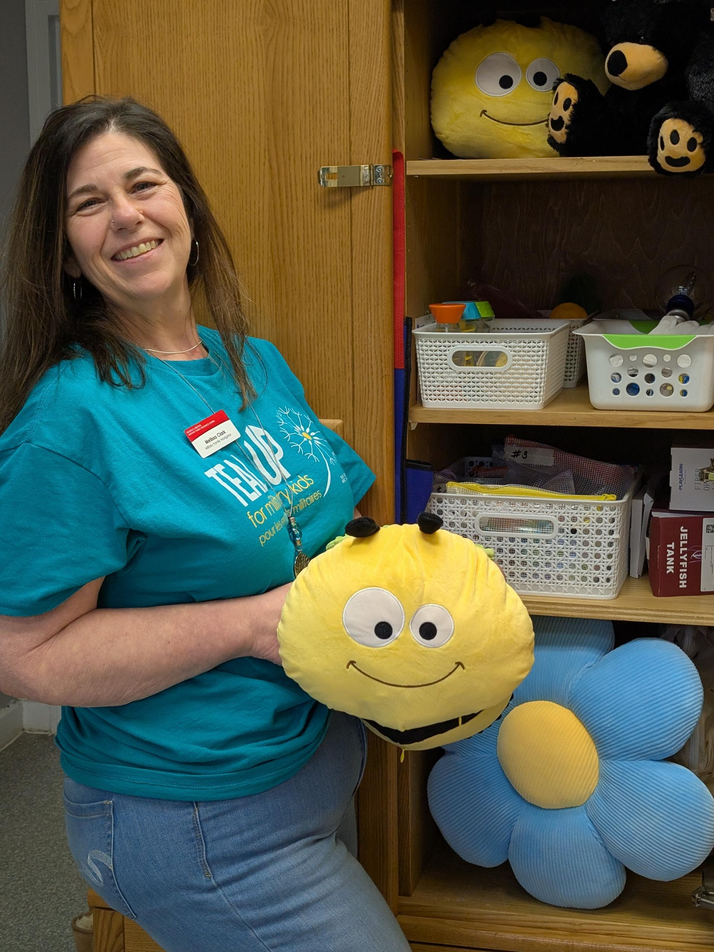
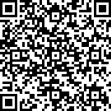
SENSORY LENDING LIBRARY
Explore a variety of sensory tools at no cost, helping to reduce the expenses on equipment while helping to discover effective strategies that work for their individual needs.
Notes:
Items are available on a first-come basis.
Members can borrow up to 2 items for two (2) weeks.
Pick up and drop off locations are specified at time of check out

Slide 23
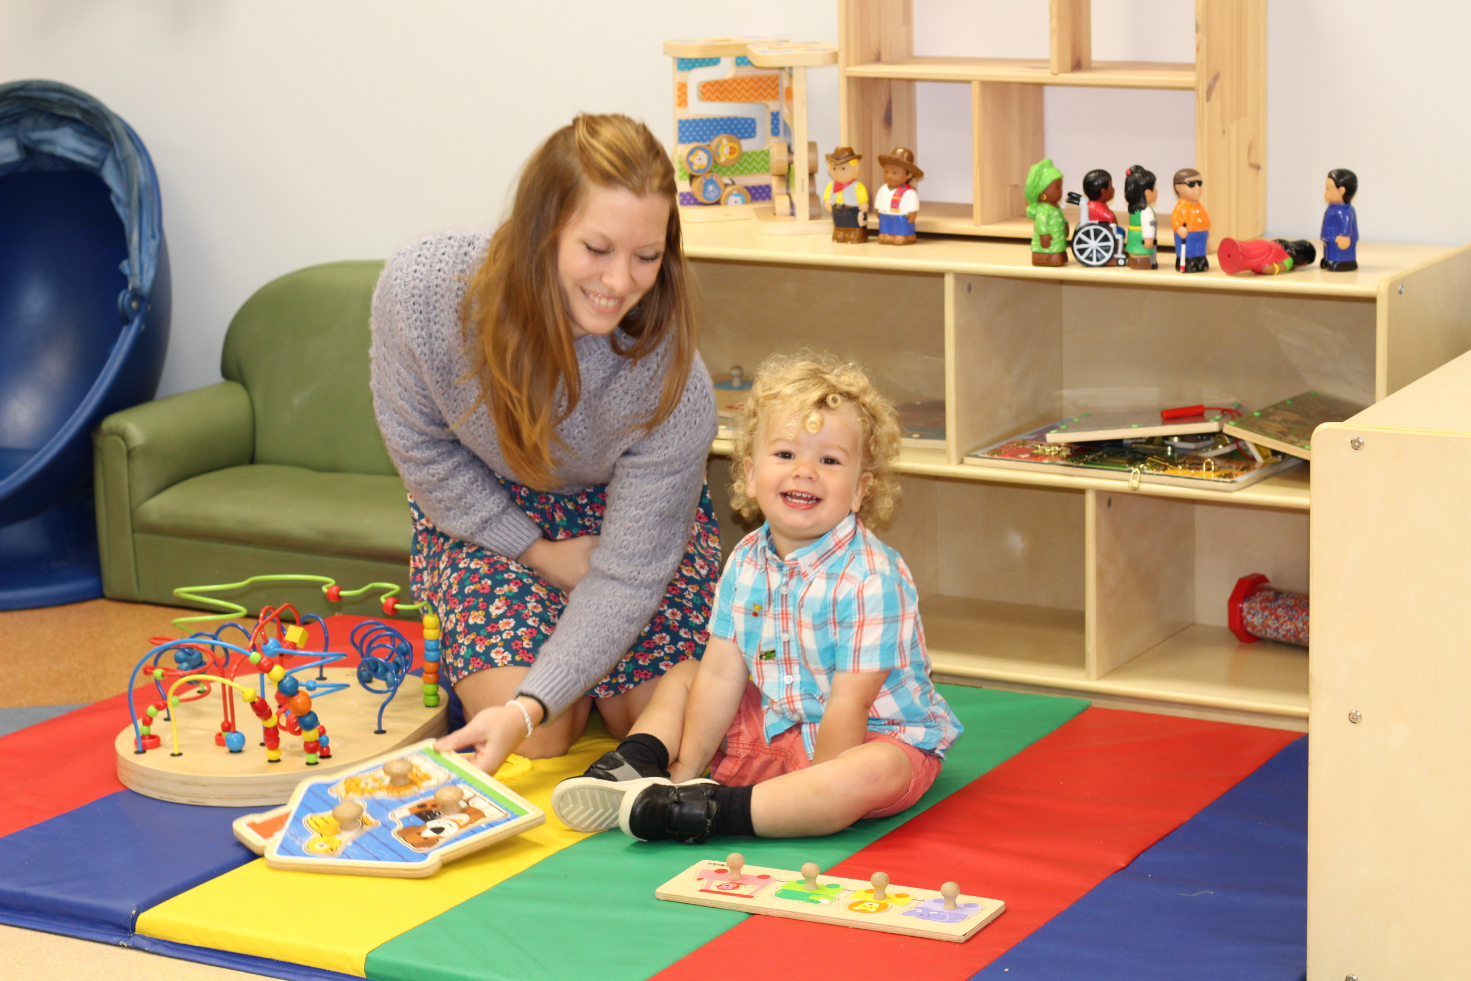
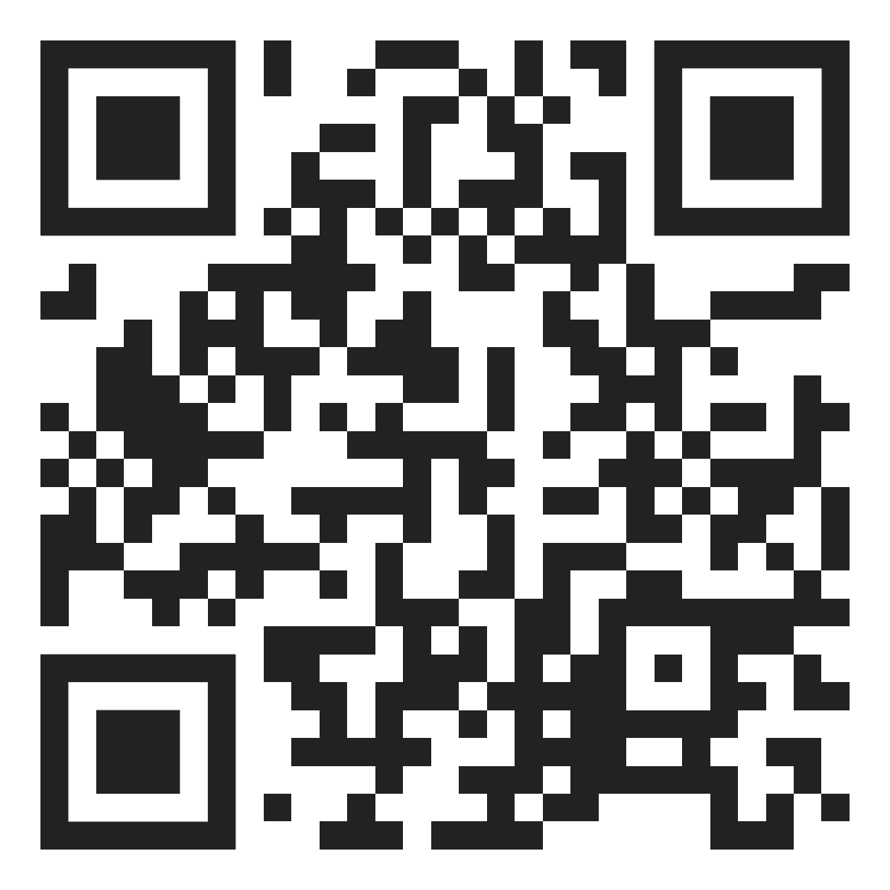
OCCASIONAL & RESPITE CHILD CARE
A flexible and inclusive short-term child care service in Halifax and Shearwater.
Notes:
Occasional & Respite Care is available weekday mornings and some Saturdays.
The service rotates between Halifax and Shearwater.
Children and infants ages eight months up to 12 years of age
$20.00 for four hour sessions per child.
Can be accessed for self care or during relocations, transitions and absences

Slide 24
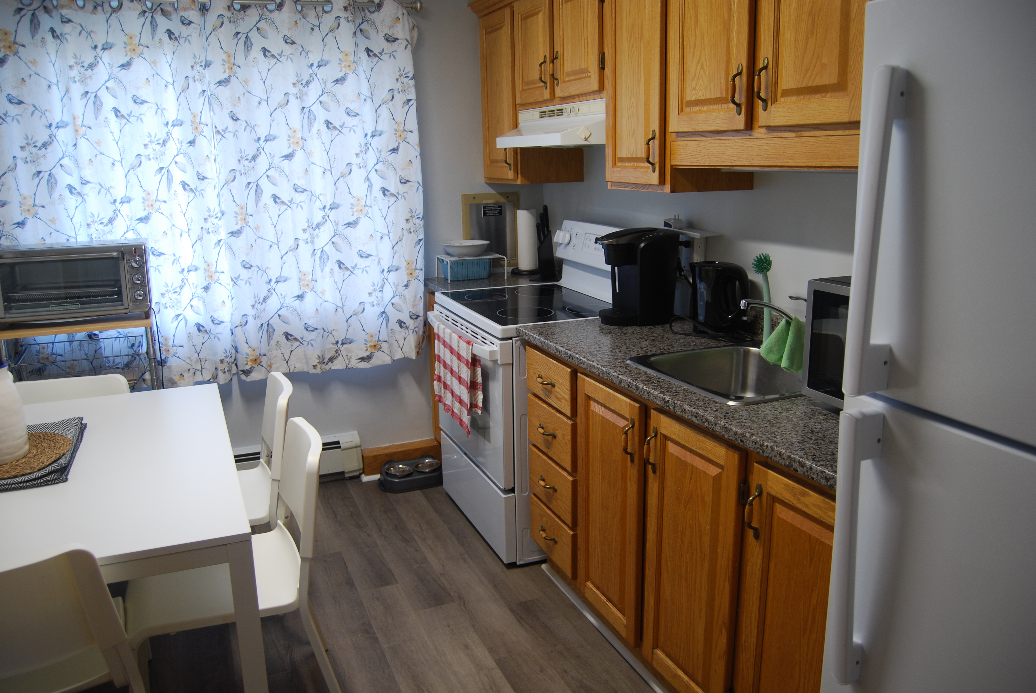
SHORT-TERM ACCOMMODATIONS
Six apartments in Halifax for CAF families to use for:
Medical appointments
Family crisis
Compassionate/exceptional circumstances
Notes:
We manage six apartments in Halifax for families of CAF members to use when a crisis, compassionate or exceptional circumstance affects the family’s ability to remain in their home.
The stay is subsidized by the H&R MFRC and an established criteria is used to determine priority stays and length of stay.

Slide 25
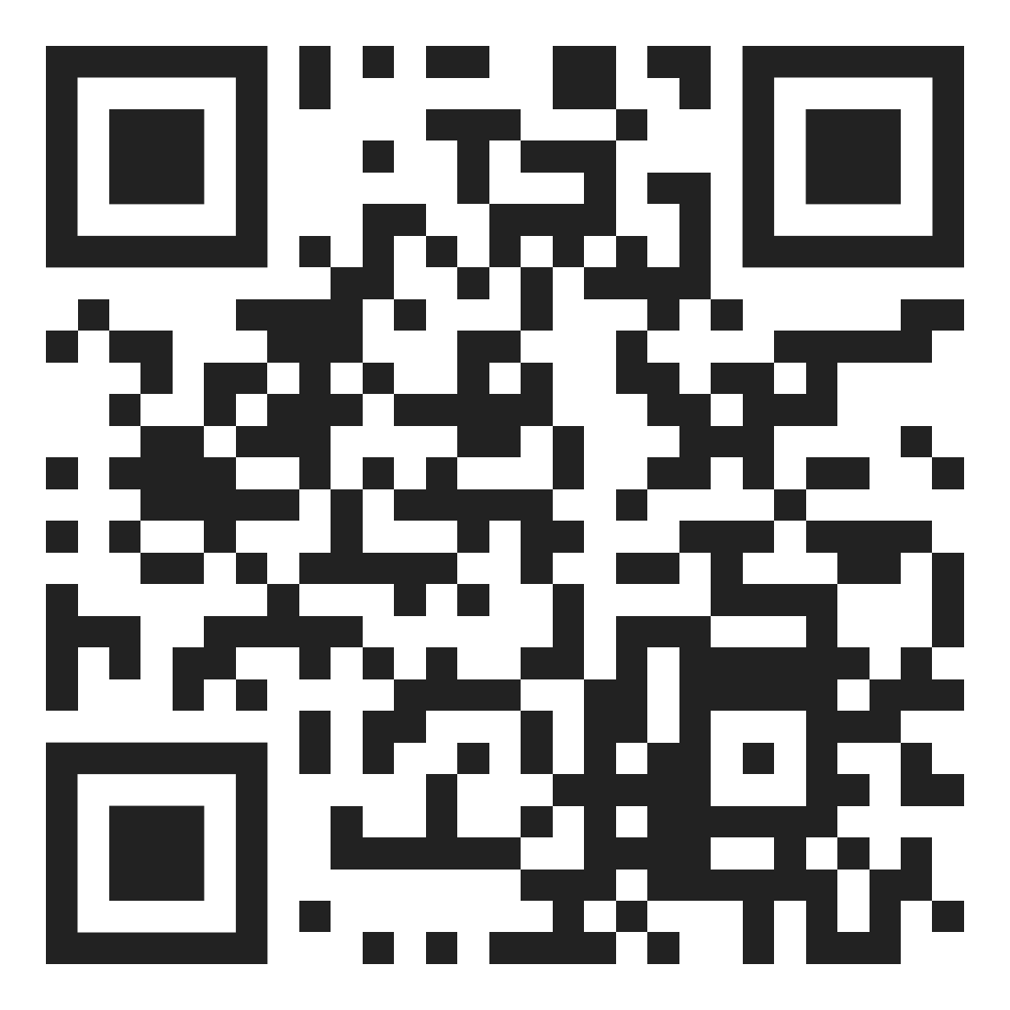


GET CONNECTED
halifaxmfrc.ca
info@hrmfrc.ca
902-427-7788
In-Person
@hrmfrc
Notes:
Follow us in some way, whether it's on social media, signing up for our newsletter, or visiting our website AND
Encourage your family members to do the same
Suggestion: snap a picture send to your family member or share the QR code with them
Time for questions!
Does anyone want to share something they learned today?

Slide 26
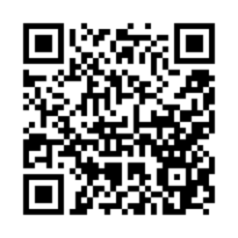
POST BRIEFING EVALUATION
https://www.surveymonkey.com/r/823HVHZ

