Slide 1



22 Wing
Cottage Club
On Talon Lake
Membership Renewal and Draw
$15.00 (taxes included)
Payments can be made at the reception desk, over the phone or by using the online portal:
https://bkk.cfmws.com/northbaypub/memberships/index.asp

Slide 2
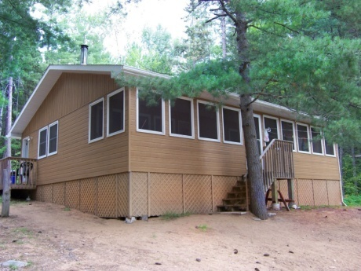
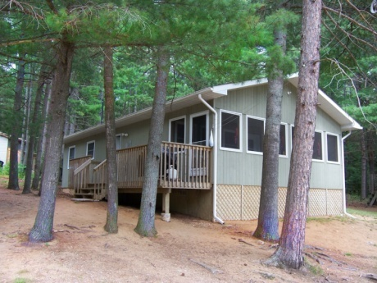
22 Wing
Cottage Club
On Talon Lake
Annual General Meeting
2026

Slide 3
Our Executive Committee
President: Sgt Chris Chartrand
Vice President: Sgt Adam Kittson
Secretary: Cpl Olivia Wiwchar
Treasurer: MCpl Jason Rowsell
Facility Manager: Sgt Adam Kittson (open for volunteers)
Administration: Mack Joseph
Booking Contacts: 22FitWellCenter@forces.gc.ca

Slide 4
Executive Nominations
Positions available:
Facility Manager:
  Oversees building & grounds maintenance
  Ensures security & emergency preparedness procedures are implemented properly
  Conducts & documents regular facilities inspections
  Communicates workplace safety precautions
Expressions of interest for Executive positions… discussion / nominations / vote

Slide 5
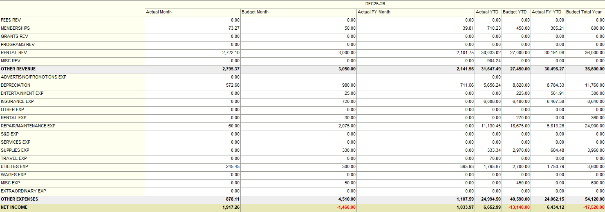
Treasurer’s Report
Income Statement
YTD for Dec 25

Slide 6
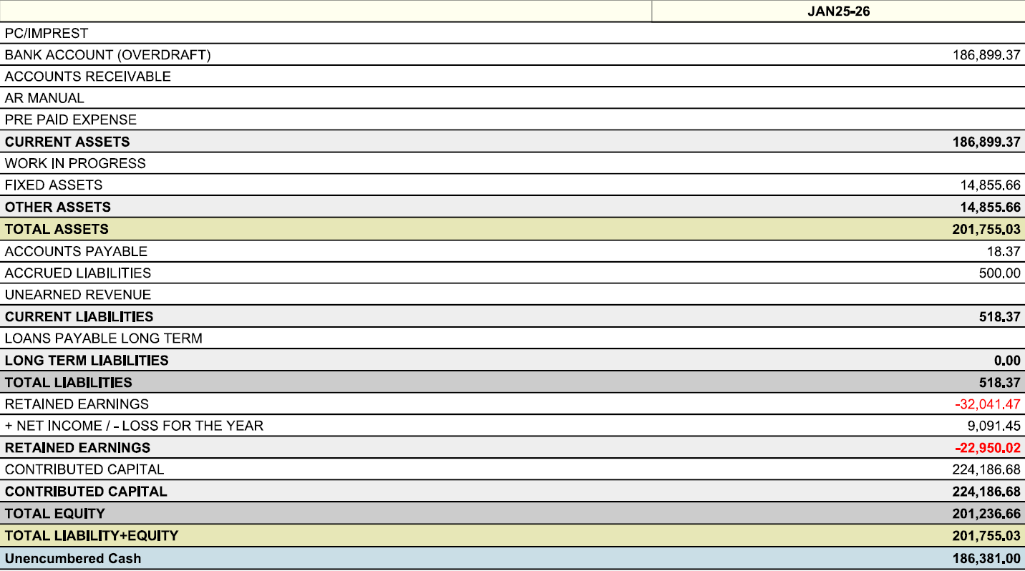
Balance Sheet
As of January 2026
Unencumbered Cash $186,381.00
Provided by NPF Accountant

Slide 7
Membership
As of March 11, 2026
Total Membership
is 73
Historical Averages
2016/2017 = 81
2017/2018 = 71
2019/2020 =0 Closed
2020/2021=38
2021/2022 = 29
2022/2023 = 66
2023/2024 = 70

Slide 8
Eligibility
REGULAR / DND:
Canadian Forces members: Currently serving Regular and Reserve Force personnel and their families;
Members of Foreign Military currently serving with the CAF and their families; and
Veterans (Former members of the CAF who have successfully completed Basic Military training and have been honourably discharged) and their families.
ORDINARY
Current DND Public Servants, Staff of NPF, Staff of MFRC's, Staff of DRDC and DCC and their families;
Serving RCMP and their families;
Currently-serving Honorary Colonels/Captains (N) and Honorary Lieutenant-Colonels/Commanders and their families;
Former Staff of NPF receiving a pension and their families; and
Former RCMP in receipt of an annuity and their families.
North Bay Active Emergency Services Personnel (Fire, OPP, City Police, Paramedics)

Slide 9
Rental Rates
Peak Season - June 26 - September 3 2026
Regular Members: $665 / week (7 days)
Other Members: $791 / week (7 days)
Non-Peak Period – April 1 - June 26 2026 & September 5 - Mar 31 2027
Regular Members: $95 / day (min. 2 day)
Other Members: $113 / day (min. 2 day)

Slide 10

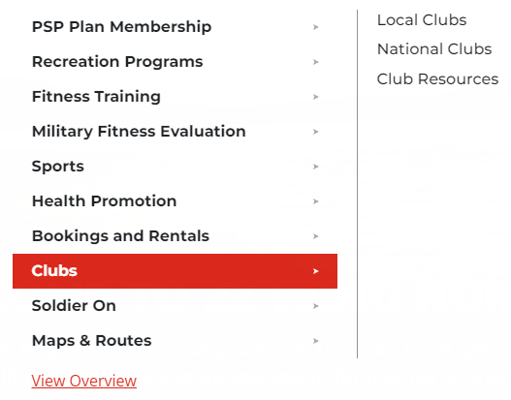
Website
Our website (bilingual) located on:
https://www.cfmws.ca/North-Bay

Slide 11
Expectations
KEEP THEM CLEAN – Treat the cottages like you would your home, leave the cottages looking better than how you found them. (If supplies need replenishment, leave a comment on check-in/check-out sheet)
FIRE PIT – Empty your ashes in the provided ash bin.
      – Avoid burning wood on bricks/overloading pit.
GARBAGE DIPOSAL – Dispose of your own garbage in the dumpster. Dumpster key is on the keychain located in each cottage.
PROPANE – Return empty tank(s) to the Fitness & Wellness Centre.
DOGS – Clean up after your dogs and leashed outdoors.
    – No dogs permitted in Tremblay

Slide 12
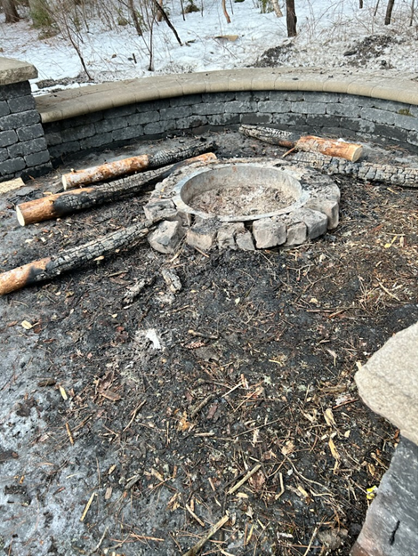
Expectations
What Not To Do!!

Slide 13
Cottage Updates
Peak Season Maintenance (Jun to Sept)
-Will be done 3rd Monday of every month
2026-27 Projects:
  Dock replacement, starlink, and new mattresses.

Slide 14
Cottages are Equipped With:
Propane Tanks
Life Jackets (to be replaced)
Paddles
Canoes
Kayak
Aluminum Boat
Televisions (old tv’s replaced) with Blu Ray player

Slide 15
Things to Bring:
Linens
Food
Firewood
Toilet Paper
Paper towels
Garbage Bags

Slide 16
New Business
  New Check In and Check Out Times
  1100hrs Check Out
  1500hrs Check In
Spring Cleanup!
Volunteers Needed!
Date TBD – End of May
Lunch is provided
All bookings will go through:
22FitWellCenter@forces.gc.ca
Any other inquiries : +22 Wg Cottage Club@22 Wing@NorthBay
p-ntb.cottageclub@forces.gc.ca

Slide 17
Annual Draw
Names drawn from the proxy forms that were submitted to PSP Staff.
      Members will have until April 3rd to pay their $50 deposit for each cottage booking, as well as the $15 Cottage Club membership fee. Failure to submit both payments by the due date will result in the cancellation of their cottage booking and open the availability to other members for the 2026-2027 season.
      Only one cottage per draw
The remaining cottage season (May 1 – June 26 & September 3 – March 31) will open on March 23rd at 0900hrs at a first come first serve basis. *Any booking request before this date will not be accepted or noted.
Make cheques payable to “22 WING BASE FUND”

Slide 18
Questions ??

