Slide 1

Communication Through a Developmental Lens- A Toolkit Approach
Cindy Harrison, M.Sc., Reg. CASLPO
Speech Language Pathologist
CEO, ACT Learning Centre
www.actlearningcentre.ca

Slide 2

A Little About Me
I wear many hats
SLP
Mom to two wonderful kids – one of whom is on the autism spectrum
Practice owner
Autism advocate

Slide 3
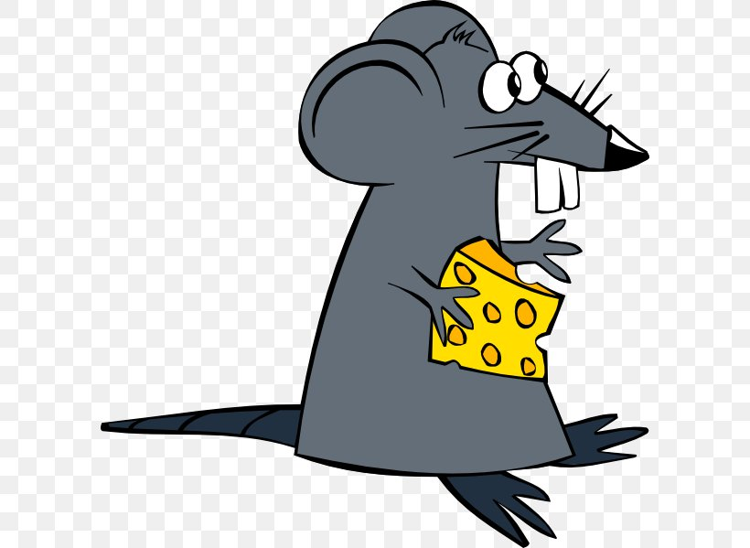
My Approach
Developmental
Strengths based
Individual
Filling the holes in the Swiss Cheese
Assume competence
If they can do it some of the time then it is my job to figure out how to help them do it all of the time
Notes:
Developmental – top of the box bottom of the box
Strength based philosophy – assessment – room with someone you don’t know and see what you can’t do
Often times prefer not to read assessment reports prior to seeing the child/adolescent
Man that I presented with
Dr Greenspan’s words….if he can do it some of the time…..

Slide 4
Goals for Today
To support your understanding of speech, language and communication
To support you in developing strategies that will help you engage, interact and communicate better with your child
To build your “toolkit” of strategies

Slide 5

The Developmental Lens
The Process and the Premise
The process and the basis of DIR is to understand the child’s individual differences (the ‘I’) and using those differences to determine the best way of interacting with and relating to that child (the ‘R’) to move them up the developmental ladder
Cindy Harrison, M.Sc., Reg. CASLPO Speech Language Pathologist
Notes:
By a finely nuanced understanding of the I and using that to adapt the R the D goes up

Slide 6

Children of the individuals who serve
Unique challenges
Children may move frequently
Family units under stress
Separation from attachment figures
Little information on developmental trajectory
Those supporting the children may have little information about their clinical profile and history

Slide 7
Examples of communication challenges for children
Typical challenges in communication, language, and speech of children/youth
Producing ‘language’ – gestures, sounds, words, sentences (production)
Understanding ‘language’ – gestures, sounds, words, sentences (comprehension)
Understanding and creating new ideas and meanings (comprehension)
Understanding and expressing intentions (comprehension)
Producing speech
Engaging in fun, playful, interpersonal interactions
Social use of language (pragmatics)

Slide 8
Principles of Floortime (cont’d)
Increase Emotional Range Tailor Interactions that match the child’s individual profile

Slide 9
What are the Principles of Floortime?
We follow the child’s lead.
We join the child’s world to harness the child’s natural interests.
We tune in to the child’s individual processing differences.
We pay attention to our own unique individual differences as parents, caregivers and clinicians.

Slide 10
What are the Principles of Floortime? (cont’d)
We Want To Support Co-regulation:
Be present in the moment
Me + you
Take action in response to another person’s action
We Want Continuous Flow
Strive for Reciprocity
Maintain continuity of the interaction
Use affects and gestures before words
We Want To Open The Door To Symbolic Thinking
Elaborate and deepen the plot
Insert reasoning and challenges

Slide 11
Circles of Communication
The basic unit of interaction and engagement
Opening (initiating) and closing (responding)
The back and forth of the interaction
Join in to make yourself part of the activity
Notes:
This is important! Basis of interactions
Why I don’t like turn taking – different than reciprocity that comes from affect or feeling motivated to be reciprocal. Also adult led
We are hard wired as humans to be reciprocal. This is difficult for children with ASD not because they don’t have the hard wiring (though it may be different) but because their neuro biological make up makes it more challenging
You’ll hear me say it many times….if he can do it some of the time we need to figure out how to help him do it ALL of the time

Slide 12
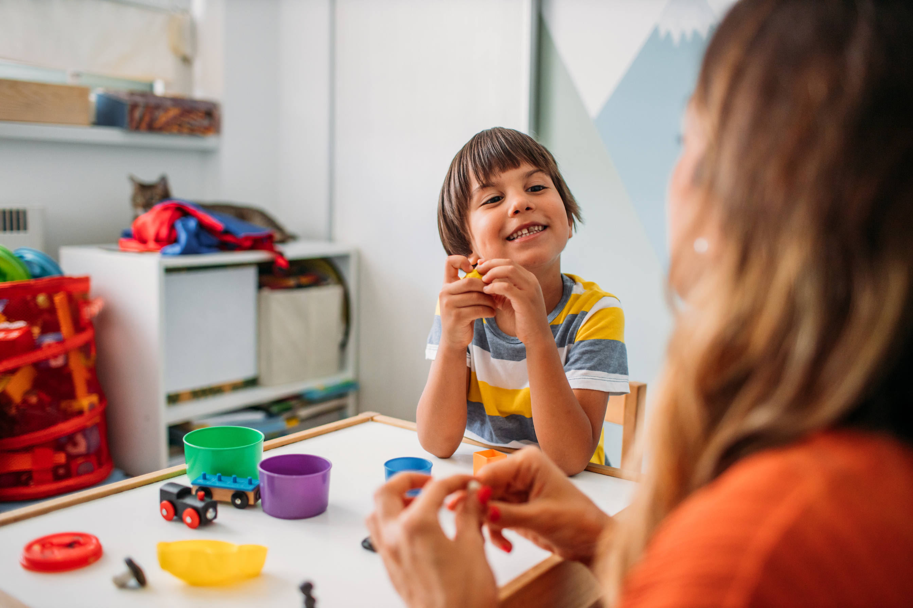

FEDL 1 – Regulation and Shared Attention
Why are Regulation and Shared Attention Important?
Regulation
The child can remain calm and focused and take in the sights and sounds of their environment
The ability to stay regulated is critical to the development of communication
Notes:
Babies are not able to regulate when they are born
Basis of attention
Mirror neurons
Universal - Syrian family eg

Slide 13
Why are Regulation and Shared Attention Important? Cont’d
Through this relationship the child:
Looks at parent
Gazes, gestures and vocalizes sounds
Follows the parent’s focus of attention looking where parent looks
The ability to share attention with a play partner is a critical component of comprehension
Notes:
Again the basis of communication
Learning that occurs in those moments - thousands of learning opportunities each day

Slide 14
Why is regulation important?
If you are regulated:
You don’t miss the hundreds of learning opportunities that present themselves each day
You are more “available” for interactions
You can participate in the interaction
Notes:
Give yourself permission to pay attention to regulation and engagement. It is the gatekeeper to communication!

Slide 15

FEDL 2 – Mutual Engagement
Why is Mutual Engagement important?
This stage involves ‘falling in love’ with your parent/caregiver
Mutually enjoyable interactions that allow the deepening of relationships
Mutual engagement is a key in the development of comprehension – the young baby may not understand the words but through affect cues can understand the meaning
15
Notes:
Give the example of Daddy cooing at his baby…all of a sudden the baby starts to cry and daddy says ‘oh so sad are you hungry? In soothing tones.
Give the love example

Slide 16
Strategies for Regulation and Engagement
We need to:
Coach parents/caregivers to help child stay regulated in order to maintain interaction with their caregiver(s).
Based on the child’s ‘I’ help parent/caregiver to engage in back and forth affective exchanges
Treat all behaviors as intentional
Based on the ‘I’ help the caregiver tune in to the affect cues of the (keeping in mind that some affect cues may be unconventional) child
Notes:
Rachel example

Slide 17
FEDL’s 1 and 2
We ask ourselves
What is the Individual profile of the child?
What can we do to support regulation?
What can we do to facilitate engagement and shared attention?
What is getting in the way of engagement and shared attention?
How does the child show their communicative intent?
Notes:
Importance of sensory play

Slide 18
Tips, Tools and Strategies FEDLs 1 and 2

Slide 19
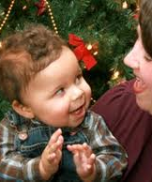
Always ask……
What do you do with your child that brings you both joy?
It gives us great clues about where to start…

Slide 20

The Power of the Moment of Anticipation!!!
Help the parent/caregiver harness the moment of anticipation
20
Notes:
I’m gonna get you!!!

Slide 21
Harness the Power of Anticipation!
Use the power of anticipation with a look for excited anticipation on your face
Some examples
Tickle bunny
I am going to get you!
Got your nose!
Pull my thumb!
Peek a boo

Slide 22

Co-Regulation & Affective exchange!
With the ‘I’ in mind…..
Peek a Boo…
Sensory Action games…
Rhyme and Action songs!
I’m coming to get you!
Watch my face Watch your face!
Early speech sound play
Tickle monster!

Slide 23

Follow your child’s interests
Some people feel that you should not reinforce your child’s ”obsessions” or intense interests
These interests are often the “way in” to meaningful interactions
During sessions where you are trying to get engagement follow your child’s lead and interests
Join in what the child is doing
YOU be the toy!!!!
Notes:
When it is okay to limit objects of obsession – very situation specific
No absolutes!!

Slide 24

Open and Close Circles
Treat every behavior as purposeful
Go for the circles of communication (you open the circle – initiate and your child closes the circle – respond)
Encourage the caregiver to observe all non verbal communications as communicative and intentional
Support the ‘affective dance’
Help alleviate any ‘mismatch’ between the caregiver and child
Help the caregiver to ‘read’ the child’s affect cues
Notes:
Give the Nathalie example – unconventional cueing
Rachel

Slide 25
Go for the “Gleam” in your Child’s Eye
Go for the “gleam” and the joy!
Use whatever works again and again and again
Be Playful
Use sensory play if your child likes it
If your child is motivated….don’t change the activity!
Use “affect” as your barometer!
Notes:
Affect as your barometer – explain using the third year physics analogy

Slide 26

Beware……
‘Why can’t you get him to talk?’
Too often we push for production when the child is not engaged, or sufficiently intentional
Notes:
Don’t have to be mutually exclusive but need to be aware of pushing only for speech/language production and ignoring the gestural system or not accepting unconventional attempts at communication

Slide 27
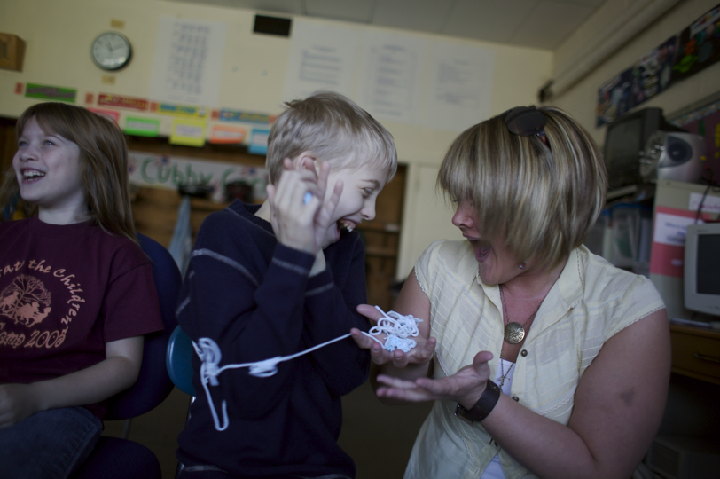
PART I: DIR® FUNCTIONAL EMOTIONAL DEVELOPMENT LEVELS FEDL 3
Level 3: Intentional Two-way Purposeful Communication: The child can engage in “back and forth” communication with their caregiver using vocalizations, facial expressions, affect, movement, gestures, or language.
Notes:
Core Milestones which lay the foundation for higher level relating,
growth and learning
*

Slide 28
PART I: DIR® FUNCTIONAL EMOTIONAL DEVELOPMENT LEVELS FEDL 4
Level 4: Complex Problem Solving/Sense of Self: The child has emerging ideas, all his or her own. The caregiver supports the child in executing the ideas and in resolving together natural and semi-structured “problems” that can occur. “Circles of Communication” are increasingly robust and sustained. The child's sense of self is strengthened.
.
Notes:
Core Milestones which lay the foundation for higher level relating,
growth and learning
*

Slide 29
Questions to ask about Intentional 2-way Communication
Does the child participate in back and forth exchanges with the caregiver?
Does the child use repair strategies when he is not understood?
Does the child follow his partners gaze or point?
Does the child vocalize or use gestures to express feelings?
Does the child follow his partners gestures?
Does the child respond to his caregivers attempts to share attention?
Does the child express communication intentions (protest, joy, frustration etc.)
Notes:
These are all important questions because they tell us where to focus
The focus on the point and why it can be misguided
Hand over hand and the point
What we really need it to be is for joint attention or to request

Slide 30
The “Reciprocal Muscle”
The ability to be reciprocal is at the basis of communication
If you are not able to be reciprocal you will have a very hard time making and keeping friends, entering into conversations, developing relationships, being successful in school or work
It is SO much more than turn taking!!!
In typical development we are hard wired to be reciprocal. With individuals with ASD reciprocity often does not develop easily
There are many reasons for this (sensory processing, comprehension, visual processing etc.
It is something we need to pay attention to from the beginning
Notes:
Challenges with ABA – great responders, not great initiators
Diagnosis based thinking – most kids with ASD can be reciprocal!

Slide 31
Was Nate….
Regulated?
Opening and closing circles of communication?
Intentional

Slide 32

Tool Kit Strategies for Levels 3 & 4

Slide 33



Treat all behaviours as intentional
Nate was hopping so his SLP incorporated it into the play
When he left the play you might say “run away bunny!” and then go and get him
Notes:
When a child is in and out and becomes fragmented like Nate we need to avoid becoming fragmented too. DIR is not just dropping everything and following the child’s lead. It is following their lead to expand opportunities to engage and communicate using those interests

Slide 34

The ‘I’ Detective
Use your detective skills to determine the ‘I’ and then tailor your interactions to that I to support the ‘back and forth’

Slide 35
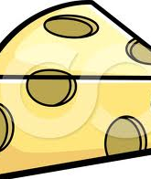
Where are the ‘holes’ in the Swiss Cheese?
Don’t forget to support regulation and engagement while focusing on the ‘back and forth’. If there are holes at earlier levels it has an impact on the later levels. Quality not quantity!!
35
Notes:
Spencer – highly verbal easily dysregulated at would lose ability to spontaneously use language and would rely on or revert to scripts.
Bear farts – emerging verbal but few gestures and working on being reciprocal
Gestural communication predicts language

Slide 36


Talking starts with Gestures!
Before a child will have a conversation with words they are able to have one without words (baby after nap example)
Why I always focus on gestural communication
Respond to your child’s gestures (conventional and unconventional)
16 by 16
Make sure YOU use gestures with sounds and with words
A little about pointing
Notes:
When a child is in and out and becomes fragmented like Nate we need to avoid becoming fragmented too. DIR is not just dropping everything and following the child’s lead. It is following their lead to expand opportunities to engage and communicate using those interests

Slide 37

Gestural Communication
Pay close attention to gestural communication
How well or how much does the child gesture?
Do they read your gestures?
What is their repertoire of facial expressions/gestures (i.e. sad, puzzled, happy, angry, disappointed, surprised)
Notes:
One of the things I always look for during an evaluation
Don’t have this often miss nuances because can’t read gestures (Gray in the IPRC meeting)

Slide 38

No Talking Dust
Reduce your language level….
Sprinkle ‘No Talking Dust’ and focus on affective cueing and affective exchanges with sounds, noises and simple words
Notes:
No verbal attention getters

Slide 39

Observe, Wait, Listen!!
OWL (Hanen program)
Observe…pay attention to the affect cues and intended meaning
Wait….Pacing is important. Try to balance the tension between waiting for a response and losing the moment
Listen….to vocalizations, to sound, to words

Slide 40

Be Clueless!
Even if you know what your child wants be clueless and wait for a gesture, a vocalization, a word approximation or a word
Hand your child the juice jug with the lid screwed on tightly and wait with an expectant look on your face
Give your child their favourite pudding with no spoon
Put a favourite toy up high and out of reach

Slide 41

During play and interaction……
Try not to go in to teaching mode
Your goal is interaction not teaching
Try not to ask any question that you already know the answer to!

Slide 42
ALWAYS…..
Support comprehension within the context of meaningful interactions….
A child will comprehend ‘out’ much faster if they are trying to get out of the therapy room vs. looking at a picture of a girl going outside…….

Slide 43

Upping the Ante!
In level 3 you were working on getting your child to be intentional and to engage in purposeful two way communication
In level 4 you want multiple circles of back and forth communication that focuses on solving a problem
I Can’t Reach It! What would have happened if mommy had just reached out, grabbed the scarf and given it to him? Instead she created multiple opportunities for back and forth circles of communication

Slide 44

DIR Levels Five and Six
Level 5: Creating (Emotional) Ideas: The child begins to use symbols (language) to express and share ideas. In play at first, the child mimics daily life; begins moving to more original imaginary ideas and actions dramatizing a widening range of child's real‐ life issues.
Level 6: Logical Thinking: Can connect ideas logically and give reasons behind ideas (answer “why questions”); discovers new organizing concepts by connecting symbolic ideas which in turn leads to complex, fuller, emotionally- charged plots
Notes:
Give example of birthday cake bus

Slide 45
At Level 5 the Child Begins to…..
Pretend
Pretend play is important because it loosens the child’s reliance on the concrete and moves to the abstract
It helps with comprehension, cognition, and production
It helps to understand emotion
Pretend play usually starts with routine experiences (nurturing – feeding the baby, putting a stuffy to bed)
We often rush to pretend play before the child is ready

Slide 46
Tool Kit Strategies for Level 5

Slide 47
Whole Body Play
First the child learns to play using his/her body
Whole body play is important!
What do I mean by whole body play?
Notes:
Lots of whole body props fire fighter hats, animal ears, Nurf swords

Slide 48

I am Superman!
Have props available so that the child can pretend to be superman, a princess, a king, a cat etc.
Jump into the drama with superman
Pretend to be superman’s rocket and put him on your back to go on an adventure
Notes:
Story of the little guy at the grocery store – how he learned internalized the word bravery. The Disney princesses lightness sparkly or Jasmine saucy and sassy

Slide 49
Pretend Play Toolbox
Expand pretend play. If your child is pretending to be a car, identify where you are going to go and have a race
Focus on words that go with the theme of play (if you are a car….fast, slow, vroom)
Use lots of gestures and affect cues to help improve comprehension
Look for a symbolic solution to a symbolic problem (if the car crashes get a tow truck to tow it away)
Notes:
Give example of the baskets, qtips, cotton balls elastics

Slide 50
“Use Your Words”
This is something we often say. For some children it isn’t helpful and can frustrate them further
“If I could use my words right now, I would!”
Think of the way we feel when we are overwhelmed and dysregulated. We are not our best communicators at that time!
Polyvagal theory

Slide 51
Instead of “Use Your Words”
Try to read affect cues to prevent the meltdown
Accept all communication as meaningful
Acknowledge feelings ”you are so mad”
Time in instead of time out
Review later

Slide 52

Level Six
Level 6: Logical Thinking: Can connect ideas logically and give reasons behind ideas (answer “why questions”); discovers new organizing concepts by connecting symbolic ideas which in turn leads to complex, fuller, emotionally- charged plots

Slide 53

The Plot Thickens…
At this level the plot thickens and the pretend play becomes more complex
Try to focus on feelings and labelling the feelings (“his car crashed….he is sad!”)
Use lots of gestures and affect to help with comprehension
Encourage problem solving (“she’s hungry! What should we do?”)
Expand the drama into a short story

Slide 54
Scripting and Echolalia
Scripting, echolalia or borrowed language is common among individuals with ASD
Often the scripting or borrowed language may be specific to their intense interests
Sometimes it is specific to a feeling or an affect
It almost always indicates challenges in comprehension or language formulation
It is meaningful!

Slide 55

The Monologue
When a child/youth talks about a passion or interest and no one can get a word in edgewise
The child/youth isn’t reciprocal or including his communication partner in a dialogue. Instead it is a monologue
The “reciprocal muscle” is important!!

Slide 56
Tool Kit Strategies for Scripting and the Monologue

Slide 57
Toolkit ideas…..
Recognize that the borrowed language has meaning for the child/youth. “You threw off my groove!” (You might reply “I interrupted you and threw you off. I’m sorry”)
For the highly verbal child ask questions of clarification “wait! What type of dinosaur?”
Build on the borrowed language (“Since I threw off your groove what is my punishment?”

Slide 58

The Monologue
If a child/youth is talking about an interest or passion and not being reciprocal try:
Asking questions of clarification (“I’m confused what kind of fan motor is it?”, “does that dinosaur eat meat or not?”
Take the opportunity to negotiate “so how may minutes are we going to talk about race cars?”
YOU WANT RECIPROCITY!!!!

Slide 59

Contact Information
Cindy Harrison, M.Sc, Reg. CASLPO
ACT Learning Centre
www.actlearningcentre.ca
charrison@actlearningcentre.ca
charrison@actlearningcentre.ca
Cindy Harrison, M.Sc., Reg. CASLPO Speech Language Pathologist

