Slide 1

Empower, Educate, Elevate: Enhancing Resilience in Our Future Generation
Presented by: Dr. Lauren C. Cripps RSW(q), CTRS

Slide 2

Agenda
Part 1: Family Dynamics
Part 2: Stress and Learning
Part 3: Emotional Tolerance
Part 4: Strategies for Educators

Slide 3
Part 1:
Family Dynamics

Slide 4
Family Dynamics
Roles and Responsibilities within a Family
Traditional roles such as parent, child, grandparent
Individual skills and interests can also determine roles
Communication Styles and their Impact
Healthy communication involves active listening and open dialogue
Poor communication can lead to misunderstandings and conflicts
Hierarchy and Power Dynamics
Some families have clear hierarchies and power dynamics
Can influence decision-making and conflict resolution
Conflict Resolution Strategies
Compromise, avoidance, or open discussion
Family Culture and Values

Slide 5
What are family dynamics?
Roles and Responsibilities
Communication Styles
Hierarchy and Power Dynamics
Conflict Resolution
Family Culture and Values
Emotional Support
Transitions and Life Events
Attachment and Bonding
Cultural and Societal Influences
External Stressors
Parenting Styles
Sibling Relationships

Slide 6
The impact of family dynamics on children
Emotional Well-Being: Positive family dynamics contribute to a child's emotional well-being
Children raised in nurturing environments develop self-esteem and self-confidence
Mental Health: Family dynamics can influence a child's mental health
Consistent emotional support and open communication can help children develop resilience
Social Skills and Relationships: Family dynamics shape a child's social skills and ability to form healthy relationships
Positive family interactions model effective communication and empathy
Behavioral Development: Family dynamics can impact a child's behavior
Academic Achievement: Family support and involvement in education can positively impact academic achievement

Slide 7
Unique characteristics of military family dynamics
Frequent Relocations
Disrupts established routines, relationships, and community connections
Deployment Cycle
Family members must manage daily life and responsibilities in the absence of a loved one
Dual Roles and Responsibilities
Non-serving spouse takes on dual roles and responsibilities
Emotional Stress
Related to deployments and potential risks associated with military service
Flexibility
Adaptability and flexibility are essential traits
Supportive Communities
Military families often rely on each other for emotional support and practical assistance

Slide 8
How military family dynamics impact children
Positive Impacts
Resilience and adaptability
Sense of patriotism and pride
Supportive community
Cultural awareness
Independence and self-reliance
Negative Impacts
Emotional stress
Educational disruptions
Social challenges
Parental absence
Educational and career challenges

Slide 9
Part 2:
Stress and Learning

Slide 10
What is the impact of stress on the brain?
Structural Changes in the Brain
Reductions in size of brain regions such as the hippocampus
Long-term implications for cognitive functioning
Neurotransmitter Imbalance
Disrupts balance of neurotransmitters such as serotonin, dopamine, and norepinephrine
Contributes to mood disorders such as depression and anxiety
Hormonal Changes
Release of stress hormones like cortisol
Detrimental effects on neural cells, particularly in regions important for learning and memory
Impaired Neurogenesis
Hinders formation of new neurons
Altered Brain Connectivity

Slide 11

IMPACT OF stress on Development
Structural Changes
Chronic stress can lead to reductions in the size of brain regions such as the hippocampus.
Neurotransmitter Imbalance
Stress can disrupt the balance of neurotransmitters, contributing to mood disorders.
Hormonal Changes
Impaired Neurogenesis
Altered Brain Connectivity
Cognitive Impairments
Emotional Regulation
Increased Risk of Mental Health Disorders
Long-Term Consequences
Physical Health Impact

Slide 12
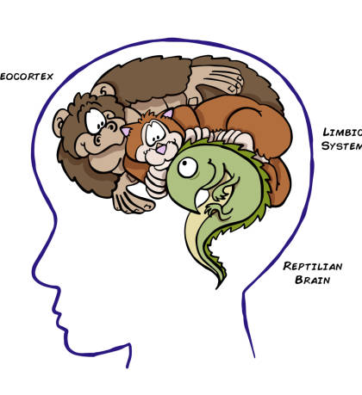
Introducing the Triune Brain Theory
Reptilian Brain (R-Complex)
Oldest and most primitive part of the brain
Responsible for essential survival functions and instincts
Paleomammalian Brain (Limbic System)
Evolved in mammals
Responsible for emotions, memory, and social behaviours
Neomammalian Brain (Neocortex)
The most recent evolutionary development
Responsible for higher-order cognitive functions

Slide 13
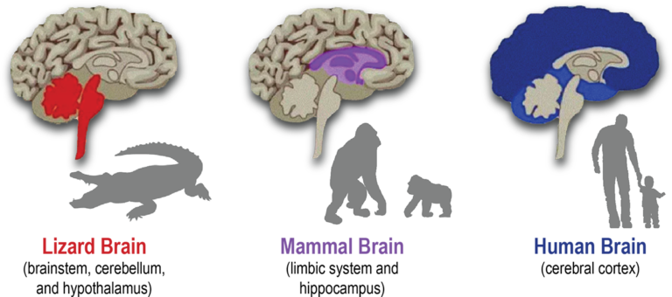
Responsible for Survival and Maintenance

Slide 14
Responsible for Feelings and Memory Formation

Slide 15
Higher Mental Functioning

Slide 16
Progression of Basic Need…
Reptilian Brain
Needs Safety
Mammalian Brain
Needs Satisfaction
Human Brain
NEEDS CONNECTION

Slide 17
Reptilian Brain
Needs Safety
Through
Safety
We Experience
Peace

Slide 18
Mammalian Brain
Needs Satisfaction
Through
Satisfaction
We Experience
Contentment

Slide 19
Human Brain
NEEDS CONNECTION
Through
Connection
We Experience
LOVE

Slide 20
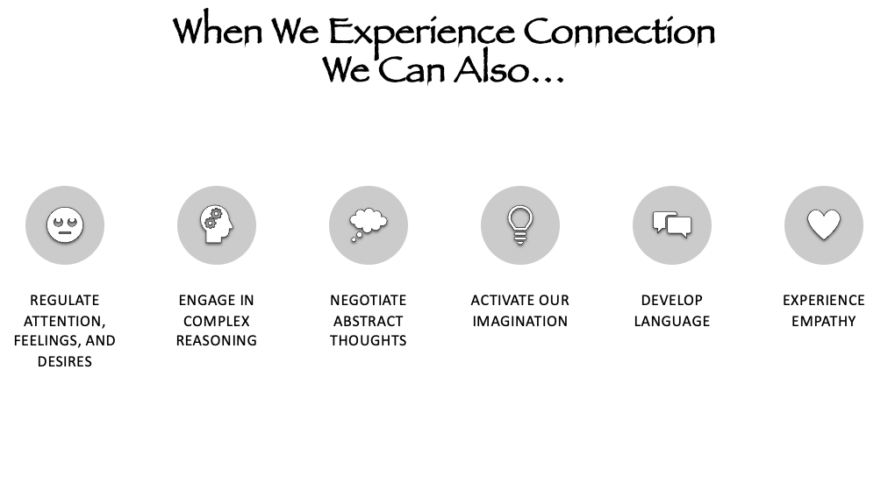

Slide 21
Connecting Triune to Children Exposed to High-Stress Environments
Reptilian Brain (R-Complex)
Heightened fight-or-flight responses
More prone to anxiety, hypervigilance, and sense of danger
Paleomammalian Brain (Limbic System)
Emotional dysregulation and mood swings
Stress can significantly impact emotion and social behavior
Neomammalian Brain (Neocortex)
Chronic stress can impair cognitive functions
Interplay of Layers
Emotional Impact
Resilience and Coping Mechanisms
Long-Term Consequences

Slide 22
How the Triune Brain theory connects to teaching and learning
Recognizing Diverse Learning Needs
Brain is not uniform, students have diverse learning styles
Emotional Engagement
Paleomammalian brain plays crucial role in learning
Stress Management
Implement stress-reduction strategies in the classroom
Building Emotional Intelligence
Promoting Critical Thinking
Individualized Learning
Cultivating Creativity
Forming Positive Relationships
Incorporating Technology

Slide 23
Part 3:
Emotional Tolerance

Slide 24
What is Emotional Tolerance?
Emotional Awareness: Being in touch with emotions and accurately identifying feelings
Ability to differentiate between emotions such as joy, anger, sadness, fear, and frustration
Emotional Acceptance: Accepting emotions as valid and normal without judging or criticizing oneself
Emotion Regulation: Having effective emotional regulation strategies to modulate intensity of emotional responses
Resilience: Being able to bounce back from difficult or emotionally challenging situations
Empathy: Ability to understand and relate to the emotions of others
Interpersonal Skills: Navigating conflicts and difficult conversations with emotional intelligence
Stress Management: Preventing emotional overload and facilitating healthier coping mechanisms

Slide 25
The role of emotional tolerance in development
Emotional Regulation in Childhood
Children learn to understand and manage their emotions
Essential for social and academic success
Social Development
Academic Success
Mental Health and Well-Being
Resilience
Interpersonal Skills
Identity Formation
Adulthood and Aging
Parenting and Caregiving
Workplace Success

Slide 26
Emotional tolerance in children exposed to high-stress environments
Emotional Dysregulation
Children may struggle with emotional dysregulation, leading to frequent mood swings and emotional outbursts.
Increased Anxiety
Chronic exposure to stressors can contribute to heightened anxiety in children.
Depression
High-stress environments can increase the risk of depressive symptoms in children.
Behavioral Issues
Some children may express their emotional distress through challenging behaviors, such as defiance or aggression.
Academic Challenges
Stress can impact a child's cognitive functioning, making it difficult to focus and perform well academically.
Physical Symptoms
Stress can manifest as physical symptoms in children, including headaches and stomachaches.

Slide 27
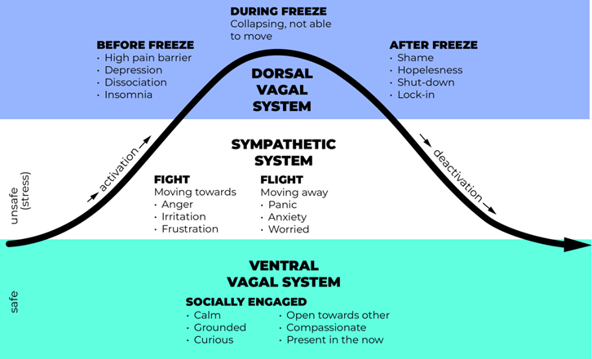
Introducing THE POLYVAGAL Theory

Slide 28
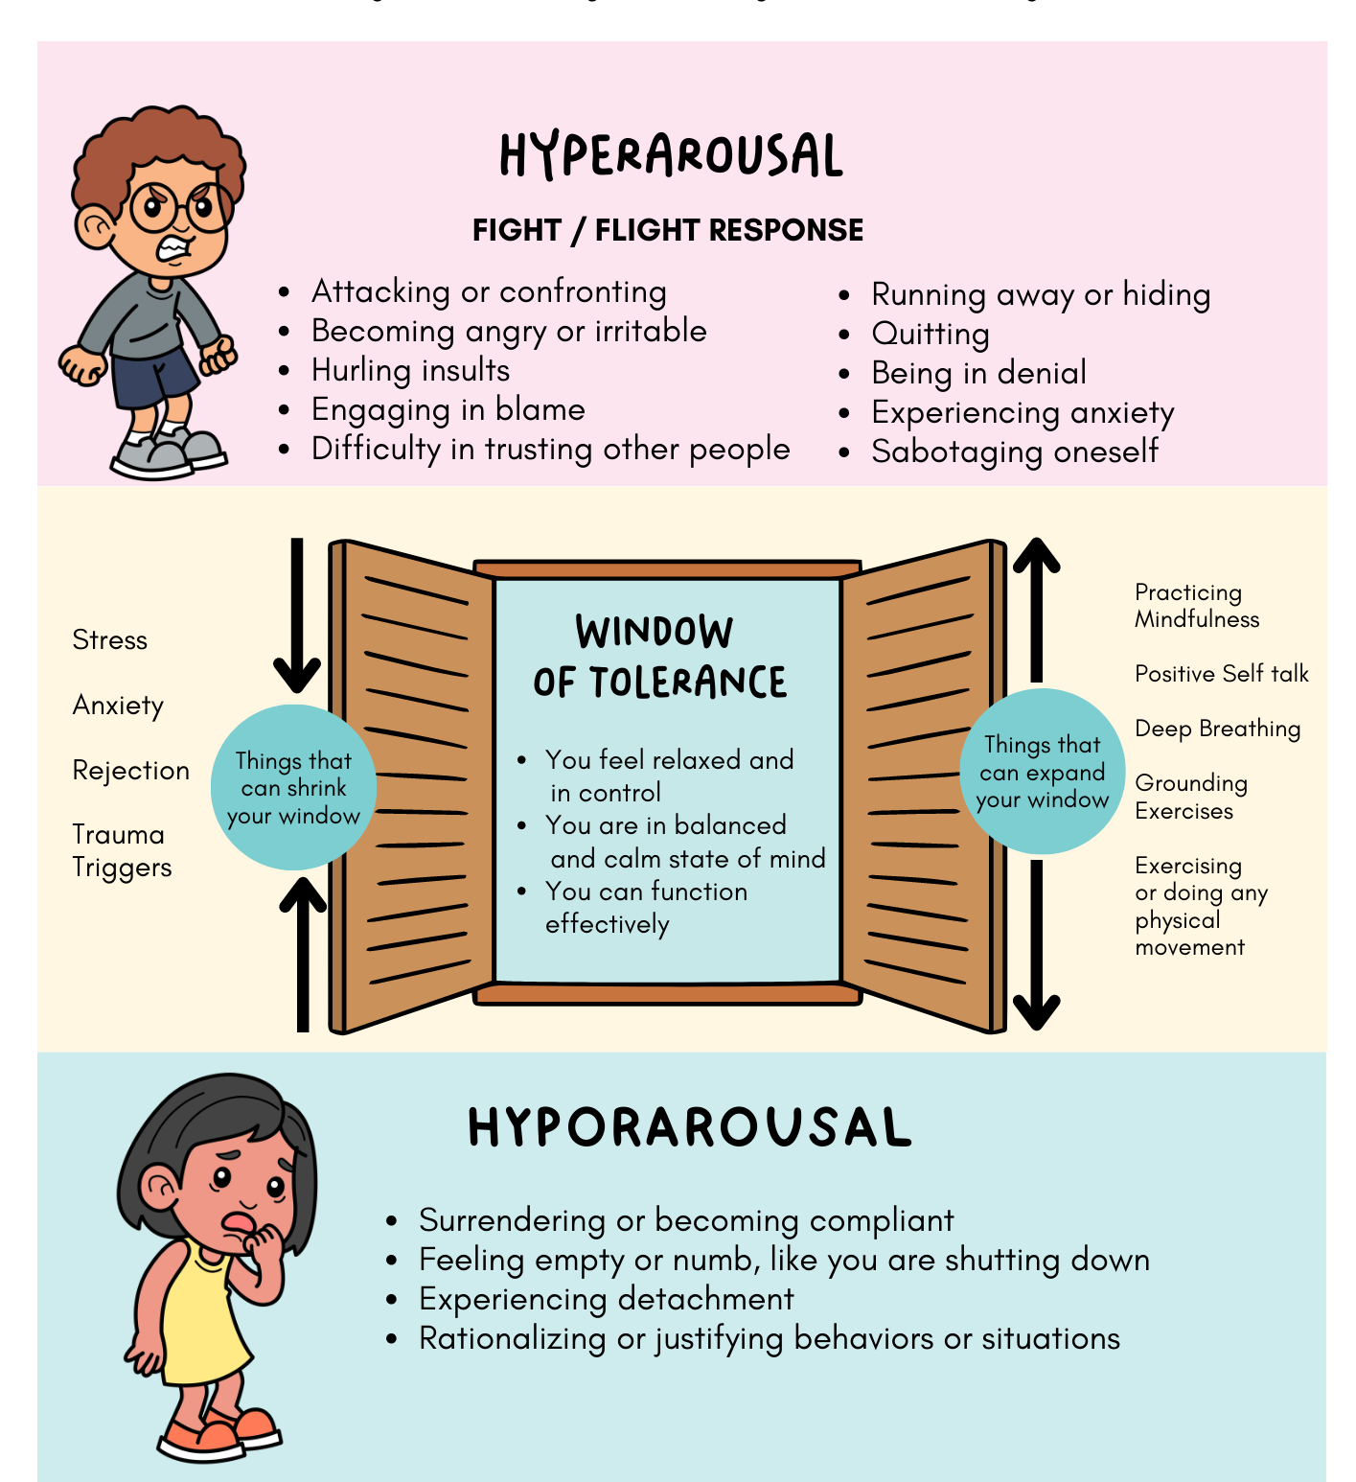
Optimal Arousal Range
The Window of Tolerance represents the emotional and physiological arousal within which an individual is most comfortable and capable of functioning effectively.
Hyperarousal
Above the upper threshold of the window, individuals experience hyperarousal.
Hypoarousal
Below the lower threshold of the window, individuals enter a state of hypoarousal.
Regulation and Flexibility
The goal is to help individuals expand their window of tolerance, allowing them to tolerate a broader range of emotional and physiological states.
Trauma and Window of Tolerance
The Window of Tolerance theory is often applied in the context of trauma.
Individual Differences
Therapeutic Applications

Slide 29
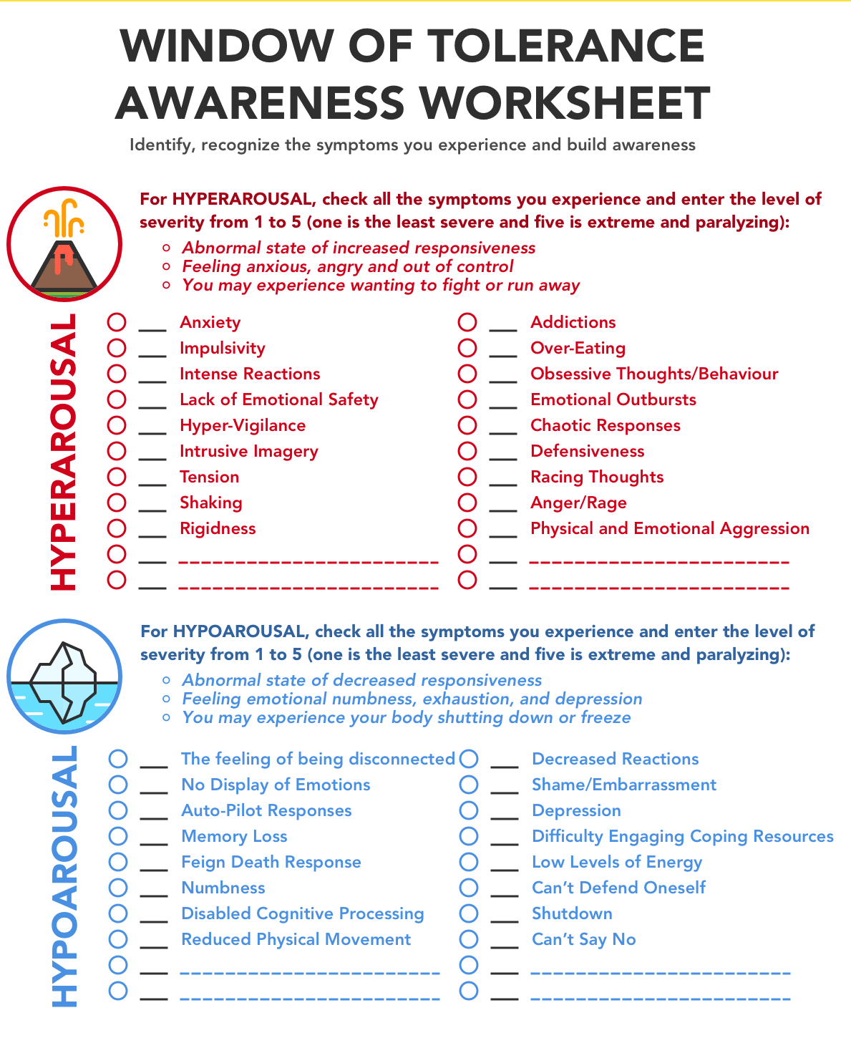
APPLYING the Polyvagal Theory in the Classroom
Assessing Emotional Regulation
Children in high-stress environments often operate at the edges of their window of tolerance
Chronic exposure to stressors can push them into states of hyperarousal or hypoarousal
Identifying Triggers and Stressors
Recognizing a child's window of tolerance can help identify specific triggers or stressors
Caregivers and professionals can tailor interventions to address those specific sources of distress
Trauma-Informed Care
The Window of Tolerance theory is crucial in the context of trauma-informed care
Teaching Emotional Regulation
Creating Safe Spaces
Promoting Resilience
Preventing Overwhelm

Slide 30
Connecting the window of tolerance to teaching and learning
Optimal Learning State: The Window of Tolerance represents an individual's optimal emotional arousal and regulation range.
Stress and Learning: High-stress environments, trauma, or emotional dysregulation can push students out of their window of tolerance.
Emotional Regulation: The Window of Tolerance framework emphasizes teaching students emotional regulation skills.
Resilience and Adaptability: Expanding a student's window of tolerance through emotional regulation skills can enhance their resilience.

Slide 31

“Adversity is part of life”
Resilience was traditionally the term used to describe to the trait that gives us the strength to bounce back from challenges in life.
When we face challenges, we develop the skills necessary to be resilient;
With increased resilience, we become more equipped to tap into our strengths and support system and it is THIS skill that gives us the best chance to work AND grow through the challenges…

Slide 32
Part 4:
Strategies for Educators

Slide 33
1. Building Trusting Relationships
2. Emotional Regulation and Support
3. Promote Social and Emotional Learning (SEL)
4. Classroom Environment and Structure
5. Student Empowerment and Choice
6. Individualized Support and Inclusivity
7. Access to Support Services
8. Professional Growth and Resources
9. Prioritize Self Care

Slide 34
1. Building Trusting Relationships
Establish Trusting Relationships
1
Be approachable, empathetic, and consistent
Greet each student warmly and show interest in their lives
Show Genuine Care and Concern
2
Regularly check in with students and offer support

Slide 35
2. Emotional Regulation and Support
Implement activities that promote emotional regulation
Mindfulness exercises, deep breathing techniques, or journaling
Teach stress reduction techniques
Time management skills, such as creating to-do lists or using a planner
Encourage creative activities
Art, music, or storytelling to engage the neocortex and stimulate creative thinking
Foster metacognitive skills
Set goals, track progress, and reflect on learning strategies to improve metacognitive awareness
Use positive affirmations and encouragement
Provide specific and constructive praise to acknowledge efforts and achievements

Slide 36
Listen
Actively listen to students
Eg. Sit down with upset students and listen attentively without interrupting
Conduct
Conduct regular emotional check-ins
Eg. Start each morning with a 'feelings check-in'
Teach
Teach stress management and coping skills
Eg. Dedicate classroom time to mindfulness exercises

Slide 37
3. Promote Social and Emotional Learning (SEL)
Integrate
Integrate SEL programs into the curriculum
Implement a weekly SEL curriculum with lessons on emotions, communication, and conflict resolution
Build
Build positive teacher-student relationships
Dedicate time for one-on-one conversations, showing empathy and building trust
Show
Show empathy and understanding toward students experiencing emotional challenges
Offer private conversations to express empathy, validate feelings, and discuss potential solutions

Slide 38
4. Classroom Environment and Structure
Take
Take a holistic approach to education
Address cognitive, emotional and social needs
Eg. Create a calming classroom environment
Create
Create a safe and nurturing classroom environment
Foster emotional well-being
Eg. Dedicate time for one-on-one conversations
Maintain
Maintain clear expectations and routines
Provide stability and predictability
Eg. Create a visual schedule

Slide 39
Consider alternative assessment methods to accommodate unique needs
Eg. Allow oral presentation or visual poster instead of written report
Implement trauma-informed teaching practices
Eg. Display visual cues in classroom for self-regulation

Slide 40
5. Student Empowerment and Choice
Offering Students Choices
Allow students to select research topics or project themes
Gives students a sense of control over their learning
Incorporating Mental Health Education
Teach students about emotional well-being and stress management
Devote time to lessons on mental health and self-care strategies

Slide 41
6. Individualized Support and Inclusivity
Recognize students' unique responses to stress
1
Provide additional time or alternative assessments for students who require accommodations
Implement trauma-informed teaching practices
2
Create options for students to take breaks when needed
Use sensory tools like stress balls or fidget spinners to help them self-regulate

Slide 42
7. Access to Support Services
Collaborate with school counselors, social workers, and other support staff
Ensure students have access to mental health services and resources
Host regular meetings with the school's counseling team
Discuss students' well-being
Identify those who may benefit from additional support

Slide 43
8. Professional Development and Family Engagement
Advocate for and participate in professional development opportunities related to trauma-informed care, social and emotional learning, and strategies for working with children in high-stress environments.
1
Eg. Attend a workshop on trauma-informed teaching to learn about the impact of trauma on students and how to create a trauma-sensitive classroom.
Maintain open and regular communication with parents or caregivers.
2
Eg. Send home a weekly newsletter or email updates to parents, summarizing classroom activities and providing tips for supporting their child's learning at home.

Slide 44
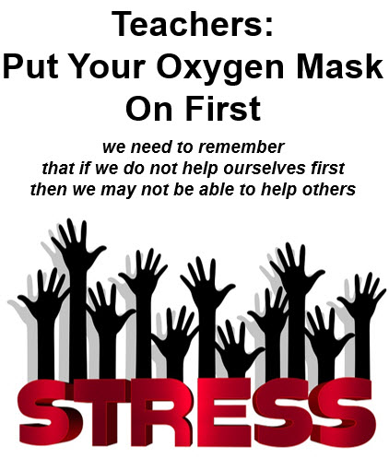
9. Prioritize Self Care

Slide 45
Sustainable Self Care Begins and Ends With You!
Be
Be kind to yourself.
Enhance
Enhance your awareness with education and experiences.
Accept
Accept where you are on your path at all times.
Exchange
Exchange information and feelings with people who can validate you.
Clarify
Clarify your personal boundaries. What works for you; what doesn't.
Express
Express your needs verbally.
Take
Take positive action to change your environment.
Create
Create a network of support.
Build
Build your Self-Care Toolbox and use it every day!

Slide 46
Chi-miigwetch. Nia:wen. Marsi. Wela'lin. Woliwon. Thank you.
Dr. Lauren C. Cripps, RSW(q), CTRS
Senior Consultant, Clinician & Educator
Lauren@McLeanConsultingGroup.com
OR
www.linkedin.com/in/lauren-cripps
Chi-miigwetch. Nia:wen. Marsi. Wela'lin. Woliwon. Thank you.

