Slide 1
Caregiving in a Sometimes Stressful World:
How to Recognize and Support Diverse Regulation Needs in Children
Dr. Kristen McLeod, PhD
drkristenmcleod@attunecentre.ca
www.attunecentre.ca

Slide 2

Understanding Stress
Stress Response lives in our arousal system and is involved in numerous neural functions including:
  Hunger
  Novelty and Learning
  Transitions
  Challenges
Some is needed to build resilience….no stress does not equal resilience
Too much stress can significantly impact ability to regulate relationships and numerous brain functions

Slide 3
Determinants of Stress Capability
Genetics
Epigenetics
Intrauterine
Early Childhood Experiences:
  Primary caregivers are external regulators for infants
  Predictable responses to stress help build flexibility and resilience
Adverse Experiences

Slide 4
The Impact Of Too Much Stress
How We Grow Our Brains
Altered stress response system: Stress, Cortisol, Amygdala’s, HPA, and Neurons
The Role we Play as Builders and Regulators
Notes:
Stay on this slide for how we grow our brains.
Included understanding on how much occurs after birth and the impact trauma has on this development before going on to the next slide

Slide 5
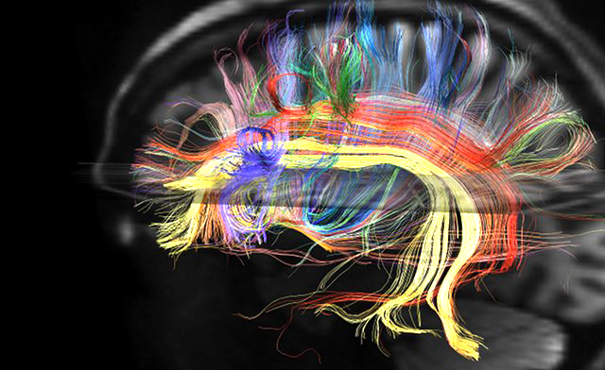
UnderstandingRegulation

Slide 6
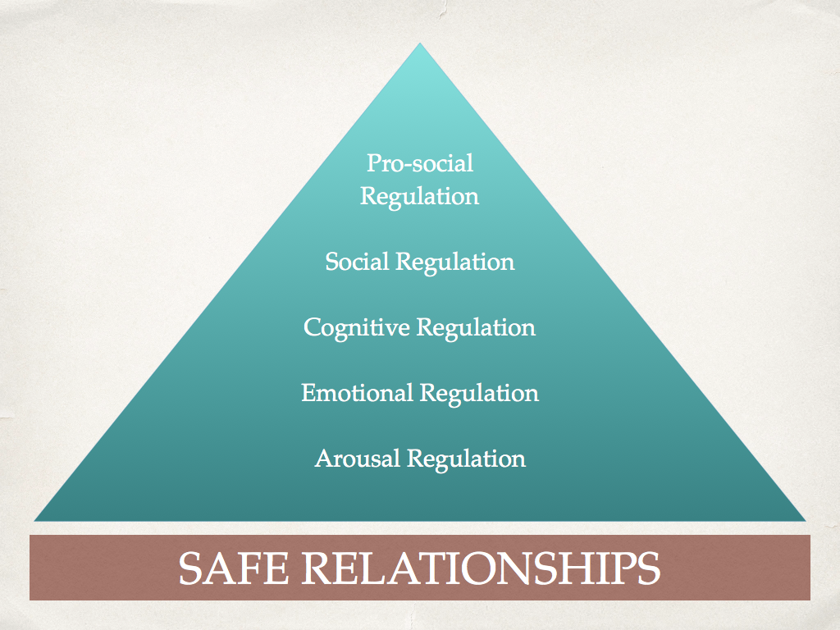

Slide 7
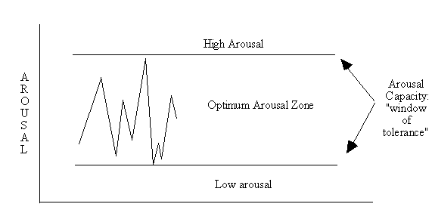
Window of Tolerance

Slide 8
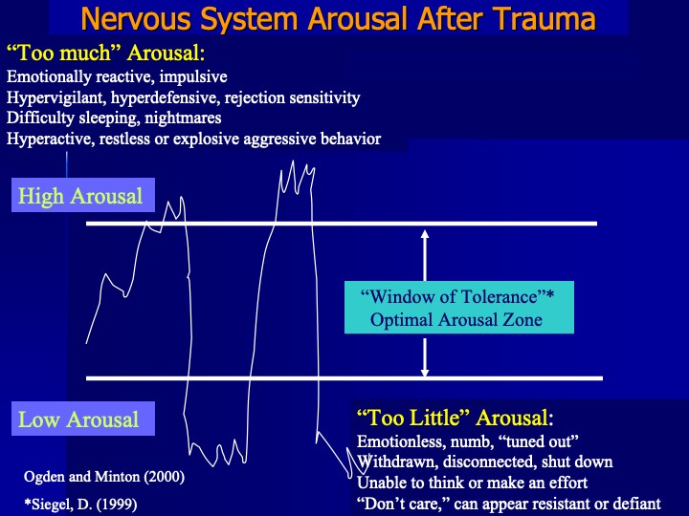

Slide 9
Some Signs Kiddos Are Struggling with Their Windows
Running Away
Triggered Aggression
Defiance/Overly controlling behaviour
Picking at Skin or Clothing
Intense clinginess
Self Harm
Anticipatory Rejection
Covering Eyes/Ears
Hiding under tables/in closets
High pitched Vocalizations
Regressive Behaviours
Lying
Dissociation

Slide 10
What Impacts their Windows?
Other people’s ability to stay in their windows
Poor Sleep
Not exercising/eating well/getting outside
Illness
Stress/adversity
Isolation
Insecure relationships
(Mal) adaptive reactions
Pressures on the Pyramid (that get bigger as they do! - how heavy is the backpack??)

Slide 11
Understanding Leads to Efficacy,
Which Leads to Hope

Slide 12
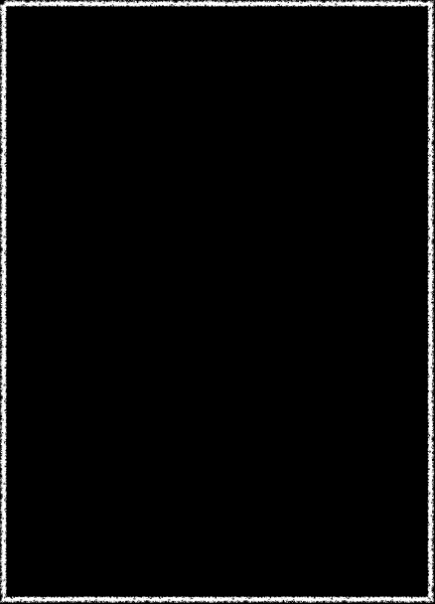
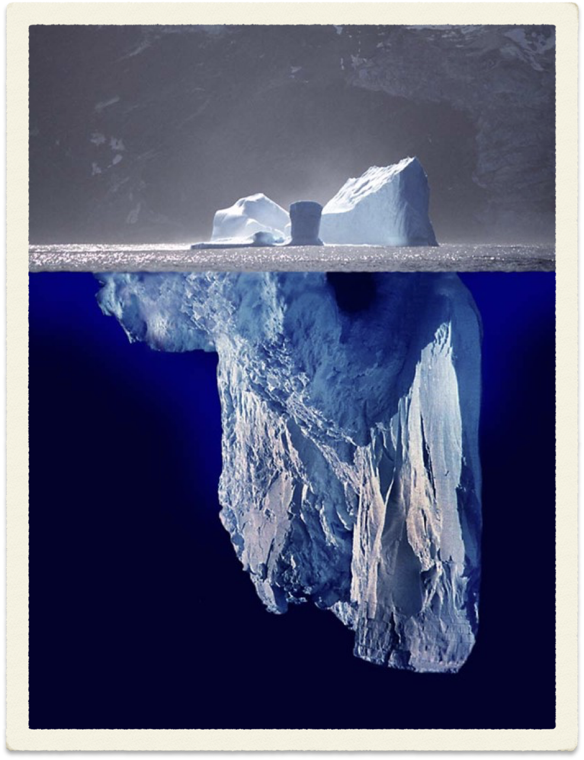


Slide 13
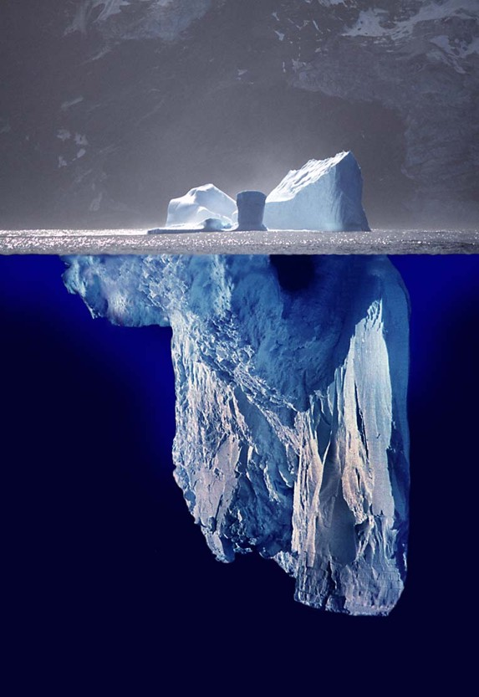
What we see
What’s Happened?
(not “what’s wrong”)
What’s the stress?
What are the strengths?
What do they need?
Notes:
Do attention seeking

Slide 14
Building the Window
Be curious - always
Validate
Be predictable and routine
Build routines around connection
Think sensory!
Teach about stress and how to manage it
Be mindful and teach others to do the same
Create spaces in your setting for caregivers to feel connected
Look after yourself so you can look after them; so you can respond to them and not react to the lava

Slide 15
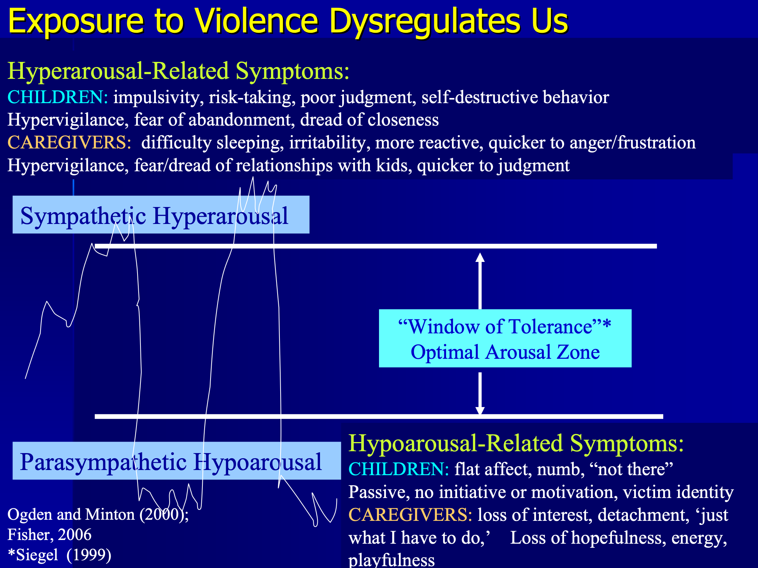

Slide 16
Building Your Window
Know what most worries you/where you are struggling. Don’t be afraid to naval gaze. Remember - Vulnerability brings joy.
Ask others for help and ideas. Work as a team
Know your symptoms of burnout and keep an eye out for them. Early detection is key
Think positively; Focus on strengths, not weaknesses
Take care of your pyramid. Actively engage in self-care. Little bits add up
Never forget the difference you make (understanding, leads to efficacy, leads to hope….it’s contagious too!)

