Slide 1
Supporting Children’s Regulation
Tools, Tips and Tricks From an Occupational Therapist
Jessica Faith, OT Reg. (Ont.)
2024

Slide 2
This Workshop Will Explore
01
What factors cause dysregulation
04
Useful sensory-motor and cognitive behavioural tools for a daycare or classroom setting.
What happens in the brain during periods of calm and stress
Environmental supports to promote regulation.
02
05
03
How to identify and monitor dysregulation
06
How you, the participant, can learn to co-regulate with the children in your care.
Jessica Faith, 2024

Slide 3
Stressors and Triggers
Sensory stimuli
Brain chemistry
Unresolved hurt
Family/Workplace dynamics
Change or The Unexpected
Loss of control
Jessica Faith, 2024

Slide 4
Stressors
Negative stress may cause a child to become disorganized, agitated, anxious, depressed, or aggressive.
Positive stress (winning a game) can cause a child to become elated, silly, agitated and even aggressive.
Jessica Faith, 2023

Slide 5
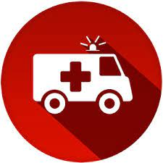
What Is a Stress Response?
A stress response is a physiological reaction to the detection of a real or perceived threat
…and it begins in the brain.
Jessica Faith, 2024

Slide 6
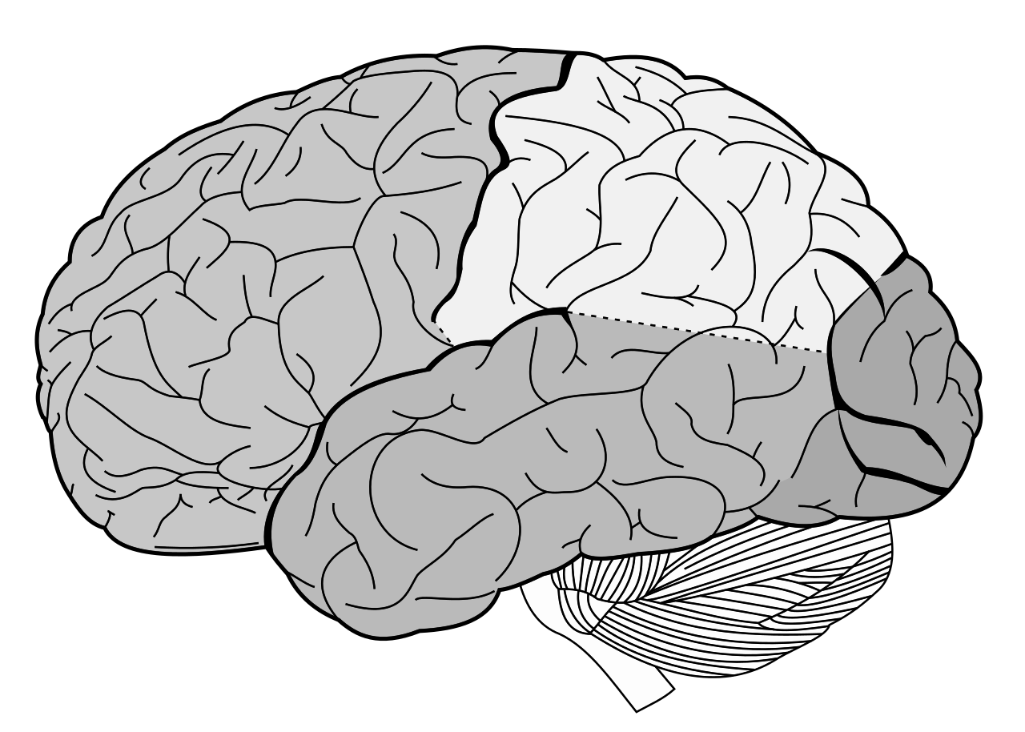
The Brain
llPrefrontallCortex:ll
llLogic, Learning andll
llProblem Solvingll
BrainlStem/Diencephalon: -Information from Sensors
-Regulate body systems (respiration, heart rate, digestion, reproductive systems)
-Activate 5 F’s
Van Der Kolk, 2005
Jessica Faith, 2024
Notes:
Describe areas of brain. Then discuss what brainstem does

Slide 7
Our Eight Senses
Vestibular (head movement in space and orientation to gravity)
Proprioception (body awareness, body position in space)
Interoception (Inner body sensations: full bladder/bowel, fatigue, hunger/thirst, pain, nervousness, fast heart beat, flutters in stomach, etc)
Auditory (hearing)
Visual (sight)
Tactile (touch)
Olfactory (smell)
Gustatory (taste)
Jessica Faith, 2023

Slide 8
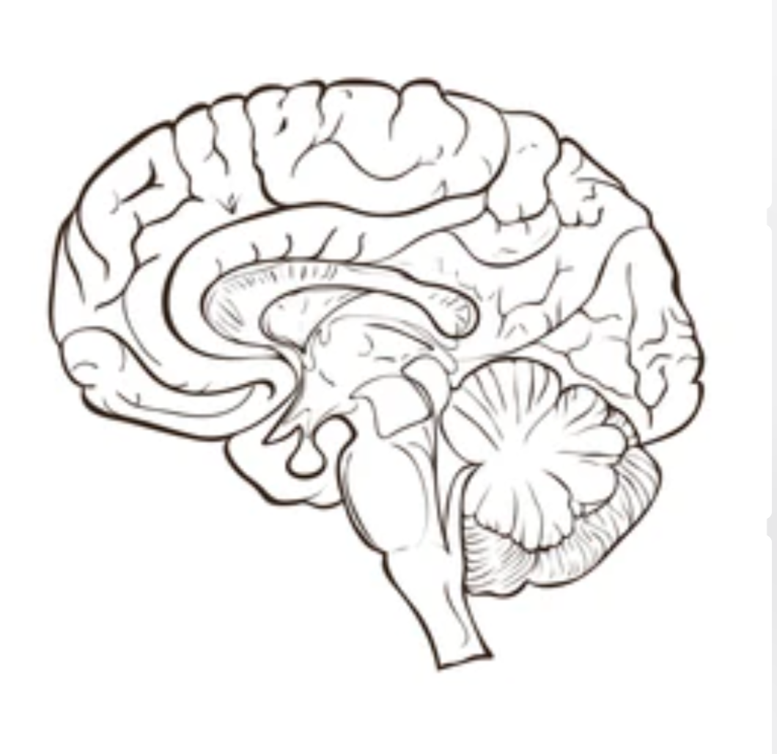
Input from thoughts
Prefrontal Cortex
Thalamus
Deactivate
Hippocampus
Activate
Threat Response
Amygdala
Brain stem
Input from 8 sensory systems
Jessica Faith, 2024
Notes:
One areas shuts off while the other is enabled. Causing 4 f’s

Slide 9
Threat Response: The 5 F’s
FIGHT Verbally Aggressive Physically Aggressive Argumentative Controlling Bullying | FLIGHT Avoiding Anxious Over-Achieving Running Away Hiding | FREEZE Shutdown Isolated Disengaged Stuck Overwhelmed | FAWN Anxious to Please Over-Sacrificing Co-Dependent Loss of Self Afraid to say “no” | FLOP Fainting Disengaged Lack of emotion Hopeless
Jessica Faith, 2024

Slide 10
The Brain
llPrefrontallCortex:ll
llLogic andll
llProblem Solvingll
Unavailable or Limited Availability
Increased heart rate, blood flow and respiration rate. Ready muscles for action on threat.
Release Adrenaline and Cortisol.
Activated
Threat Response
BrainlStem/Limbic System: l5 F’sll
Van Der Kolk, 2005
Jessica Faith, 2024
Notes:
Arousal high, need to regulate to gain back function of pre-front cortex. What is arousal and reg?

Slide 11
Arousal and Self-Regulation
Arousal (physiological arousal) is the state of the nervous system: it is expressed in how alert one feels, how calm, how excited or lethargic, etc.
Self-Regulation is the ability for a person to attain, maintain, or return to, an arousal level that is appropriate for the task they are performing or the context they are in.
Jessica Faith, 2024
Notes:
As staff it is our duty to assist those we are incharge of to manage the energy they bring into the camp space.

Slide 12
When should a child be able to self-regulate?
From 0-12 months: a child requires an adult to help manage regulation. The child is should be regulated enough to explore their environment and begin to learn how to engage with others.
From 18 months -3 years, a child should be able to regulate enough to follow basic adult instruction. A regulated child can Imitate others, learn new skills and enjoy reciprocal social interaction.
By age 5, a child should be able to recognize basic emotions and regulate these emotions with some assistance from an adult.
Some psychologists believe that you can’t truly self-regulate until your 25 years of age!!
?

Slide 13
Arousal Management vs. Self-Regulation
Arousal Management
Adult assisted monitoring and identification of arousal state.
Adult assisted management of arousal state based on context.
Self-Regulation
Self monitoring and identification of arousal state.
Self management of arousal state based on context.
Jessica Faith, 2024
Notes:
How do we identify an arousal state. Lets talk about the levels of arousal

Slide 14
Levels of Arousal
Threat Response/Meltdown (Fight, Flight, Freeze, Fawn)
High Arousal (Anxious, Angry, Scared, Elevated, Shocked, Aggravated, Excited)
Optimal Arousal (Calm, Focused, Alert, Adaptive, Flexible, Curious, Problem Solving) “window of tolerance”
Low Arousal (Sluggish, Sad, Tired, Sick, Bored)
Sleep
Jessica Faith, 2024

Slide 15
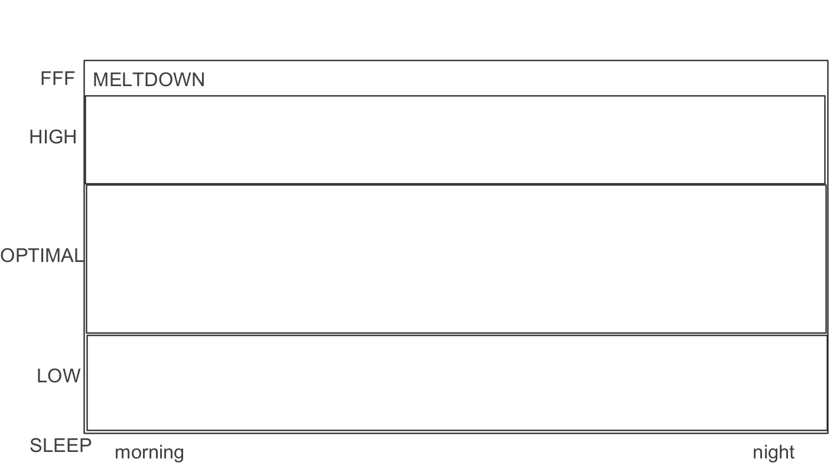
Optimal Arousal “The Window of Tolerance”
The window of tolerance
Jessica Faith, 2024
Notes:
Arousal fluctuates throughout the day. We are constantly trying to keep ourselves within the window of tolerance.

Slide 16
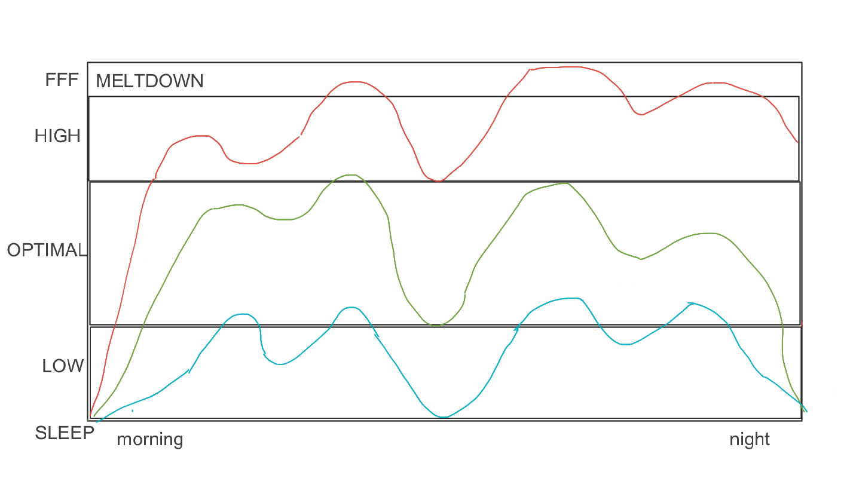
The window of tolerance
Jessica Faith, 2024

Slide 17
A Regulated Brain
llPrefrontallCortex:ll
llll
Alert
Focused
Logical
Learning
Rest/Digest
BrainlStem/Diencephalon l
Van Der Kolk, 2005
Jessica Faith, 2024
Notes:
Keep ourselves in the window of tolerance so we can rest and digest.

Slide 18
Regulated Activation vs. Reactive Emotions
“It is neurobiologically and behaviourally possible to be highly aroused and still be regulated and contained within one’s window of tolerance…..”
“….Disconnected, harmful and reactive emotions that are truly dysregulated can result in the perpetuation of suffering rather than as a communication aimed at restoring and maintaining contact in relationship.”
-Kim Barthel
Jessica Faith, 2024
Notes:
Screaming at someone because they put a spoon in the wrong drawer vs. screaming at someone to watch out for the bear.

Slide 19
Sensory Processing Differences and the Impact on Arousal
Jessica Faith, 2024

Slide 20
Our Eight Senses
Vestibular (head movement in space and orientation to gravity)
Proprioception (body awareness, body position in space)
Interoception (Inner body sensations: full bladder/bowel, fatigue, hunger/thirst, pain, nervousness, fast heart beat, flutters in stomach, etc)
Auditory (hearing)
Visual (sight)
Tactile (touch)
Olfactory (smell)
Gustatory (taste)
Jessica Faith, 2024

Slide 21


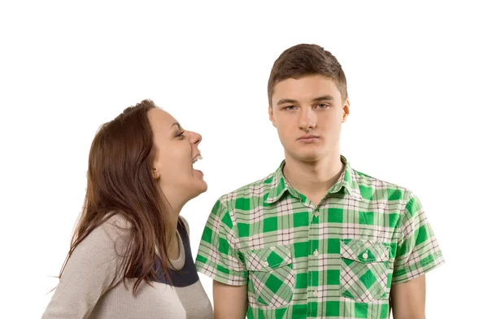
Spectrum of Response to Sensory Input
Under-Responsive
Over-Responsive
Unresponsive
(Unconscious)
Defensive
(Threat Response)
Jessica Faith, 2024

Slide 22
Increased Arousal
Increased Responsivity to Sensory Input
Jessica Faith, 2024

Slide 23
Sensory differences do not always lead to challenges but may lead to unique gifts and enhanced skills and quality of life. -Ellen Yack
Jessica Faith, 2024

Slide 24
Body Break!

Slide 25
Monitoring Dysregulation Through Body Signals and Behaviour
Jessica Faith, 2023

Slide 26
Assessment batteries available
https://www.aacap.org/AACAP/Member_Resources/AACAP_Committees/Infant_and_Preschool_Committee/Assessment_of_Young_Children.aspx
Jessica Faith, 2023

Slide 27
Signs of Stress Activation (Dysregulation)
Disengagement (avoidance of social engagement or participation in activities)
Regression in self-care activity (toileting and feeding)
Disrupted sleep
Difficulty adapting to changes
Strong emotional responses that appear out of context
Changes in affect (facial expression)
Changes in speech/breathing rate and/or rhythm
Changes in body posture
Jessica Faith, 2024
Notes:
Subtle signs of dysregulation

Slide 28
Signs of Dysregulation
High Arousal
Anxious, elated, angry, irritated, fidgety, wide eyed, red ears, disorganized thought/movements, fast speech, fast breathing, etc
Low Arousal
Low mood, slow speech, slow to respond, difficulty initiating, limited motivation to move, flat affect, reduced social engagement, etc
Jessica Faith, 2024

Slide 29
Analysing Dysregulation
What does the underlying behaviour look like?
What are the triggers?
Where does the behaviour in question happen?
When does it happen?
Who does it happen with and why?
When are they calm?
What are they doing to calm themselves?
Jessica Faith, 2043

Slide 30
Optimal Arousal Presentation
How does the child present when calm? (How do they behave)
When the child is upset, what are they trying to do to calm themselves?
How does the child calm for sleep?
Do they ever present at an optimal arousal level?
Jessica Faith, 2024

Slide 31
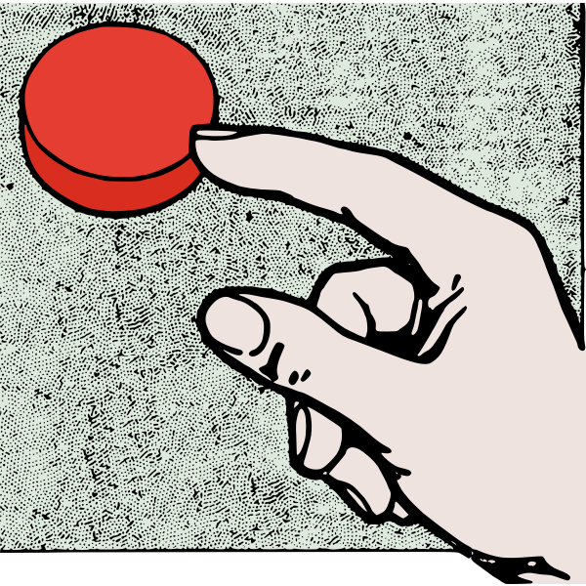
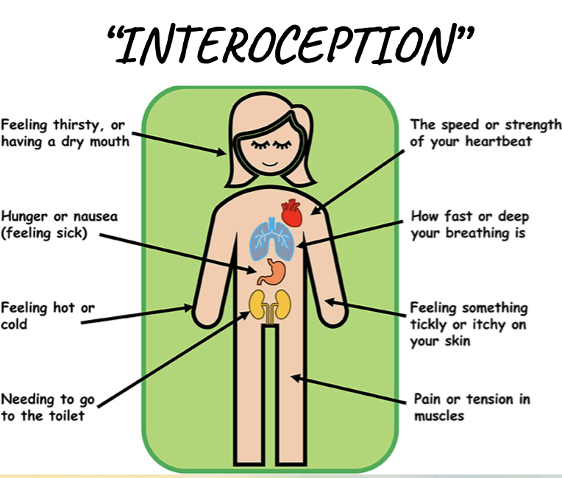

Investigate Triggers, Body Signals, and Tools
J
Triggers (What internal or external occurrences cause them to escalate or plunge?)
internal and external sensory input, social interactions, demands, thoughts, unmet needs, medical issues…
Body Signals (What body sensations are communicating their state of physiological arousal? How does this influence their behaviour?)
heaviness, fast heart beat, headache, tingling arms, sweaty palms, tight stomach, yawning. Hand flapping, hiding, speaking quickly, loss of eye contact)
Tools (what are they doing to regulate themselves)
Chewing/mouthing, running/jumping, hiding, lying on floor, sucking thumb, groin stimulation, fidgeting, pushing/hitting/biting, elopement.
Jessica Faith, 2024

Slide 32
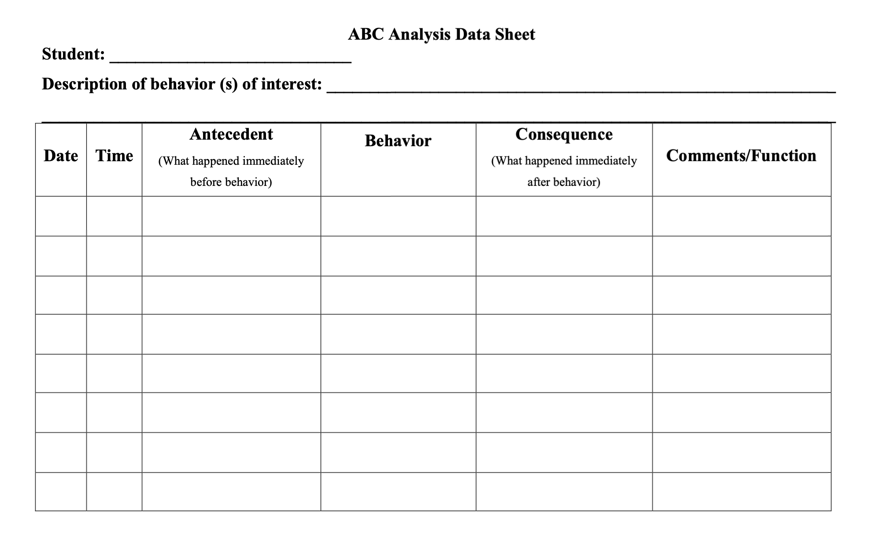
What was their level of arousal?
Jessica Faith, 2024

Slide 33
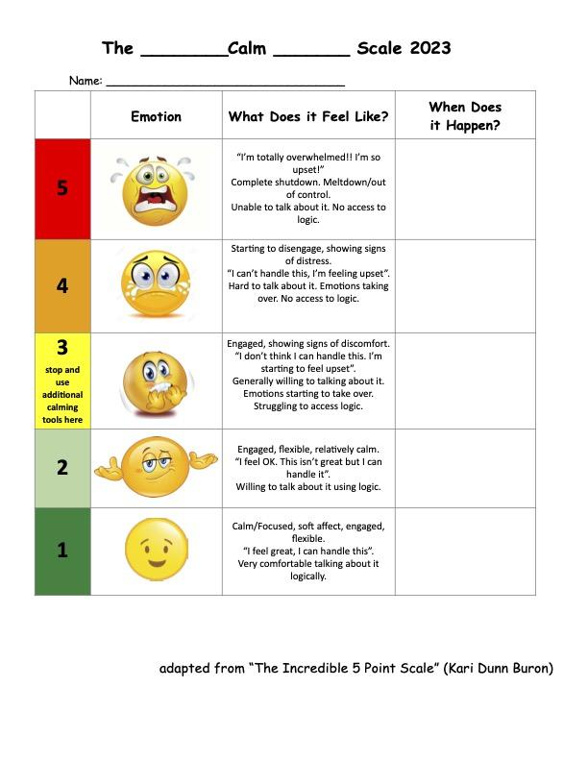
Jessica Faith, 2024

Slide 34
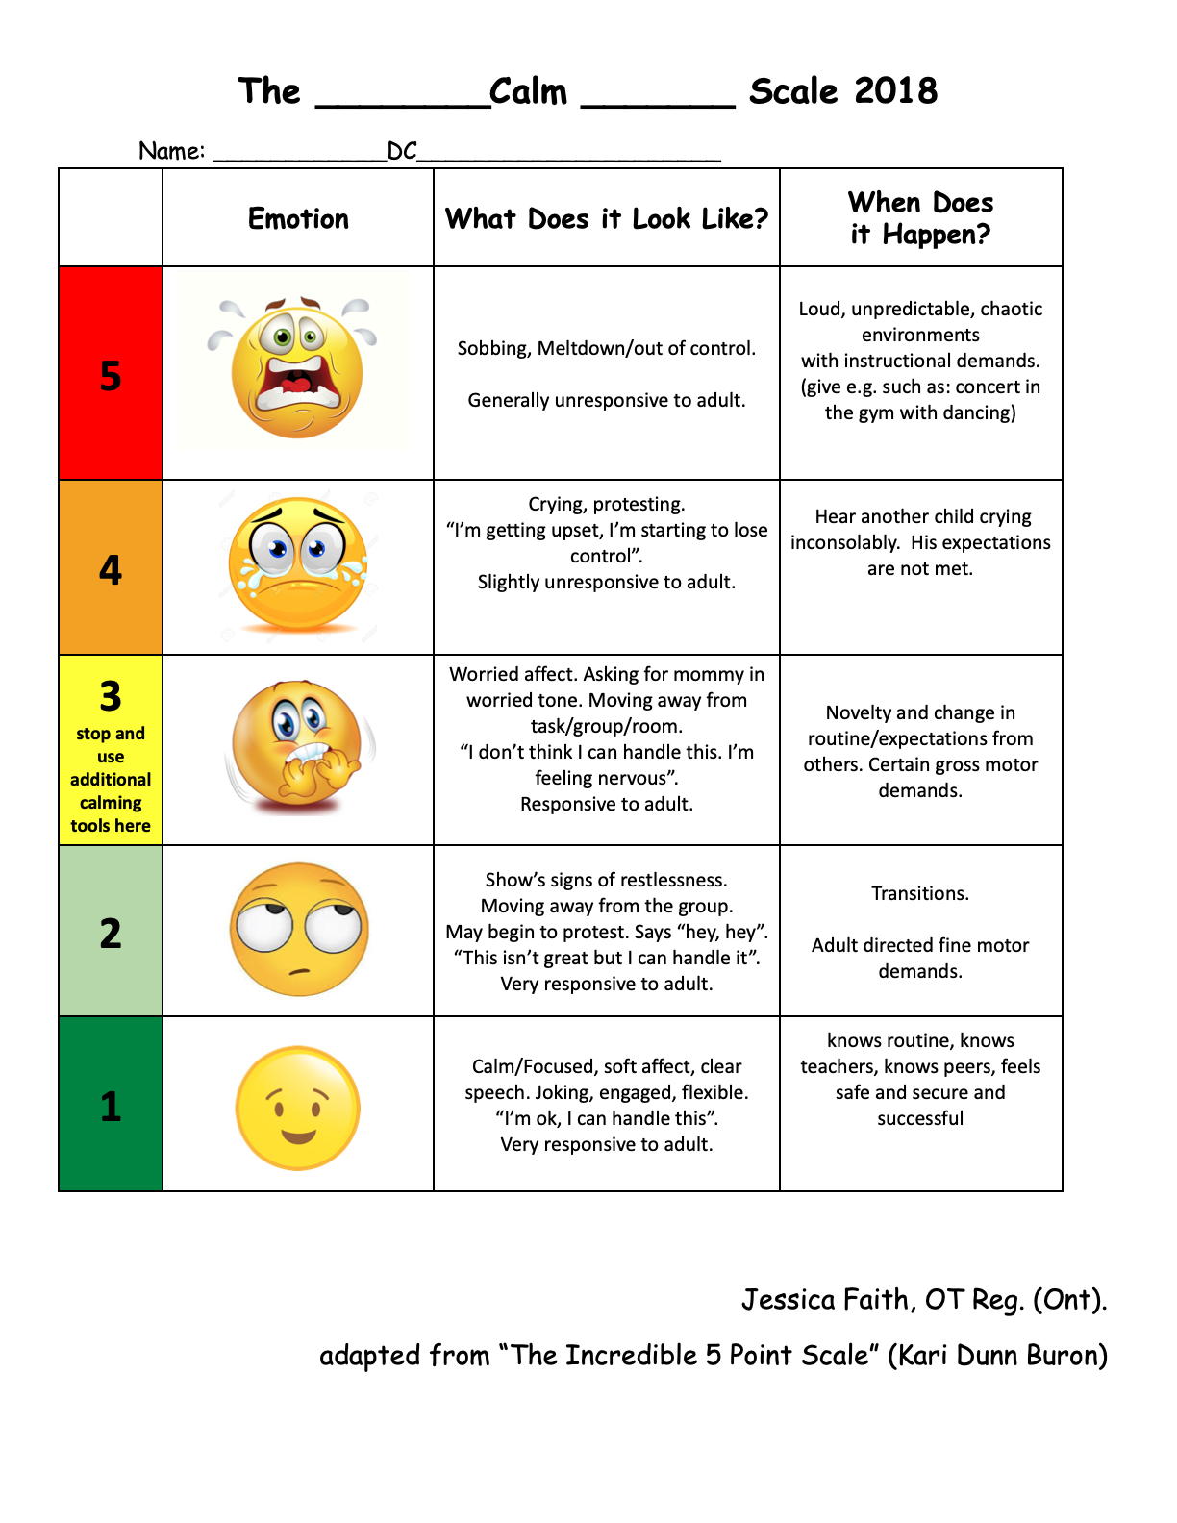
Jessica Faith, 2024

Slide 35
Regulation Data Sheet- Momentary Time Sampling
Data Tracking Legend
Level 1 | Calm, compliant, readily follows 90-100% of IT's instructions, makes good eye contact
Level 2 | Follows 75-90% IT's instructions, some avoiding of task but can be redirected, some vocal stereotopy. Requires verbal prompt to follow IT's instructions
Level 3 | Moving quickly around the room in a circuit, follows less than 50-75% of IT's instructions, vocal stereo… equires gesture prompts to follow IT's instructions
Level 4 | Whining, crying, task avoidance, does not follow most of IT's instructions, protest "no [activity]", head hitting, requires partial physical prompt to follow IT's
Level 5 | Meltdown, out of control, head hitting, screaming, seeking surfaces to bang head on, requires full physical prompt to follow IT's instructions
Date:_____ | AM IT: ________ | PM IT:_________
 | 5 | 4 | 3 | 2 | 1
9:00 | Activity: | Activity: | Activity: | Activity: | Activity:
9:30 | Activity: | Activity: | Activity: | Activity: | Activity:
10:00 | Activity: | Activity: | Activity: | Activity: | Activity:
10:30 | Activity: | Activity: | Activity: | Activity: | Activity:
11:00 | Activity: | Activity: | Activity: | Activity: | Activity:
11:30 | Activity: | Activity: | Activity: | Activity: | Activity:
12:00 | Activity: | Activity: | Activity: | Activity: | Activity:
1:00 | Activity: | Activity: | Activity: | Activity: | Activity:
1:30 | Activity: | Activity: | Activity: | Activity: | Activity:
2:00 | Activity: | Activity: | Activity: | Activity: | Activity:
2:30 | Activity: | Activity: | Activity: | Activity: | Activity:
3:00 | Activity: | Activity: | Activity: | Activity: | Activity:
3:30 | Activity: | Activity: | Activity: | Activity: | Activity:
Occurrences/ # of opportunities
Percentage of intervals % |  | % | % | % | %
*** Graph daily percentage of intervals at each regulation level on the momentary time sampling graph
Jessica Faith, 2024

Slide 36
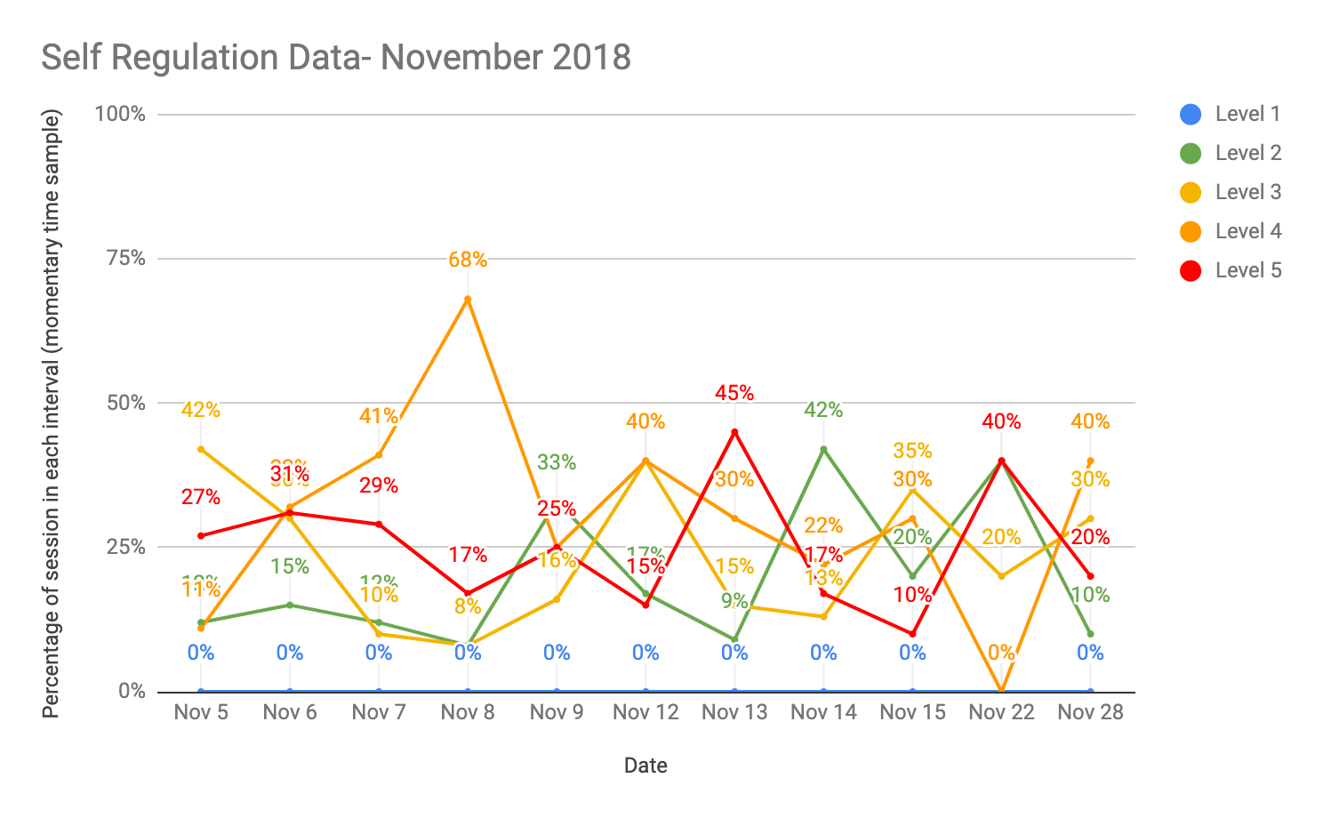
Jessica Faith, 2024

Slide 37
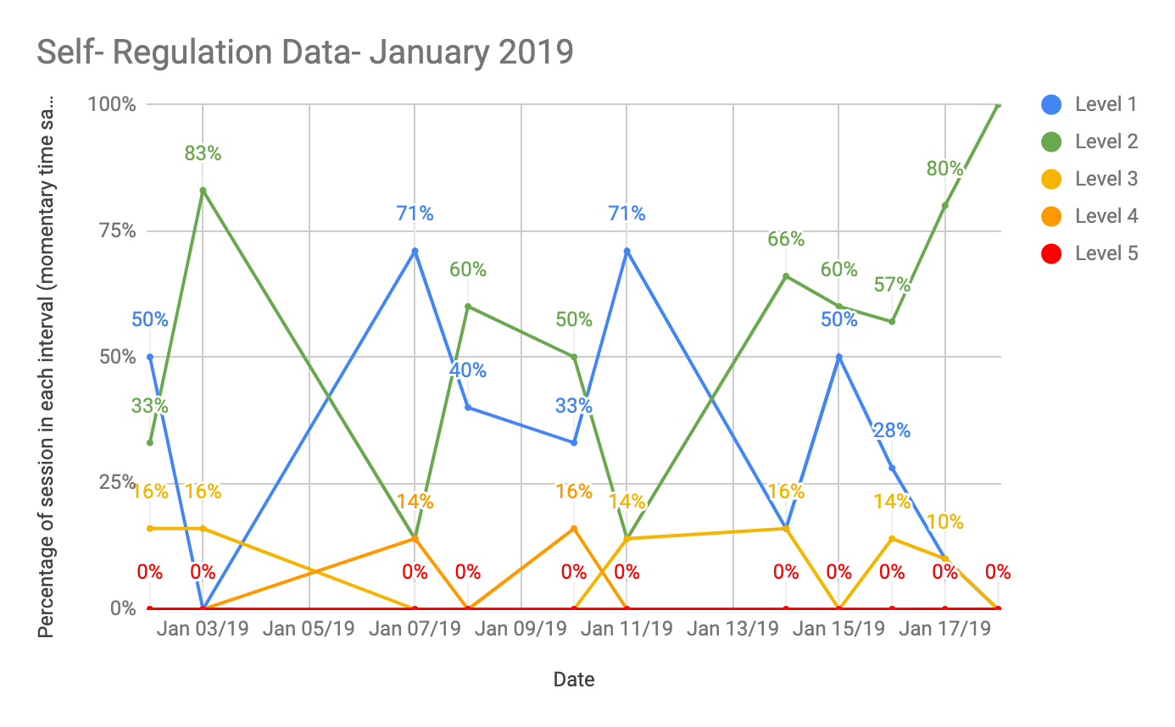
Jessica Faith, 2024

Slide 38
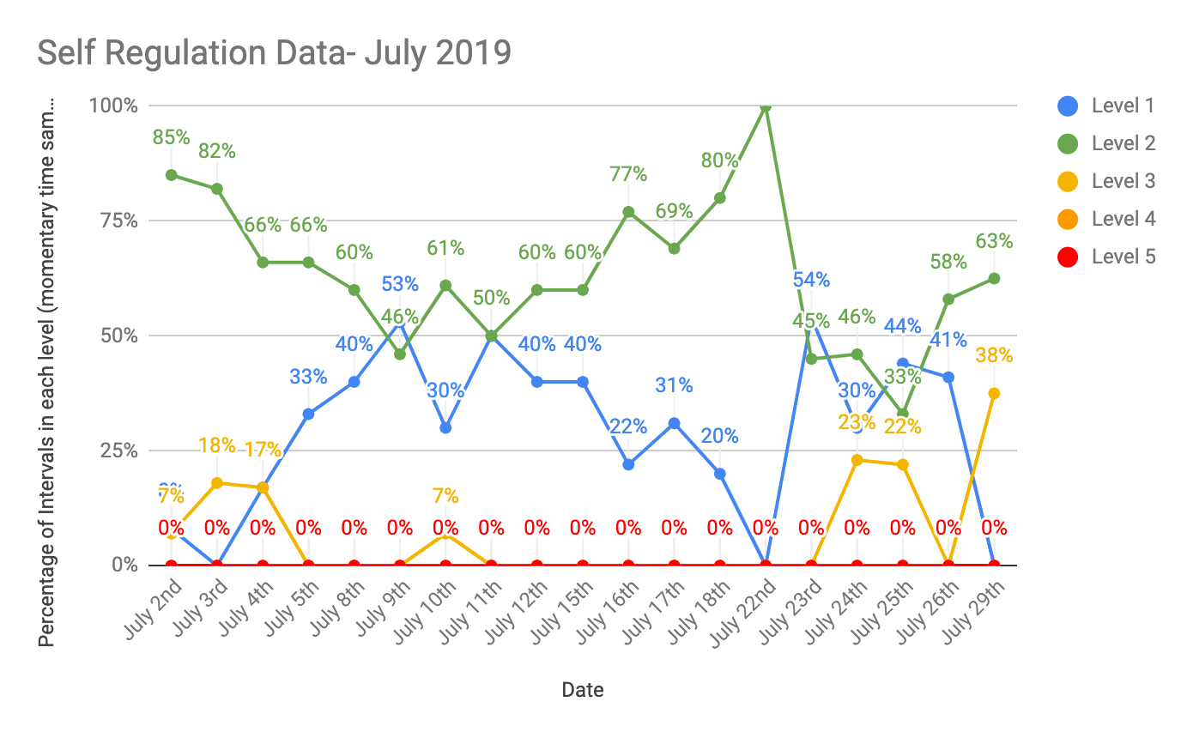
Jessica Faith, 2024

Slide 39
Body Break!

Slide 40
Managing Arousal and Building Self-Regulation Skills
Three Approaches:
Sensory-Motor Tools (Body)
Cognitive Behaviour Tools (Mind)
Co-Regulation (Relationship)
*Most effective when all three are combined
Jessica Faith, 2024

Slide 41
Sensory-Motor Tools (Body)
Calming
Slow, predictable, rhythmic movement, deep breathing.
Deep pressure, weighted items, massage, warmth.
Heavy work: lifting, pushing, pulling, weight bearing, chewing/sucking, blowing bubbles.
60 bpm music, lavender scent, visual fixation, neutral colours, warm milk, bland flavours.
Connection with a calm, safe, familiar person.
Alerting
Fast, irregular, unpredictable, arrhythmic movement.
Fast light unpredictable touch/tickling, cold input
Heavy work: lifting, pushing, pulling, weight bearing, chewing/sucking.
100+ bpm music, mint scent, bright colours/lights, cold drinks, sour flavours.
Interaction with a lively, active person.
Jessica Faith, 2024

Slide 42
Calming Tools
Appropriate
Effective
*Intense dysregulation requires intense input*
Jessica Faith, 2024

Slide 43
Accommodations and Supportive Environments
How do you create regulated spaces for both seekers and avoiders of input?
Jessica Faith, 2024

Slide 44
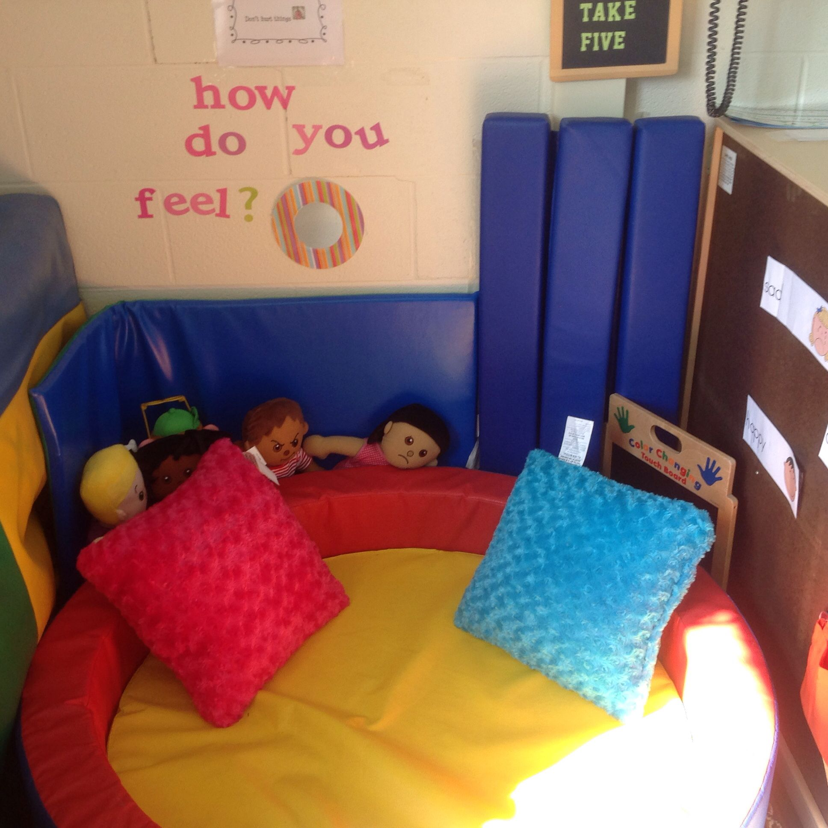
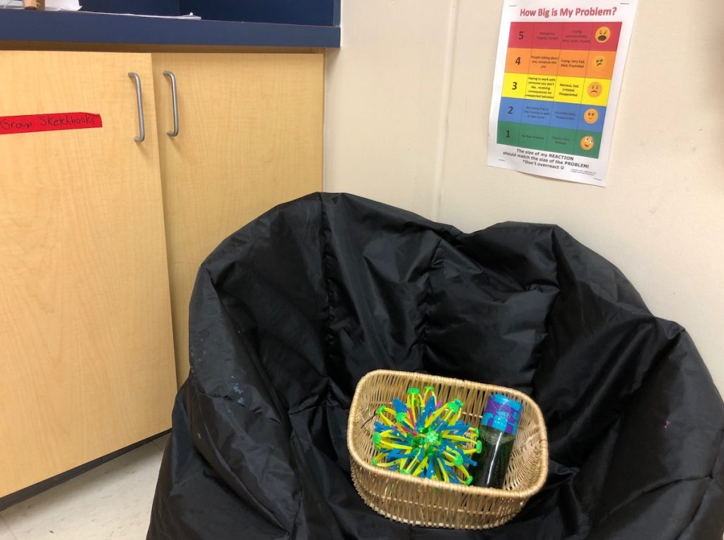
Calming corners

Slide 45
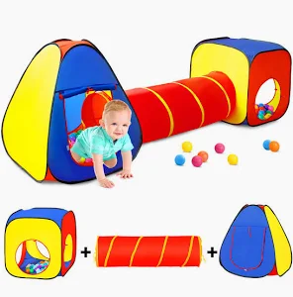
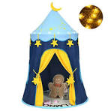
Play tents for movement and calming spaces

Slide 46
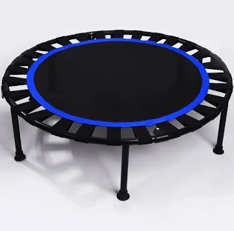

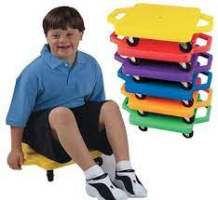
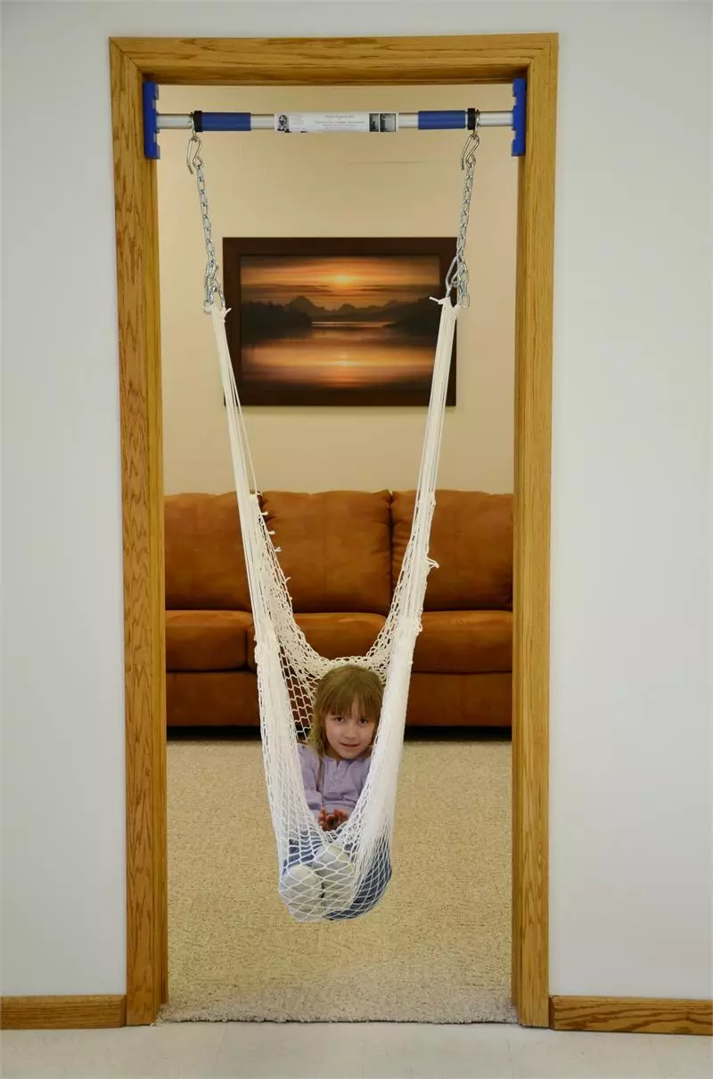
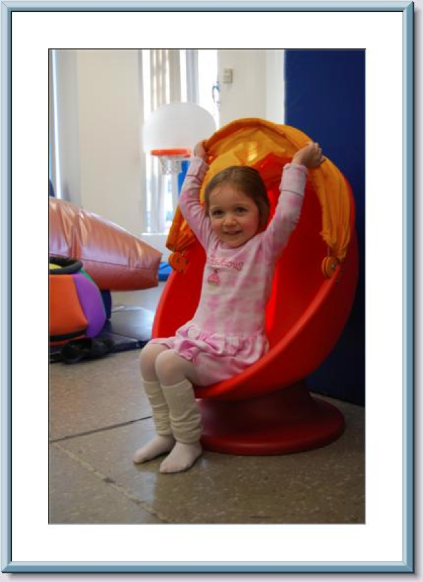
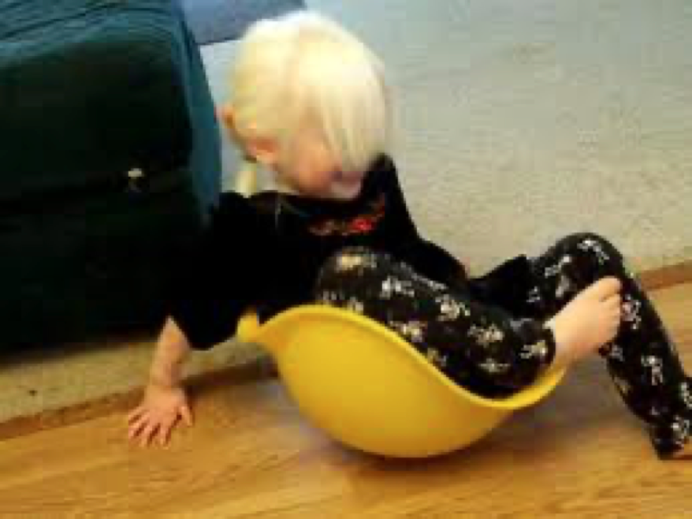
Vestibular Input
Bilibo

Slide 47
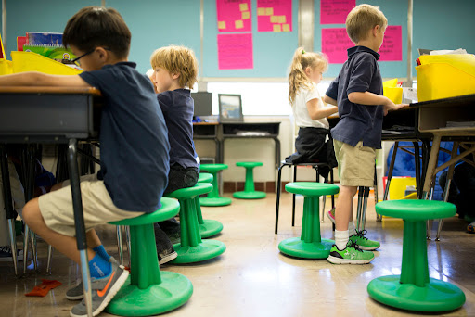
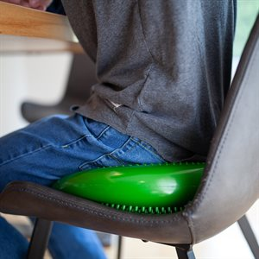
Active Sitting

Slide 48

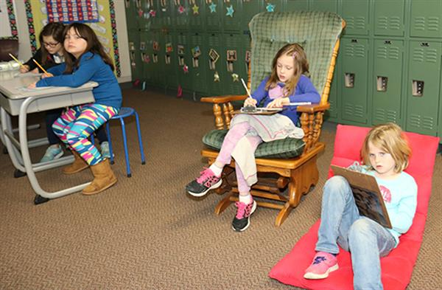
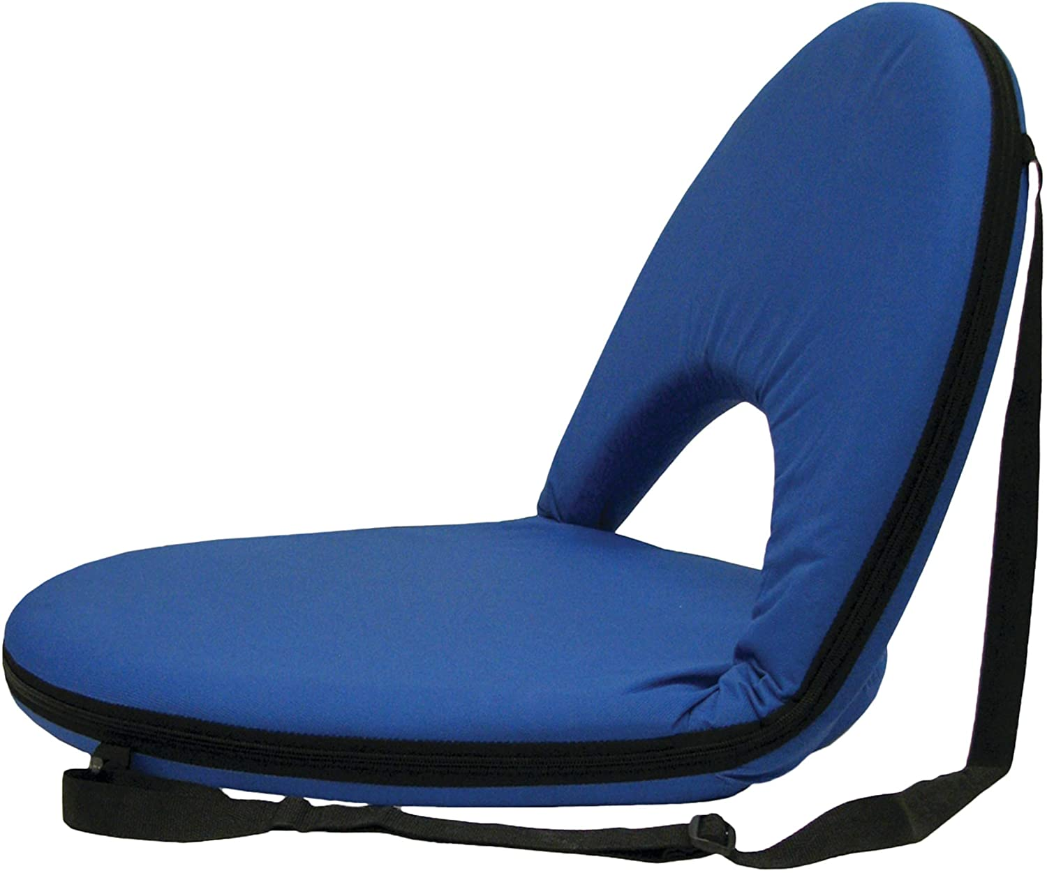
Flexible Seating
ikea

Slide 49

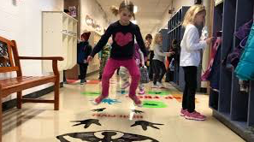
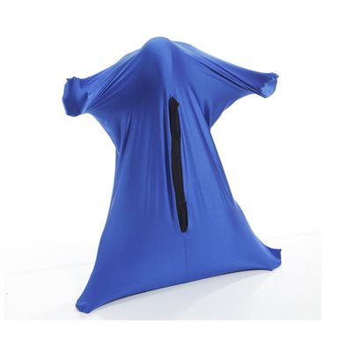
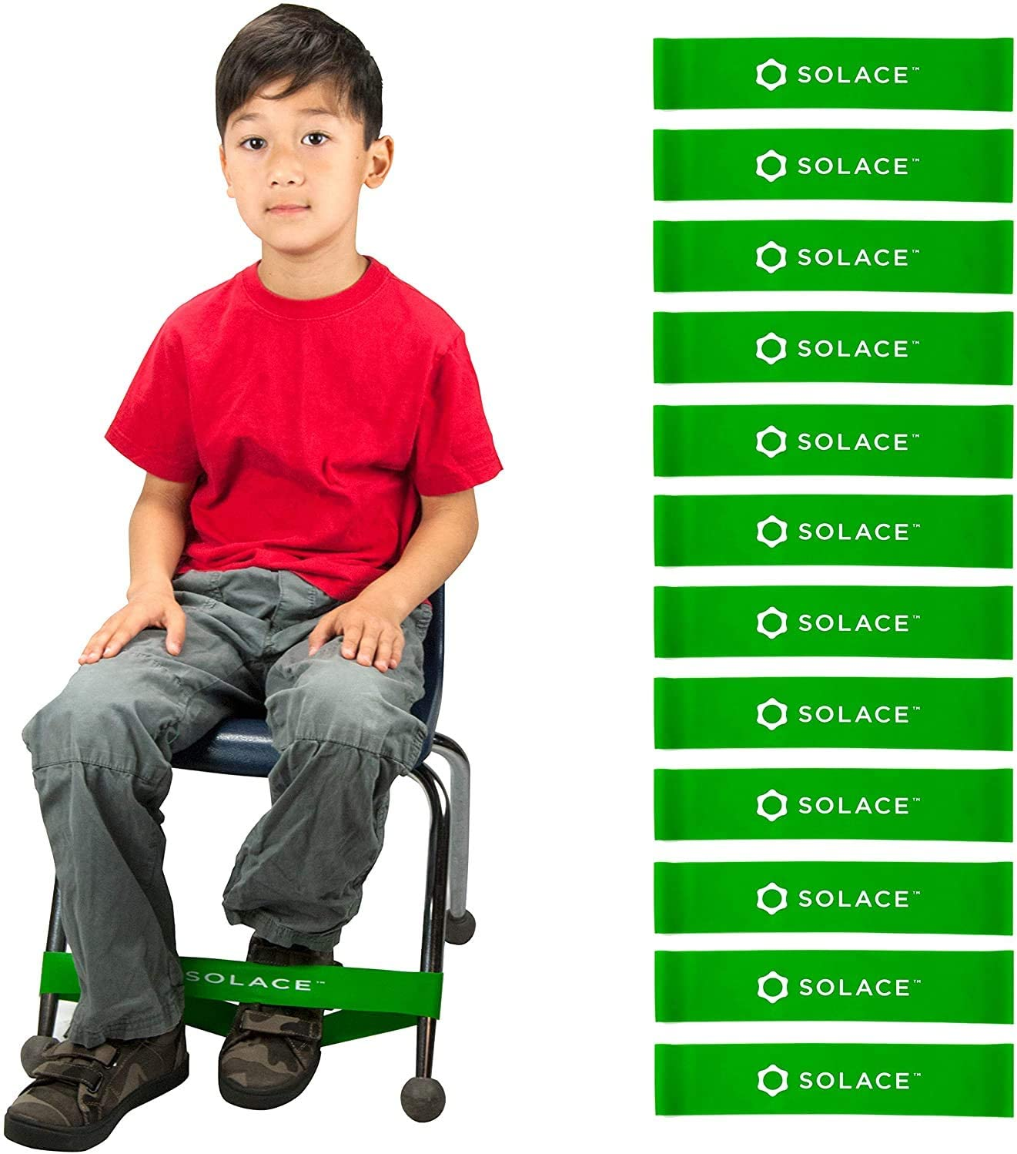
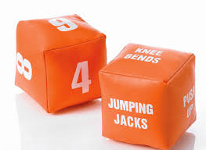
Heavy work

Slide 50

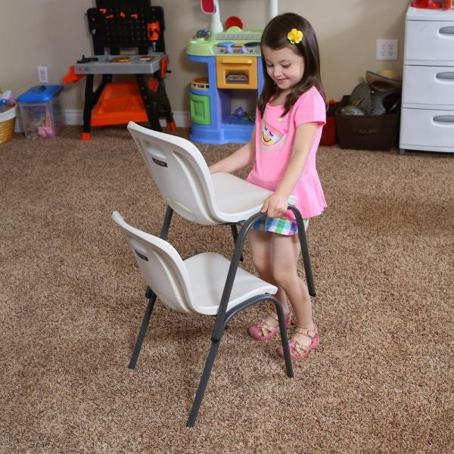

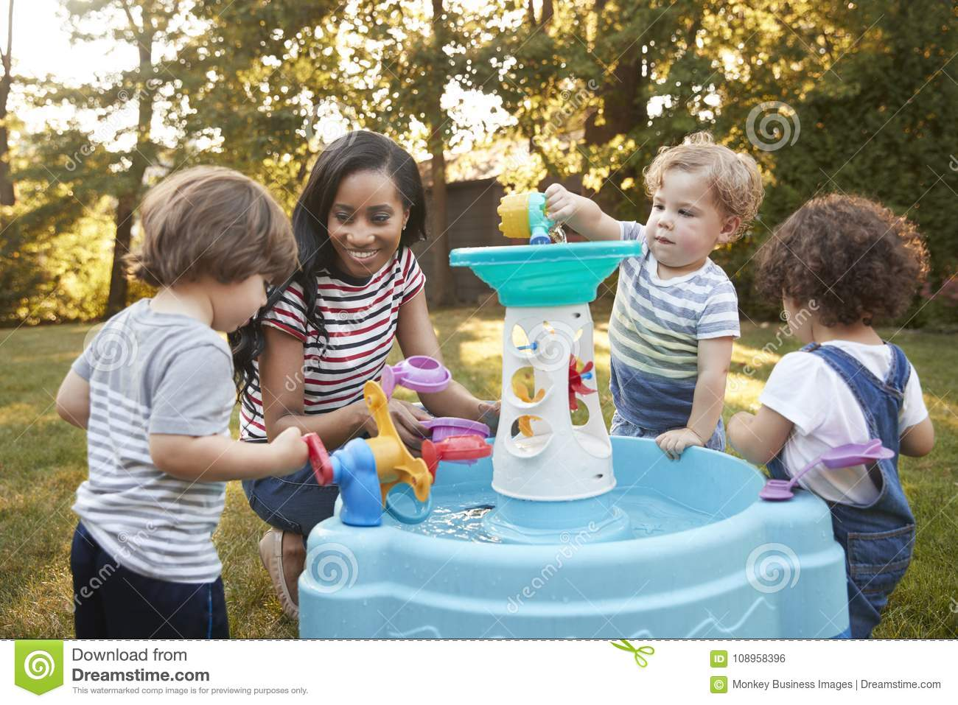
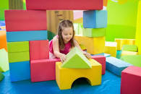
More Heavy Work Ideas

Slide 51
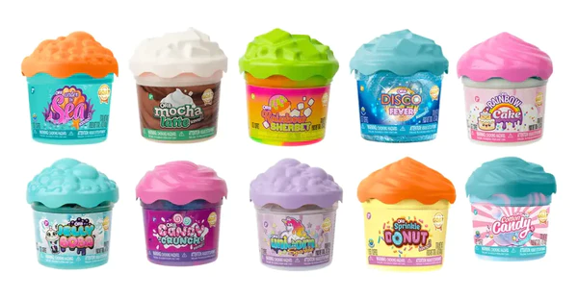
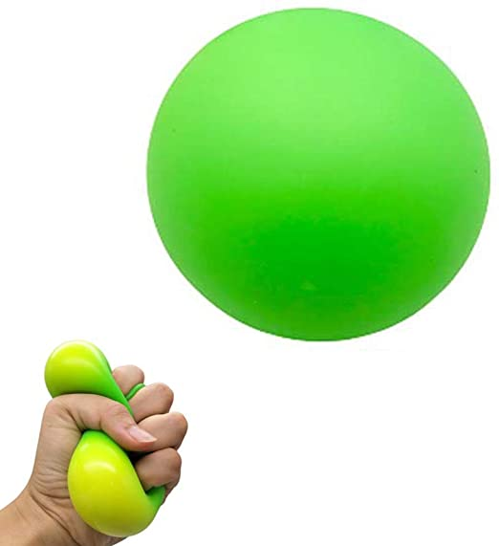
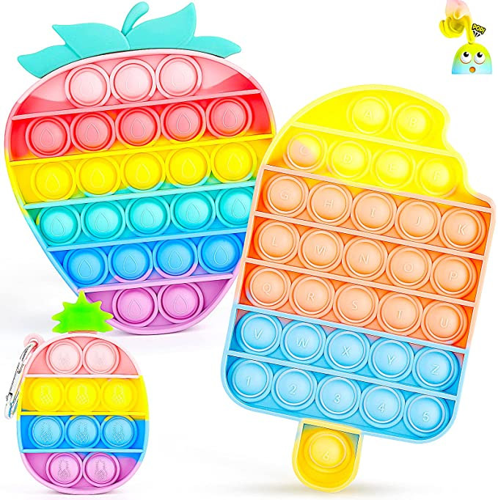
Fidgets
Ideally with no visual interest or sound if used during instruction.

Slide 52

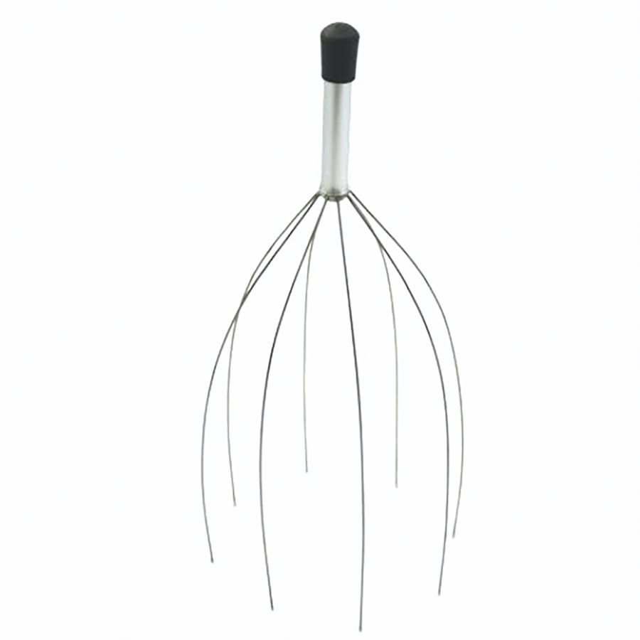
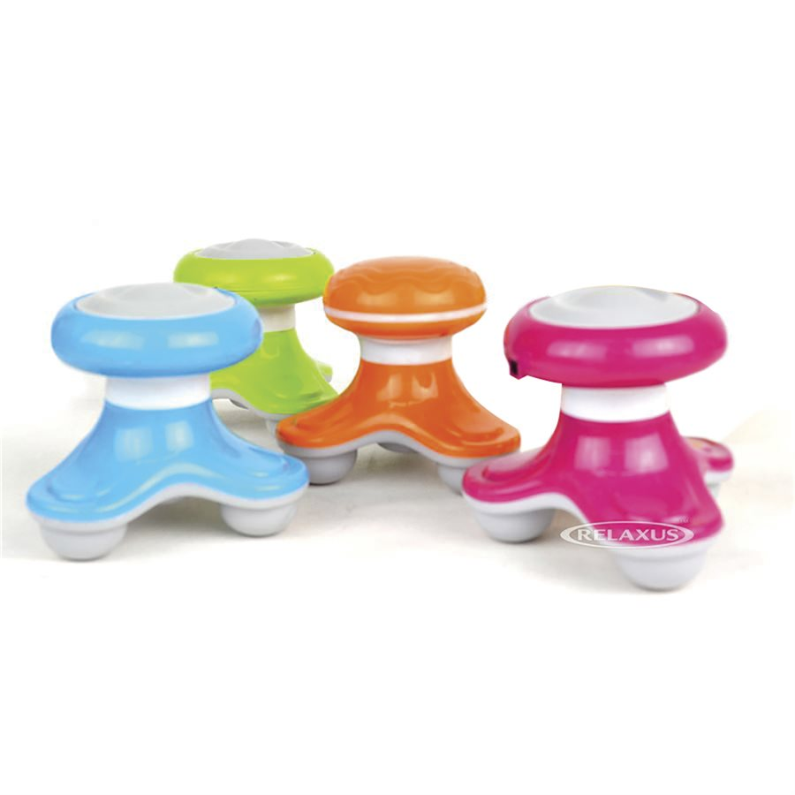
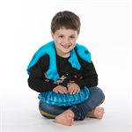


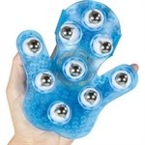
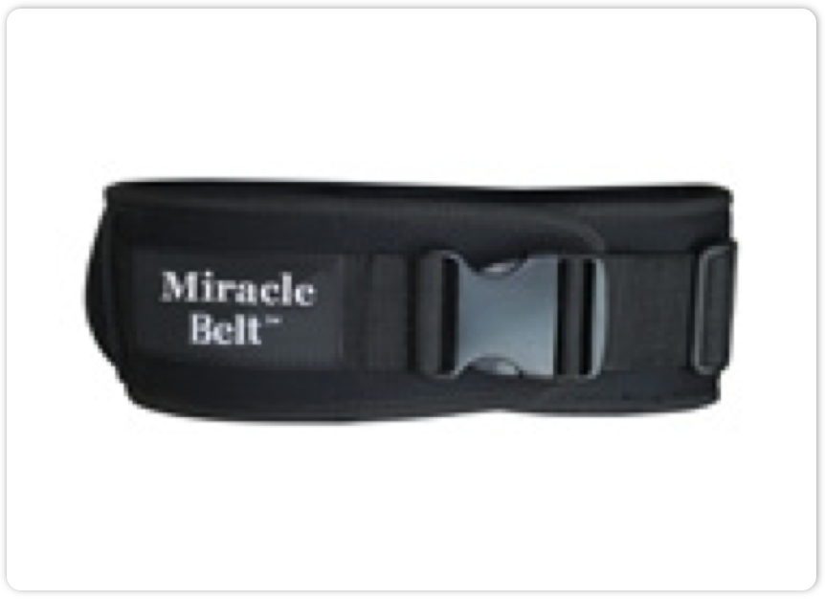
Deep Pressure Input

Slide 53
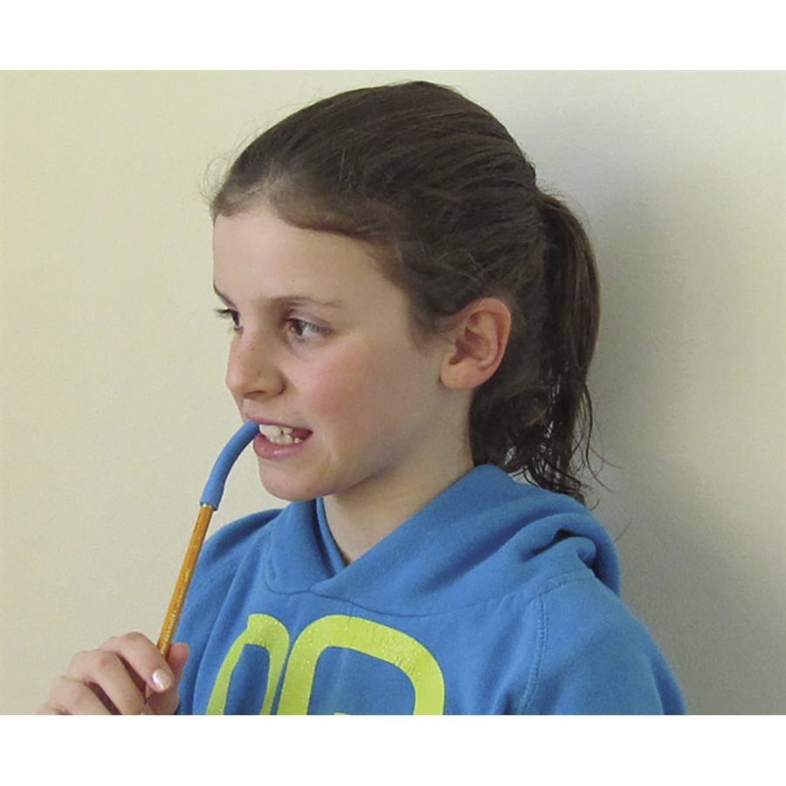
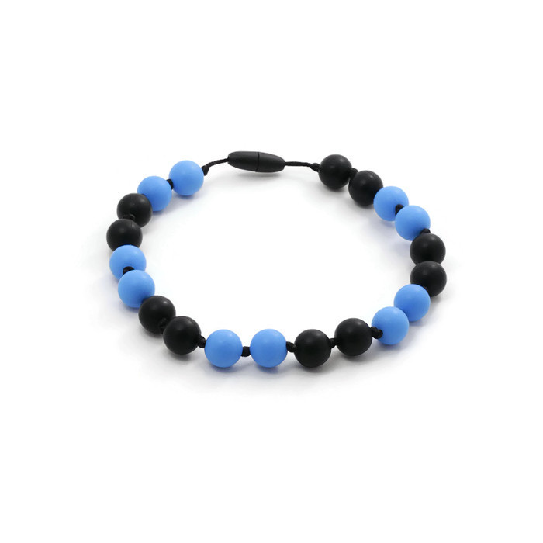
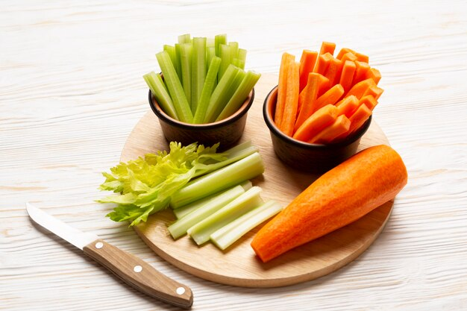
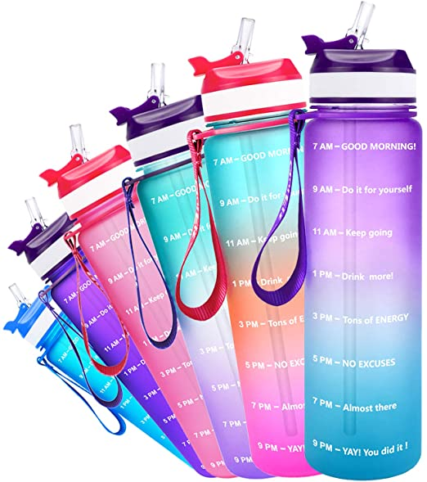
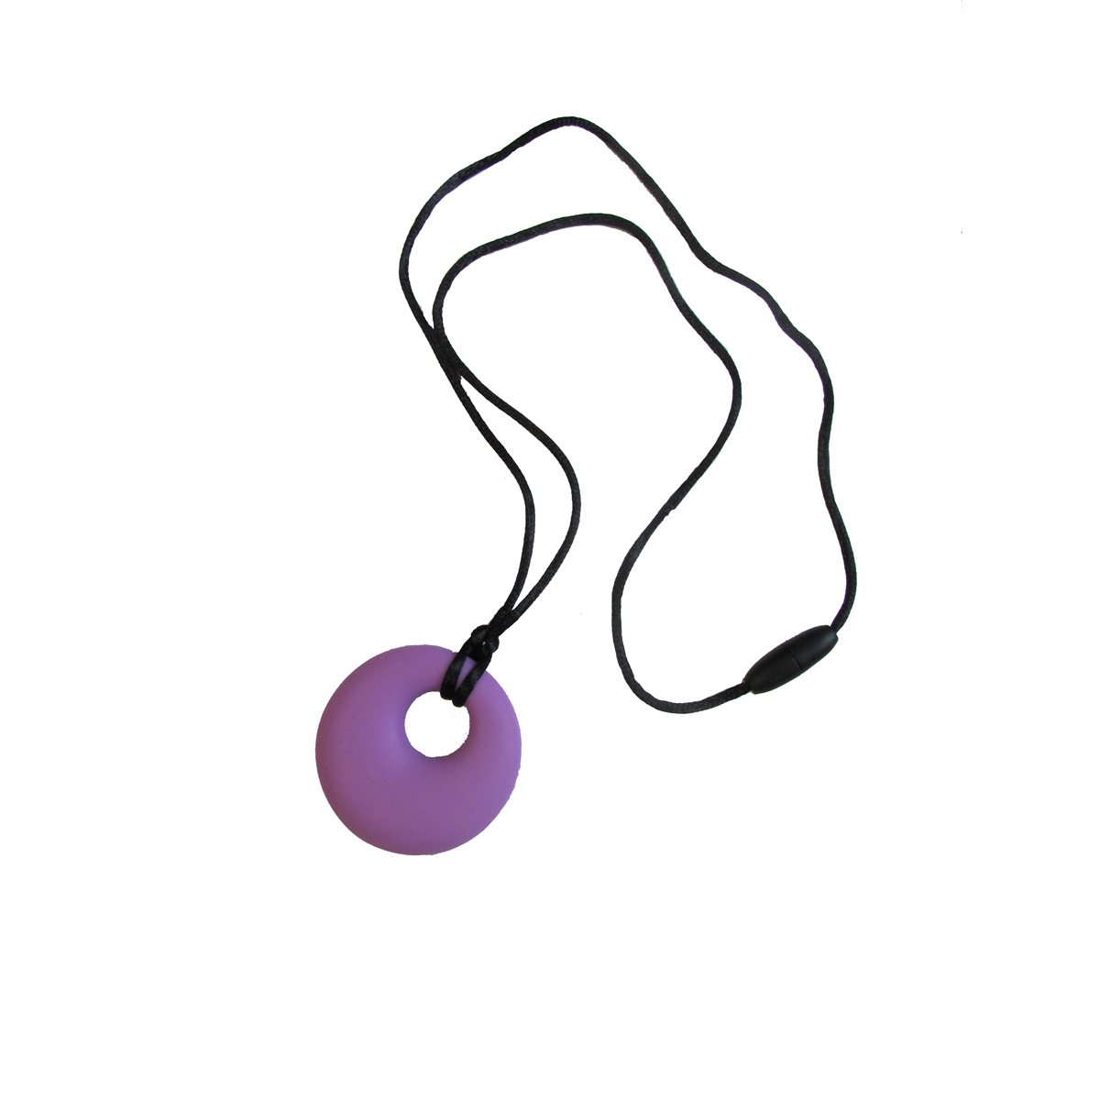

Oral Motor Input (heavy work for the mouth)
Snoezelen® Multi-Sensory Environments

Slide 54

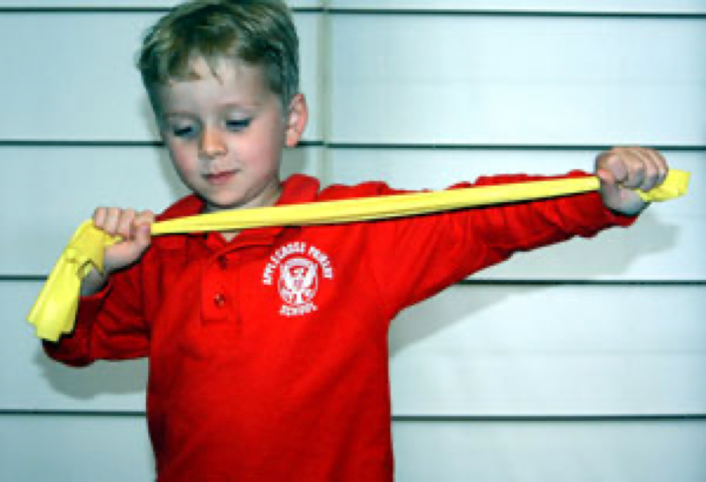
Multiple Inputs

Slide 55
Cognitive Behaviour Programs (Mind)
The Zones of Regulation (Kuypers, 2011)
The Incredible 5-Point Scale (Dunn Buron & Curtis, 2003)
The Alert Program: How Does Your Engine Run? (Williams & Shellenberger, 1996)
Jessica Faith, 2024

Slide 56
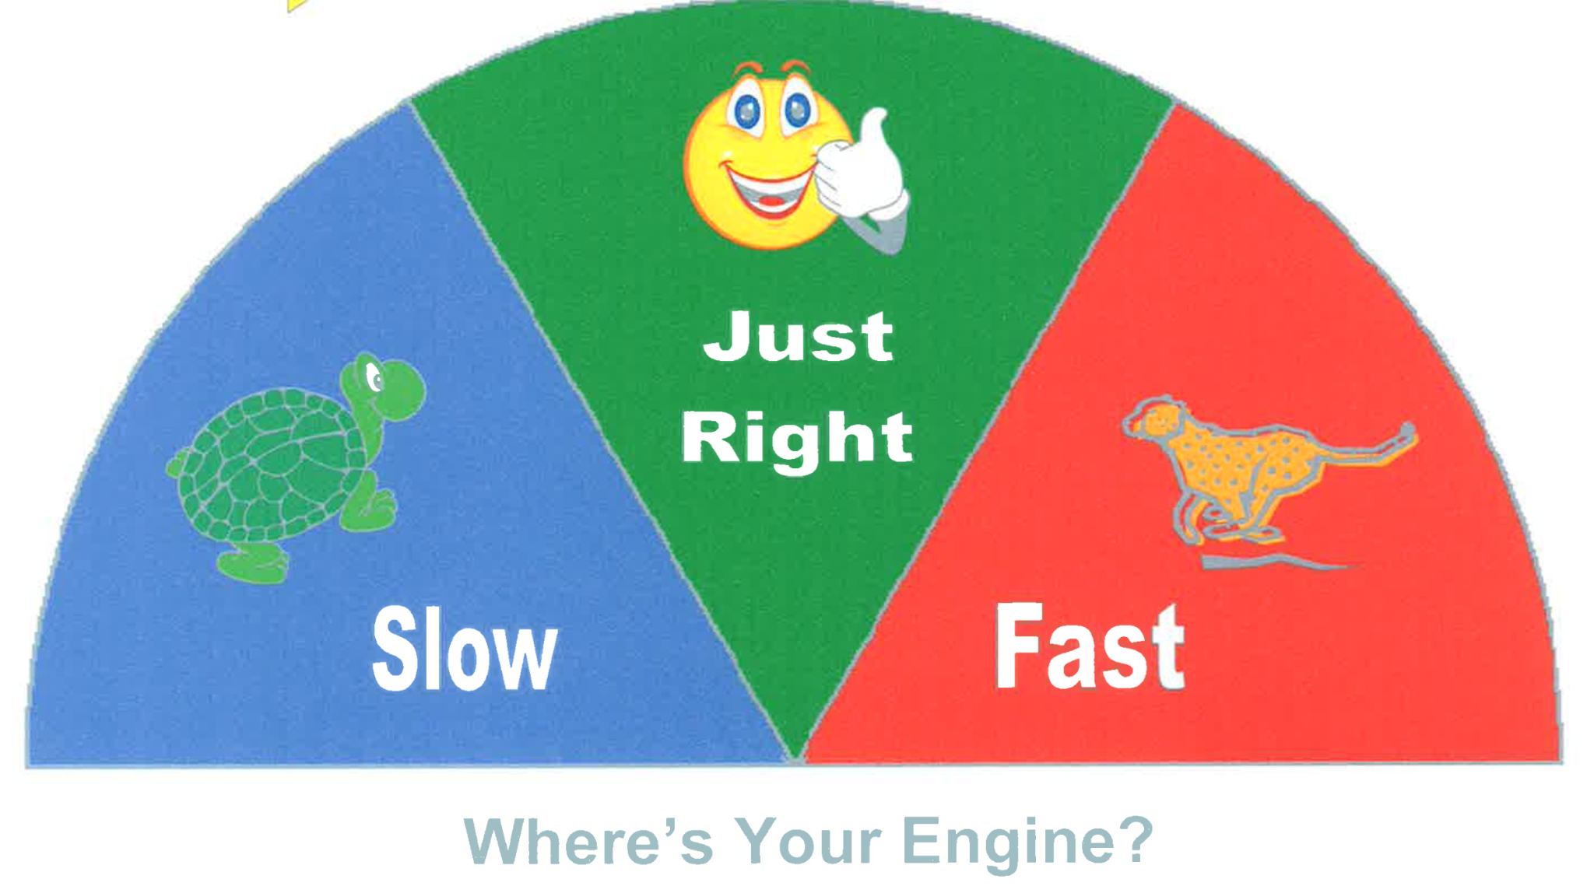
The Alert Program
The Alert Program: How Does Your Engine Run? (Williams & Shellenberger, 1996)

Slide 57
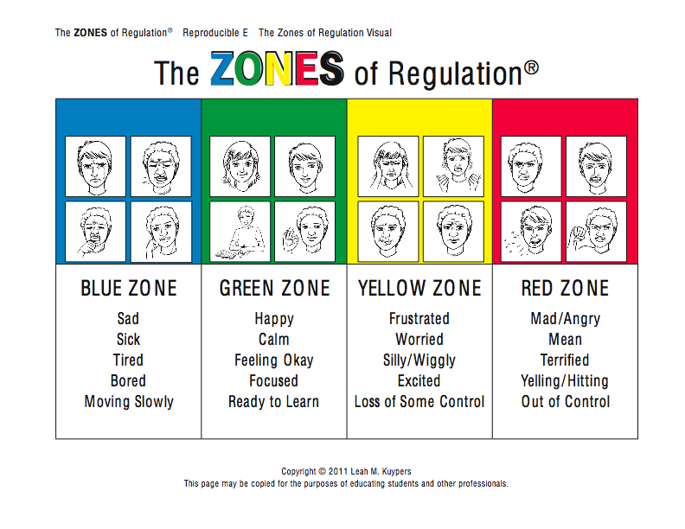
Jessica Faith, 2024

Slide 58



3 Point Scale
3
2
1
Jessica Faith, 2024

Slide 59
Co-Regulation: Calming Together
Regulation Through Relationship
Jessica Faith, 2024

Slide 60
“Take responsibility for the energy you bring into this space”.
-Dr. Jill Bolte Taylor
Jessica Faith, 2024

Slide 61

You cannot save someone from drowning if you don’t know how to swim
Regulate yourself first
Jessica Faith, 2024

Slide 62

What is co-regulation?
Involves the ability to utilize relationships to either stimulate or calm, keeping oneself inside the window of tolerance. (Koomar, 2009)
Requires one to model and influence arousal levels and emotional responses that are adaptive to the environment and specific demands.
Jessica Faith, 2024

Slide 63

Therapeutic Use of Self
“involves a planned interaction with another person in order to alleviate fear or anxiety, provide reassurance, obtain necessary information, provide information, give advice, and assist the other individual to gain more appreciation of, more expression of, and more functional use of his or her latent inner resources” (Mosey, 1986, p.199).
PHOTO: EMMA DARVICK
Jessica Faith, 2024
Notes:
It is not spontaneous, or unconscious but requires forethought – what the message will be and how you will get it across.

Slide 64
Regulation and the Brain
llPrefrontallCortex:ll
llLogic andll
llProblem Solvingll
BrainlStem/Diencephalon: l
Van Der Kolk, 2005
Jessica Faith, 2024
Notes:
Threat response flows from the brain stem, through the limbic system (processing emotion), up to the cortex. Body already reacting before cortex is aware that a possible threat is present.

Slide 65

Dr. Bruce Perry’s 3 R’s
Talk about it
Validate emotions
Use Body Tools and Co-Regulation
www.beaconhouse.org.uk
Jessica Faith, 2024

Slide 66

The Goldfish With the Shark Fin
“May we all spend the day looking for the goldfish, instead of punishing the shark.” -Stacey Gagnon.
Institute of Child Psychology

Slide 67
Dr. Bruce Perry’s Neurosequential Model in Education (NME)
“The Neurosequential Model in Education (NME) draws upon the NMT (a neurodevelopmentally-informed, biologically respectful perspective on human development and functioning) to help educators understand student behavior and performance.”
https://www.neurosequential.com/nme
Notes:
Four critical areas of brain functioning are also scored on the NMT metric: sensory integration, self-regulation, relational function, and cognition

Slide 68

The Conscious Dance
Monitoring the child’s affect, movement and engagement while adjusting your affect, movement, and engagement to guide the child towards positive outcomes.
*requires constant observation, analysis, trial, feedback and adjustment.
Jessica Faith, 2024

Slide 69
Monitor and Adjust Your...
Own state of arousal
Emotional response
Posture
Affect and facial expression
Eye contact
Voice volume, tone, rhythm, speed (...and content of speech)
Speed of movement and gestures
Breathing rate
Use of equipment
Jessica Faith, 2024

Slide 70
When a person in your care is dysregulated
Practice mindful attunement (calm yourself, leave your goals behind, focus on the person)
Analyze the emotion motivating the behaviour*.
Focus on up or down-regulation as required
Use calming or alerting voice, posture, affect, etc
Reduce or eliminate language
Use sensory-motor input
Only when individual is in an optimal state of arousal, do you use cognitive strategies and social thinking concepts (if age/developmentally appropriate)
*Look at the anger not the fact that the person is hitting. Look at the fear rather than the fact that the person is crying and avoiding. Which emotion is driving the behaviour?
Jessica Faith, 2024

Slide 71

(What are your triggers?)
Jessica Faith, 2024
Notes:
Collect and reflect.

Slide 72
-I’m disrespected
-Tight chest
-Stomach ache
-Hands shaking
-Deep breathing
-Meditation
-Lifting weights
-Walking
-Connecting with a loved one
-Camomile tea
-Hot bath
-Presenting a new topic
-Lifting weights
-Volleyball
-Dancing
-Walking
-Music
-Mint tea
-Coffee
-Singing
-Being with loved ones
-Connected with clients
-Meditating
-Relaxed body
-slower heart rate and breathing
-Heavy head
-Floppy
-Muscle ache
-I’m overworked
-Ignoring my needs
Jessica Faith, 2024

Slide 73

Jessica Faith, 2024

Slide 74
Case Study
Armand
3 years old
Hx of biting other kids
Screams or speaks loudly
Breaking toys
Toe walking
Mouthing non-edibles
Needs constant redirection
Attention issues

Slide 75

Questions and Comments
Contact Information: jessicafaith.ot@gmail.com
www.ellenyack.com

Slide 76
Audio Books, Podcast References and Online Articles
Neuroscience Meets Social and Emotional Learning Podcast EPISODE #52 inspired by Dr. Bruce Perry on “Igniting Your Personal Leadership That Builds Resiliency” https://andreasamadi.podbean.com/e/igniting-your-personal-leadership-that-builds-resiliency-inspired-by-dr-bruce-perry/
[iii] What Happened to You: Conversations on Trauma, Resilience and Healing https://www.amazon.com/What-Happened-You-Understanding-Resilience/dp/1250223180
[iv] Neuroscience Meets Social and Emotional Learning Podcast EPISODE #66 on The Legendary Bob Proctor on “Social and Emotional Learning: Where it All Started” https://andreasamadi.podbean.com/e/the-legendary-bob-proctor-on/
Neuroscience Meets Social and Emotional Learning Podcast EPISODE #53 Inspired by Dr. Bruce Perry on “Self-Regulation and Your Brain: How to Bounce Back Towards Resiliency” https://andreasamadi.podbean.com/e/self-regulation-and-your-brain-how-to-bounce-back-towards-resilience/
Neuroscience Meets Social and Emotional Learning Podcast EPISODE #56 with Educational Neuroscience Pioneer Dr. Lori Desautels on her NEW Book “Connections Over Compliance: Rewiring Our Perceptions of Discipline” https://andreasamadi.podbean.com/e/educational-neuroscience-pioneer-dr-lori-desautels-on-her-new-book-about-connections-over-compliance-rewiring-our-perceptions-of-discipline/
https://www.kimbarthel.ca/reflections/2023-02-calm-is-overrated

Slide 77
Websites
https://www.cdc.gov/ncbddd/actearly/milestones/index.html
https://fpg.unc.edu/sites/fpg.unc.edu/files/resources/reports-and-policy-briefs/PromotingSelf-RegulationIntheFirstFiveYears.pdf
https://fpg.unc.edu/sites/fpg.unc.edu/files/resources/reports-and-policy-briefs/Co-RegulationFromBirthThroughYoungAdulthood.pdf
https://www.pbs.org/parents/learn-grow/age-3/emotions-self-awareness
https://childdevelopment.com.au/areas-of-concern/sensory-processing/self-regulation/

Slide 78
Other References
Bar-Shalita, T., Vatine, J. J., & Parush, S. (2008). Sensory modulation disorder: A risk factor for participation in daily life activities. Developmental Medicine and Child Neurology, 50, 932–937. http://dx.doi.org/10.1111/j.1469- 8749.2008.03095.x
Cosbey, J., Johnston, S. S., & Dunn, M. L. (2010). Sensory processing disorders and social participation. American Journal of Occupational Therapy, 64, 462–473. http://dx. doi.org/10.5014/ajot.2010.09076
Craig, A. How do you feel? Interoception: the sense of the physiological condition of the body. Nat Rev Neurosci 3, 655–666 (2002). https://doi.org/10.1038/nrn894
Denham, S. A., Wyatt, T. M., Bassett, H. H., Echeverria, D., &amp; Knox, S. S. (2009). Assessing social-emotional development in children from a longitudinal perspective. Journal of Epidemiology and Community Health, 63(Suppl 1), i37–i52. https://doi.org/10.1136/jech.2007.070797
Dunn, W. (2007). Supporting children to participate successfully in everyday life by using sensory processing knowledge. Infants and Young Children, 20, 84–101. http://dx. doi.org/10.1097/01.IYC.0000264477.05076.5d
Dunn-Buron, K.& Curtis, M (2003). The Incredible 5-Point Scale. Shawnee Mission, KS:AAPC

Slide 79
Garcia-Winner, M.,Crooke, P., & Knopp, K. (2008) You are a Social Detective!: Explaining Social Thinking to Kids. San Jose, California: Think Social Publishing, Inc.
Kinnealey, M., Koenig, K. P., & Smith, S. (2011). Relationships between sensory modulation and social supports and health-related quality of life. American Journal of Occupational Therapy, 65, 320–327.
Kuypers, L. (2011). The Zones of Regulation: A Curriculum Designed to Foster Self-Regulation and EMotional Control. San Jose, California:. Social Thinking Publishing.
Mahler, K. (2018) The Interoception Curriculum: A Step-by-Step Guide to Developing Mindful Self-Regulation. Aapc Publishing.
Mahler, K. (2015). Interoception: The Eighth Sensory System. Aapc Publishing.
Shanker (2013) Calm, Alert, and Learning: Classroom Strategies for Self-Regulation. Don Mills: Pearson Canada Inc.
Van Der Kolk, B. (2015). The Body Keeps the Score: Brain, Mind and Body in the Healing of Trauma. Penguin Books.
Williams, M. & Shellenberger, S. (1994) “How Does Your Engine Run?”: A Leader’s Guide to The Alert Program for Self-Regulation. Stillwater: PDP Press.
Zareyan et al., (2021). First Demonstration of Double Dissociation between COMT-Met158 and COMT-Val158 Cognitive Performance When Stressed and When Calmer. Cerebral Cortex, 31: 1411–1426. Oxford.

