Slide 1
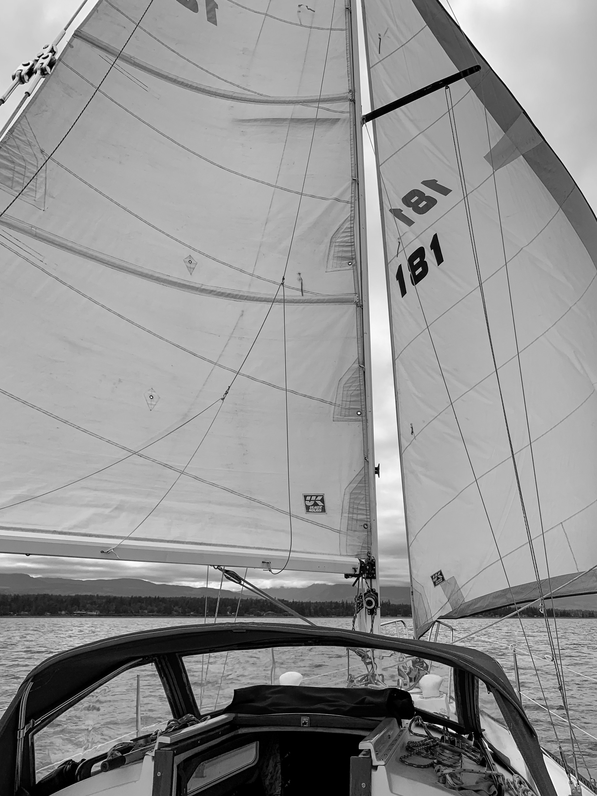
19 Wing Comox Yacht Club
Annual General Meeting
22 Feb 2023

Slide 2
Agenda
Introductory Remarks
Establishment of a quorum
Introduction of Executive
Approval of Agenda and previous Minutes
Proposed changes to Constitution and By-Laws
Treasurer’s Report – Budgets
Division Reports
Strategic Plan
Election of Executive
Open Discussion
Adjournment

Slide 3
Quorum

Slide 4
Introduction of Executive
Commodore – LCol Fil Bohac
Vice Commodore* - (Capt John Cloke)
Treasurer – MCpl Shannon Green
Secretary – Sgt Derrick Mondry
Membership Officer* - Mr. Tim Williams
Rear Commodore – Mr. James Hollis
Keelboat Captain* - Mr. Roch Massicotte
Dinghy Captain* - Maj Kevin Stevens
Paddlesports Captain – Mr. Graham Edwards
Foreshore Officer* - Maj Brett Banadyga
Training Officer – Mr. Marcel Rivest
Communications Officer† - Mr. James Hollis (appointed)

Slide 5
Agenda and previous Minutes
Last AGM – 23 Feb 22
No Open Actions
Vote 1

Slide 6
Proposed changes:
Constitution and By-Laws
Proposed wording distributed and posted in Jan 23
1 x Constitution amendment; 4 x By-Laws amendment
Constitution
1. Article V – Membership – para 7:
  pro-rated membership as of 1 Sep;
  Membership info (new/update) and payment both required

Slide 7
Proposed changes:
Constitution and By-Laws
By-Laws
1. Para 16 – Fees
  Fees to be set by Executive for course, rental, and berthage based on in-year cost changes. Membership vote required to change membership fees.
2. Para 43 – Berth Allocation points
  Change collection dates to align with membership year (1 April to 31 March)
  Do not allocate points for participating in social events
3. Para 58 – Rentals
  Add a minimum age of 16 to sign out a kayak, SUP (or Keelboat) without adult present
4. Para 42 – Berth Allocations
  Add a requirement for a Safety Inspection, in addition to proof of ownership and Liability Insurance.
Vote 2

Slide 8
Treasurer’s Report: FY22/23
 | 22/23 budget | 22/23 actual
Memberships | $ 12,000.00 | $ 16,623.61
Programs | $ 7,300.00 | $ 5,428.68
Rentals | $ 12,650.00 | $ 7,202.51
Berthage | $ 5,500.00 | $ 3,631.71
Revenue Sub-Total | $ 37,450.00 | $ 32,886.51
Depreciation | $ 16,171.32 | $ 15,116.92
Entertainment | $ 4,500.00 | $ 955.76
Programs | $ 5,720.00 | $ 260.00
Maintenance - Keelboats | $ 5,500.00 | $ 4,806.29
Maintenance - Paddlesports | $ 2,000.00 | $ 2,192.45
Maintenance - Dinghies | $ 600.00 | $ 118.32
Misc (Fees, utilities, supplies, telecom, reciprocals, etc) | $ 10,730.00 | $ 3,679.54
Expenses Sub-Total | $ 45,221.32 | $ 27,129.28
TOTAL | $ (7,771.32) | $ 5,757.23
Notes:
Programs = non-keelboat ‘rental’ fees, and BCC in/out

Slide 9
Treasurer’s Report: FY23/24
 | 22/23 budget | 22/23 actual
Memberships | $ 12,000.00 | $ 16,623.61
Programs | $ 7,300.00 | $ 5,428.68
Rentals | $ 12,650.00 | $ 7,202.51
Berthage | $ 5,500.00 | $ 3,631.71
Revenue Sub-Total | $ 37,450.00 | $ 32,886.51
Depreciation | $ 16,171.32 | $ 15,116.92
Entertainment | $ 4,500.00 | $ 955.76
Programs | $ 5,720.00 | $ 260.00
Maintenance - Keelboats | $ 5,500.00 | $ 4,806.29
Maintenance - Paddlesports | $ 2,000.00 | $ 2,192.45
Maintenance - Dinghies | $ 600.00 | $ 118.32
Misc (Fees, utilities, supplies, telecom, reciprocals, etc) | $ 10,730.00 | $ 3,679.54
Expenses Sub-Total | $ 45,221.32 | $ 27,129.28
TOTAL | $ (7,771.32) | $ 5,757.23
 | 23/24 budget
 | $ 13,000.00
 | $ 8,400.00
 | $ 10,100.00
 | $ 5,900.00
 | $ 37,400.00
 | $ 15,000.00
 | $ 4,500.00
 | $ 5,800.00
 | $ 5,500.00
 | $ 3,500.00
 | $ 1,000.00
 | $ 10,590.00
 | $ 45,890.00
 | $ (8,490.00)
Vote 3

Slide 10
Treasurer’s Report - Balance
Unencumbered Balance: $203K
  Growing every year
  Intend to benefit membership
Capital expenses (via CER) will be added to the final budget

Slide 11
Treasurer’s Report - Capital
Closed CERs (BBQ, dishwashers)
Extant CERs
  Peter Duck Engine Replacement ($24K)
  Sea-Can Storage Container ($5K) - increase value to $10K
  Replace patio furniture (Exec)
  Lightweight Kayaks (Exec)
  Inflatable Tenders for Keelboats (Exec)
Proposed Capital Expenditures
  Awning for Clubhouse
    Commercial grade; Motorized / wind sensor
    Plan to recapitalize in ~7 years
    Estimated $5-7K plus installation;
    Endorse $10K expenditure
  Trailer for Kayaks; Endorse $5K expenditure
  New Vessel (discussed later)
Vote 4

Slide 12
Membership
Number of memberships = 217
Number of members = 445
  Associate: 16 (+2)
  Honourary: 2
  Ordinary: 10
  Regular: 189
Member Info Collection
  Renewal – only verify info and change if necessary
  New – fill out electronic form
Payment
  Direct to PSP via Credit/Debit
  In mid-March for 1 April membership year

Slide 13
Division Report:
Rear Commodore
Clubhouse use:
  20 external events (RCMP, RCM-SAR, 4 CRPG, 19 AMS, 21 CF H Svcs …)
Clubhouse status/issues
  New roof by RP Ops
  Ongoing maintenance support
New commercial BBQ
  Fully Operational with 400lb propane tank
  Patio slab and hookup by RP Ops
  Secured in storage shed when not in use (keys with Bartender)
New Dishwashers – arriving end Feb

Slide 14
Division Report:
Keelboat Captain
Maintenance
  All boats are safe and serviceable for training and rental use.
  Maintenance is an on-going process, repairs and upgrades implemented as required.
‘Work party’ – good theory, hard to implement
Structural change needed in the Division

Slide 15
Keelboat: proposed restructure
Keelboat Capt
Booking OPI
Asst Keelboat Capt
Peter Duck
Wildside
A. The Wind
Maint OPI
Maint OPI
Maint OPI
Maint Asst
Maint Asst
Maint Asst
More than ‘Work Party’, less than full-time boat work
Requires Volunteers! Minimum of 6 to be sustainable.

Slide 16
Usage Stats
 | 2022 Training | 2022 Rental | 2021 Training | 2021 Rental
Mar | 13 | - | - | -
April | 46 | - | - | -
May | 38 | 3 | - | 10
June | 9 | 4 | - | 7
July | - | 26 | - | 18
August | - | 34 | - | 35
September | - | 12 | 25 | 16
October | - | - | 28 | -
November | - | - | - | -
December | - | - | - | -
Total | 97 | 72 | 53 | 86
Grand Total | 169 sorties | 169 sorties | 139 sorties | 139 sorties
Peter Duck: 97 | Against the Wind: 58 | Wild Side: 30
Notes:
Training: Peter Duck 58, Wild Side 23, Against the Wind 25 (106)
Rental: Peter Duck 39, Wild Side 7, Against the Wind 33 (78)
Usage per boat: Peter Duck 97, Wild Side 30, Against the Wind 58 (185)

Slide 17
Division Report:
Foreshore Officer
Currently 23 vessels on docks (7 + 16)
Change to berthage fees
  Three-tier vice ‘by the foot’ → allows payment at PSP
  < 30’: $209.52+GST = $220
  31-40’: $261.90+GST = $275
  > 40’: $338.10+GST = $355
Additional inspection requirement
  Intentionally left open
  Inspection available for free from RCM-SAR
  Mass Inspection for current boats
  Validity period to align with flares (4 yrs)

Slide 18
Division Report:
Foreshore Officer
Berthage Application Dates
  Current dates are not specified, but standard has been August for September
  Effectively members secure berthage ‘just in time’
  Propose earlier timeline:
    applications accepted 1 March to 30 April
    Berthage assigned by 31 May for 1 September occupancy
    Several spots held in reserve for posted-in members
Berthage scarcity could become an issue – rely on volunteer points

Slide 19
Division Report:
Training Officer
Basic Cruising Course
  1 April to mid-June
  24 Students
  Course fee increase due to cost increase
Advanced Course / Tech Nights
  “Beyond the Bay” – anchoring, weather, charts
  Free
  Non-certified
  Multi-day rentals only for those who have the course or equivalent experience

Slide 20
Division Report:
Dinghy Captain
37 Dinghy members; 8 new personnel trained in 2022.
Purchased two new Club 420s in 2019
  2 boats on docks
  2 older hulls on land for rigging training
Purchased two new covers (winter/summer)
Recapitalization of lines and sheets this spring
Currently providing rigging ‘how-to’ and basic familiarization
Plan to provide more formal instruction
Desire to participate in fun races with CBSC

Slide 21
Division Report:
Paddlesports Captain
Kayaks: 16 Singles, 2 doubles, 1 ‘play double’
SUPs: 3 solid, 8 inflatable
Accessories – recapitalize, PFDs, throw bags …
New procurement:
  Lightweight Double
  Lightweight Single
  Storage Container for kayaks – procure and site
  Trailer being investigated
Local Use only for now

Slide 22
Division Report:
Paddlesports Captain
Training
  4 pool sessions April/May
  Summer training at QUADRA
  Advanced training available
Events
  Keelboat & Kayak BBQ at Tree Island
  ‘Paddle & BBQ’ weekends
Assistant Paddlesports / Event Coord volunteer needed!

Slide 23
Division Report:
Communications
Website
  Re-generated ‘from scratch’ by CommsO – CMS change by PSP
  New site is feature-rich and has a superior experience
  Endeavour to maintain up-to-date:
    Contact info
    Constitution and Bylaws
    Membership forms and info
    Executive meeting minutes
Facebook
  Members-Only closed group
  Build sense of community
  Events, activities, requests for volunteers
Email Newsletter

Slide 24
Volunteer of the Year
2022
Mike Vattheuer
Member since 1992
Owner: Magnetic Attraction (Yamaha 33)
Notes:
Mike’s knowledge in the care and handling of the sailboats after use gave him his reputation.
Line handling, proper use and to stow them away after docking was his signature. Mike
volunteer over 80 hours last summer as a Bosun always making sure the vessels were put to
bed accordingly. He carried out over 80 after use inspections of the rental vessels and provided
support with Keelboat Maintenance when needed. Mike has been an asset to 19 Wing Comox Yacht
Club.

Slide 25
Strategic Plan
Survey Results:
  25 responses, new and long-time members
  Paddlesports and Keelboat members represented
  Highlights:
    Interest in larger cruising sailboat
    Interest in organized events (paddle, sail)
    Opportunity to crew for trip/racing
    BBQs tied to events (paddle, sail)
“Make it more of a club instead of a rental agency that has TGIFs”

Slide 26
Strategic Plan
Recapitalize Keelboats, better serve membership desires
  Purchase 35-40’ Keelboat (with a wheel)
  Dispose of ‘duplicate’ sized Keelboat (Wild Side?)
  Purchase small day-sailer?
Increase events based on on-water activities
  Dinghy
  Paddlesports
  Keelboat
Promote volunteer engagement
Promote sense of pan-club community – free BBQs, events, activities
Membership endorsement of expenditure up to $75K to procure a larger cruising vessel, following disposal of one club keelboat.
Vote 5

Slide 27
Election of Executive
Commodore – LCol Fil Bohac
Vice-Commodore – Maj Kevin Stevens
Treasurer – MCpl Shannon Green
Secretary – Sgt Derrick Mondry
Membership Officer - Ms. Paulette Hendry
Rear Commodore – Mr. James Hollis
Keelboat Captain - Maj Ian Golding
Dinghy Captain - MCpl Andrew Fraser
Paddlesports Captain – Mr. Graham Edwards
Foreshore Officer – Mr. Al Phillips
Training Officer – Mr. Marcel Rivest
Communications Officer† - Mr. James Hollis (appointed)
Vote 6

Slide 28
Open Discussion
Items from the membership

Slide 29
Closing Remarks

Slide 30
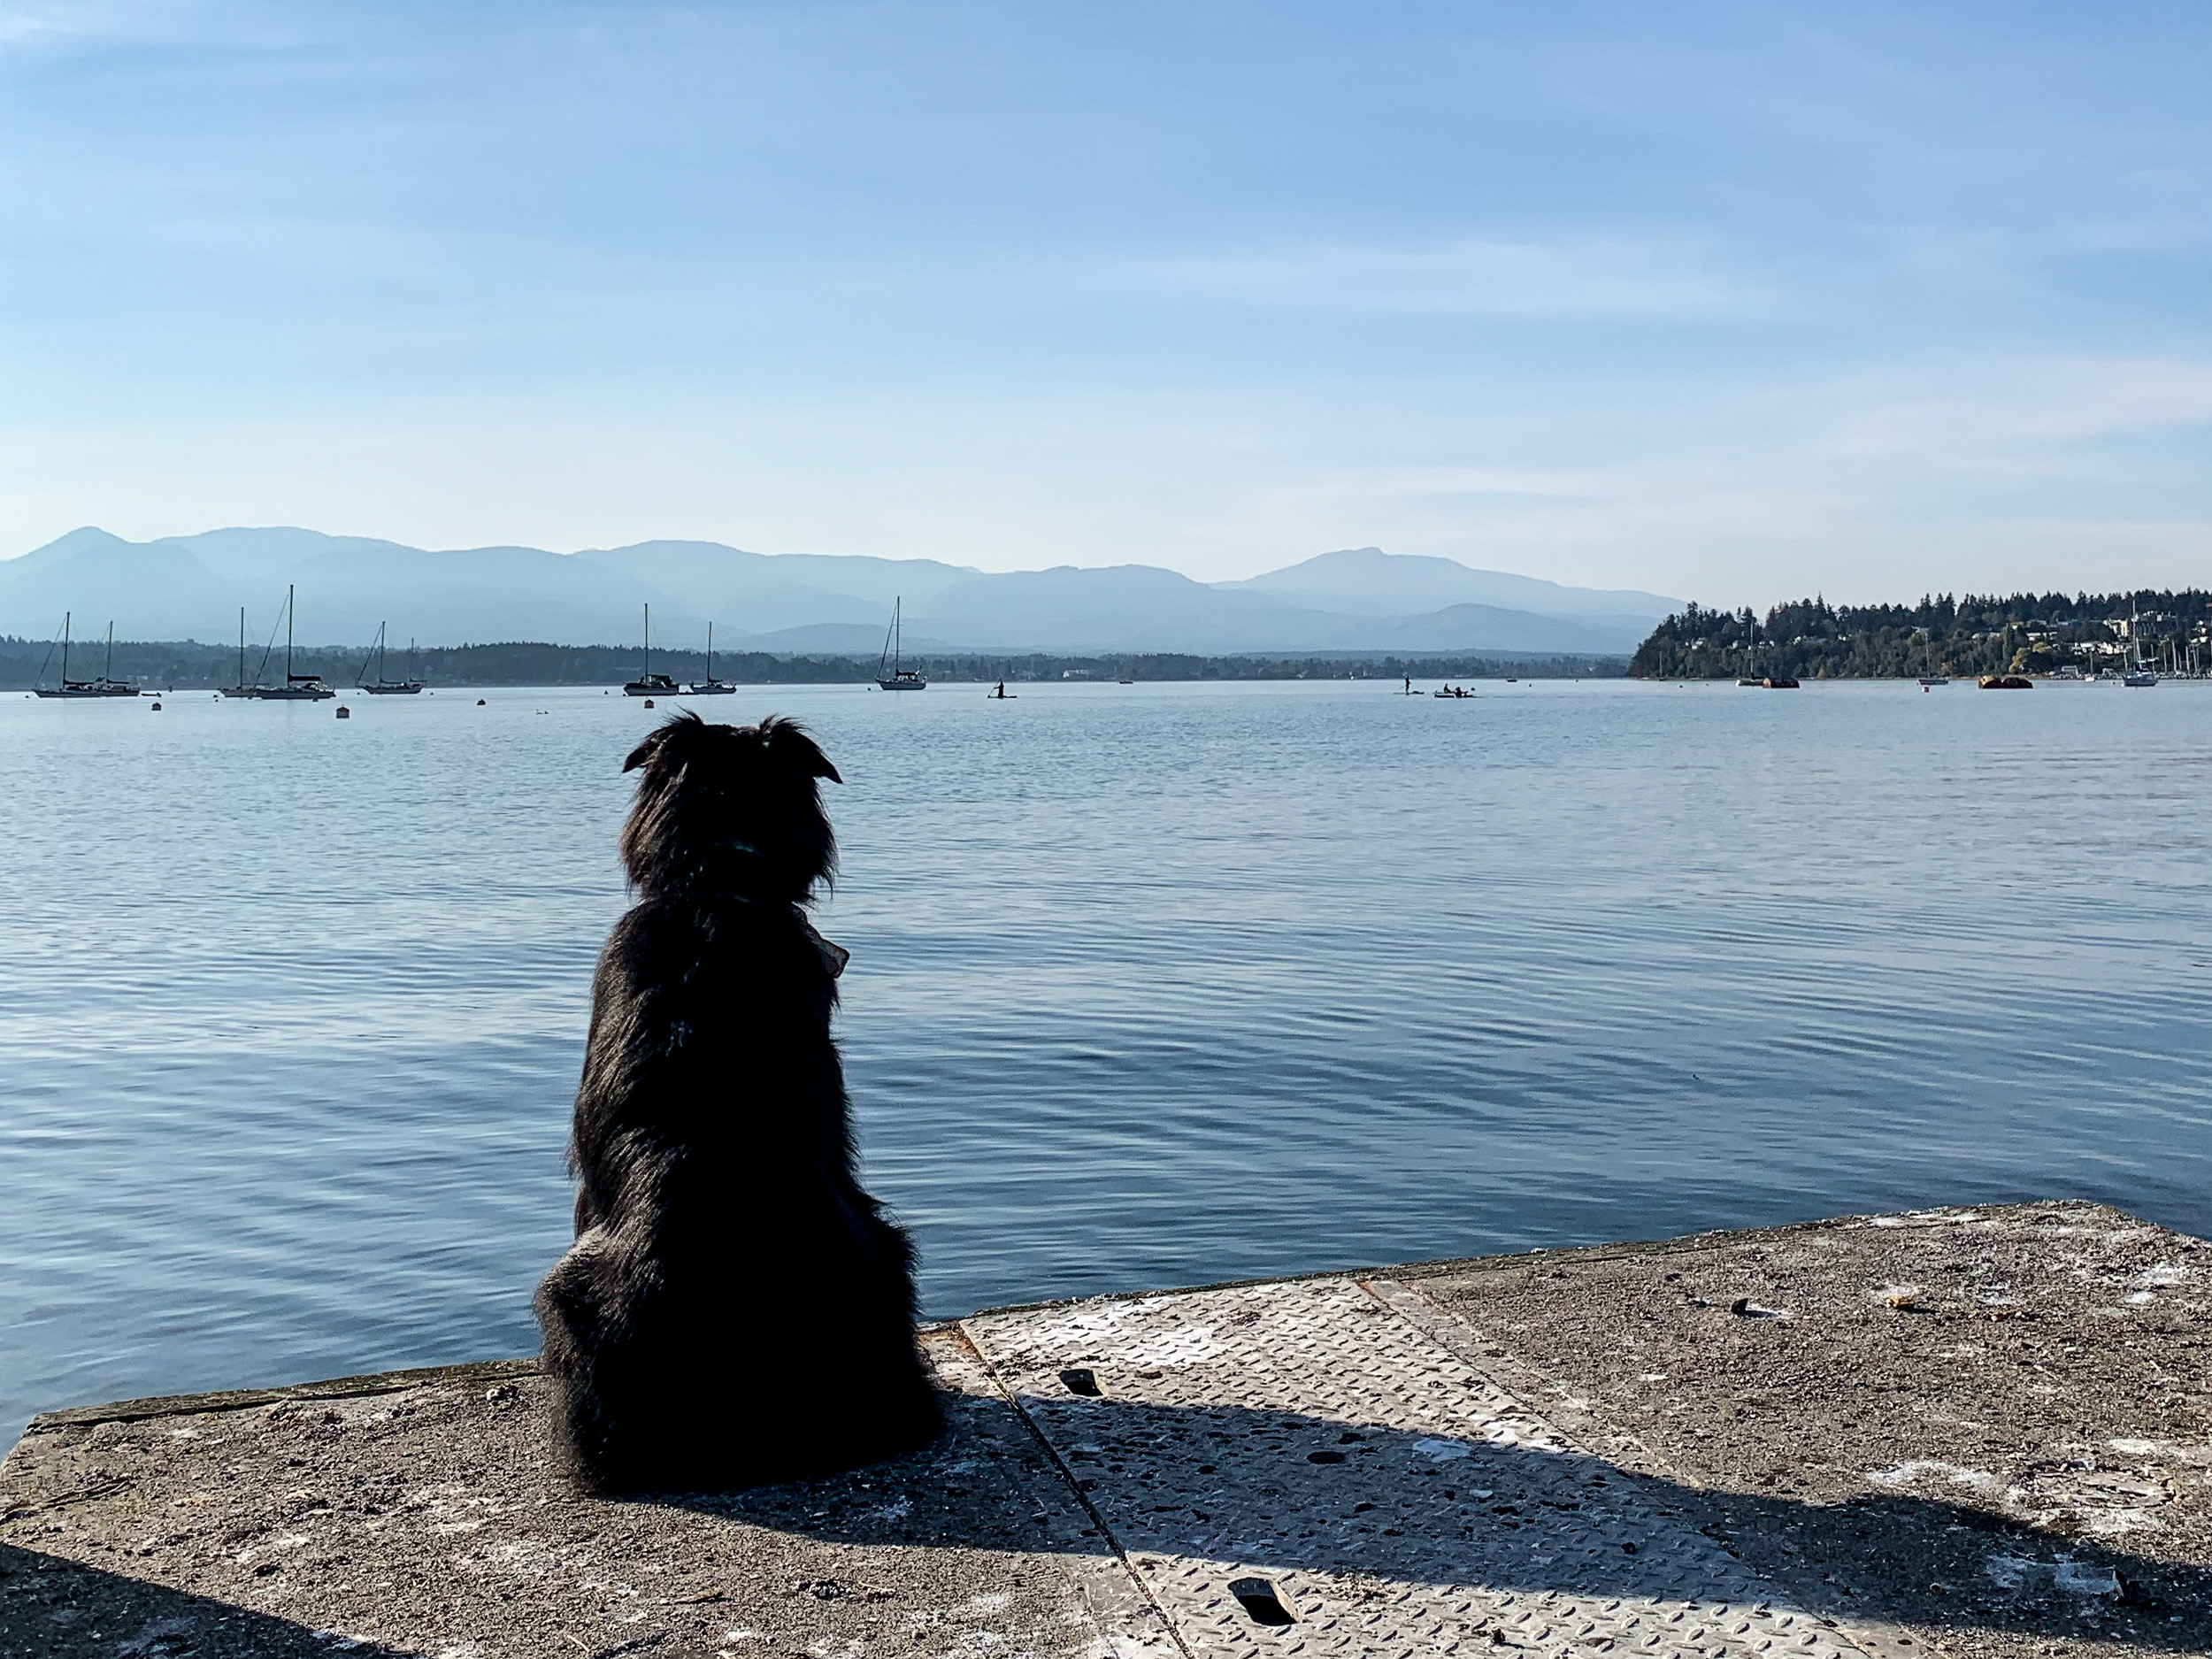
Adjournment

