Slide 1
Alcohol, Other Drugs, Gambling and Gaming Awareness
Supervisor Training: Day Two

Slide 2


Overview of Day
Check-in
Review of Objectives
Notes:
Course Objectives
Refer to AODGA ST Supervisor Pre-Read document for a list of the Objectives:
After completing this program participants will be able to:
1. Recognize the signs and symptoms of alcohol/other drug use and gambling;
2. Apply DND policies on alcohol, other drugs and/or gambling;
3. Understand the role of the supervisor in promoting an addiction-free work environment, and
4. Develop strategies to support an addiction-free work environment.

Slide 3


Slide 4
What are the qualities/characteristics of an effective supervisor?
Notes:
Ask participants to think of the best supervisor they ever had (military or civilian).
Ask them to share what characteristics their supervisors had that made them excellent supervisors. Facilitator flip charts answers.
Debrief: Ask participants how many of these characteristics they feel they have. How many of these characteristics would their subordinates say the have?
Wrap-up with commenting on how many of these characteristics are related to good communication. To be an effective supervisor, you must be a good communicator.
Review handout on Communication Skills from pre-read

Slide 5
Active Listening
Interview Tips:
  Use “I” statements
  Mention observable behaviour to be corrected
  Be assertive, not aggressive
  Be firm, but fair
  Be open-minded
  Open and Closed Ended Questions
Notes:
Refer participants to the Homework Activity ``Are you an Active Listener?`` .
Group Activity: Romeo and Juliet (found in Handout Folder) Purpose of the activity is to reinforce positive communication skills.
Participants will practice open and closed-ended questions and will learn how assumptions can skew their ability to be objective.
Source:
DRC, DND.

Slide 6
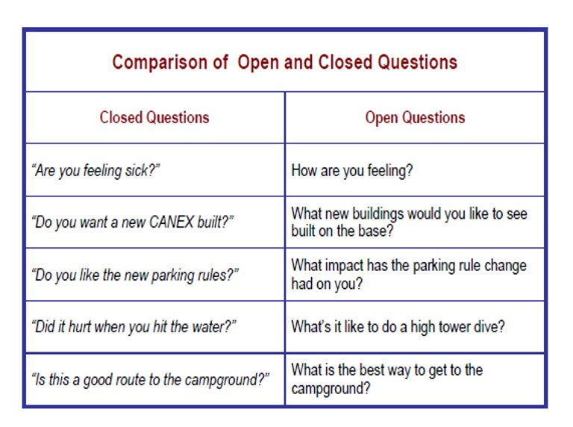
Open and Closed Questioning
Open
Closed
Notes:
Refer participants to the Homework Activity ``Are you an Active Listener?`` .
Group Activity: Romeo and Juliet (found in Handout Folder) Purpose of the activity is to reinforce positive communication skills.
Participants will practice open and closed-ended questions and will learn how assumptions can skew their ability to be objective.
Source:
DRC, DND.

Slide 7

Activity
Romeo & Juliet
Notes:
Refer participants to the Activity ‘Are you an Active Listener?’” which was assigned at end of Day 1. Highlight key areas.
Group Activity: Romeo and Juliet
Purpose of the activity is to reinforce positive communication skills.
Participants will practice open and closed-ended questions and will learn how assumptions can skew their ability to be objective.
Source(s):
DRC, DND.

Slide 8
BREAK

Slide 9
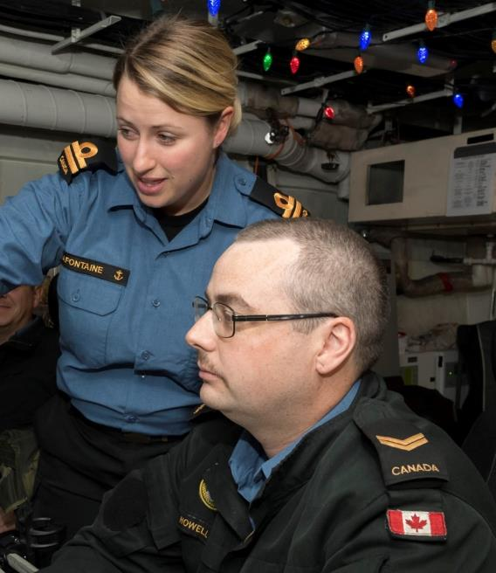
Responsibility of Supervisors
Aide Memoire for the supervisor’s role in dealing with alcohol misuse and illicit drug involvement.
Notes:
Underline the importance of using the Aide Mémoire for the Supervisor’s Role in Dealing with Alcohol Misuse and Illicit Drug involvement (A-MD-050-AAP/AG-003 DPHP 2012):
A guide for supervisors to follow when substance misuse is suspected or encountered in the workplace.
Handout:
Aide Mémoire for the Supervisor’s Role in Dealing with Alcohol Misuse and Illicit Drug involvement (A-MD-050-AAP/AG-003 DPHP 2012)

Slide 10
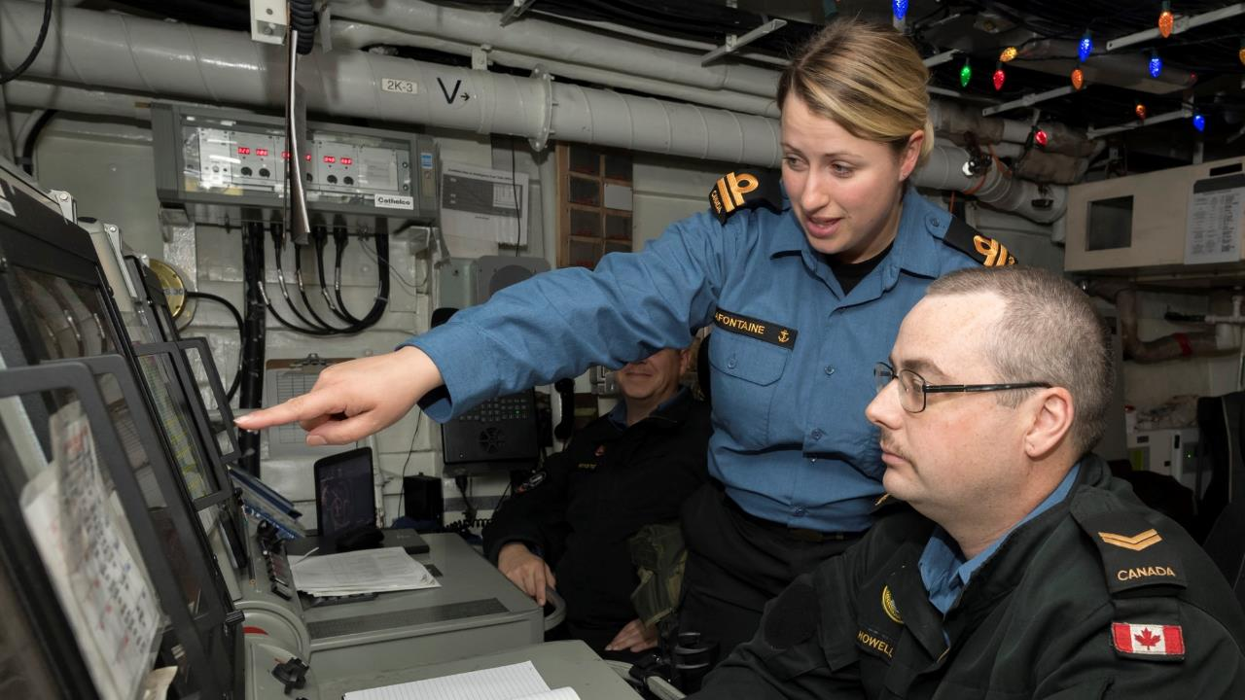
Step 1
Step 3c
Supervisor Process
Step 2
Step 3d
Step 3a
What is it?
Step 4
Step 3b
Step 5
Notes:
TEAM ACTIVITY
Purpose of Activity
This exercise provides the structure and process for supervisors to use when they intervene in cases of deteriorating performance due to substance misuse.
Prepare 5 flip chart pages… each with one of the Supervisors’ Process steps written at the top. Post them at various locations around the room. Break the group into 5 smaller groups. Depending on time, either assign each group one step to complete or rotate the groups around to all 5 flipcharts and have them add to each one. The task description for each step is listed below. At the title slide for each step (in upcoming slides), ask the related small group to present / discuss the items on their paper.
Use Slide 51 to 64 fill in gaps.
Recognition: How would you, as a supervisor, recognize that a member/employee may be problematically involved with alcohol, other drugs and/or gambling? (i.e., warning signs, information, incidents, etc.)
Example: A supervisor ought to pay attention to warning signs such as absenteeism. Other warning signs could include witnessing deteriorating work performance, incidents of drunkenness at celebrations, and other ‘red flags’ that a problem may exist
Documentation: As a supervisor, what might you need to document in the event that you have recognized a potential problem involving alcohol, other drugs and/or gambling? How and where would you document it? Who sees the documentation? How might the documentation be used?
Example: Supervisor’s need to document issues related to job performance. Decreased job performance concerns may show up before visible signs of substance misuse. Tracking performance enables a supervisor to begin to see these patterns such as absenteeism. Documenting incidences of poor performance is critical as it may be used as evidence in the future.
Interview: As a supervisor, what do you need to do to prepare for and conduct an interview related to a member’s/employee’s potential or actual involvement with alcohol, other drugs and/or gambling?
Example: When preparing for an interview with a subordinate, it is important to be organized. Have your fact sheet comprised from documented notes prepared ahead of time regarding the member’s performance. Use ‘I’ statements and only deal with observable facts. Be firm, assertive and fair.
Referral: Who would and/or could you, as a supervisor, refer the member/employee to in a situation involving alcohol, other drugs and/or gambling? What requirements are there for referral? How would you make the referral(s)?
Example: As a supervisor, you are in a position to refer employees to resources that can support them to do their job more proficiently. If you have information, knowledge or suspicion that a member has a problem with substances, refer him or her for professional assessment or support. The referral process enables you to maintain your ‘boundaries’ as a supervisor but also demonstrates your concern for the wellbeing of the individual, his/her family as well as the unit as a whole.
Follow-up: To minimize the potential for relapse, how would you, as a supervisor, follow-up with the member/employee? Are there any requirements for follow-up? If so, what are they?
Example: It is important to provide members with support once they return from treatment or help for a substance abuse issue. As a supervisor, you can change activities within the workplace so that extra curricular activities are not always geared towards drinking events. Think about ways you can reduce the over reliance on activities that are associated with drinking.

Slide 11

Step 1
Recognition
The following provide additional ways to recognize a substance use issue:
Voluntary
Behaviour / Job Performance
Drug Testing
Aide Memoire (pg. 4-5)
Notes:
The Aide Memoire notes 4 issues in regard to recognizing substance misuse:
supervisor as the expert regarding job performance;
typical signs of substance abuse;
recognition and the Supervisor’s notebook process;
steps in developing a notebook.
The following offer other ways supervisors may become aware of substance use:
There are three ways that a substance use problem may be recognized:
1.The member may acknowledge that they have a problem and seek help. Awareness and education helps to remove the obstacles to seeking help, namely, lack of awareness of the help available, and the shame that keeps one in denial.
2. A supervisor and/or other members may notice changes in behaviour and job performance. As a supervisor, it is not your job to diagnose or solve a member’s/employee’s personal problems, but it is part of your responsibility to ensure that your work environment is safe for yourself and the rest of your team. A co-worker who is under the influence of a drug could be a safety hazard, and certainly a co-worker who has a substance abuse problem poses a higher safety risk, not to mention they may have performance problems that create stress for the rest of the team (refer to “Typical Signs” in Aide Memoire, page 4; “job performance”, and the handout “Potential Indicators of Substance Abuse” for examples of signs).
3. Drug testing may identify that someone is using substances and may have a substance use problem.
Source(s):
DFHP (2012) Aide Memoire, p. 4-5.

Slide 12
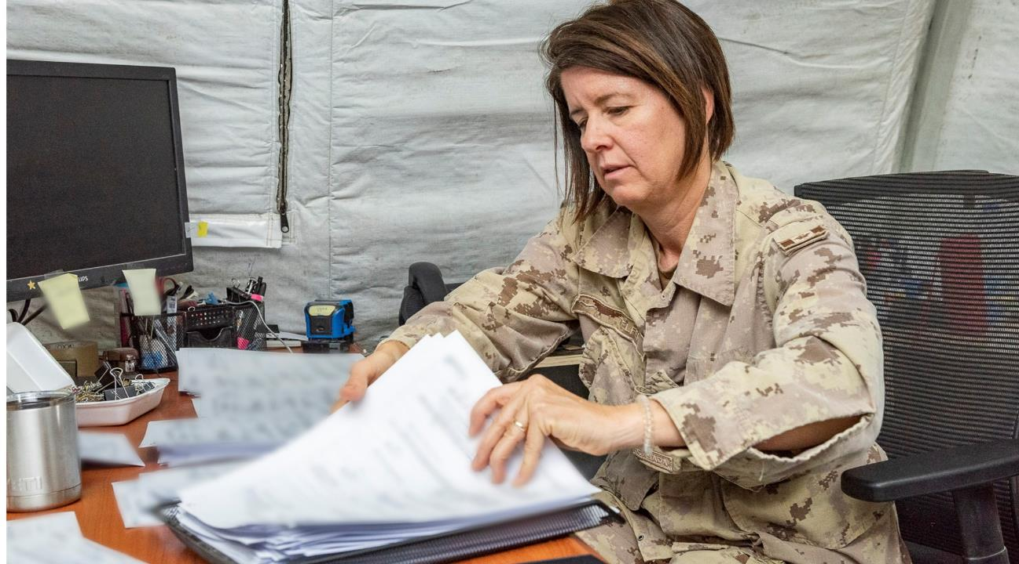
Step 2
Documentation
Poor Performance
Incidences
Patterns of Deterioration
Early Intervention
Fact Sheet
Aide Memoire (pg. 6-7)
Notes:
Note: click to reveal each of the steps.
The following outlines the process for supervisors to document and address disciplinary action:
a) Whenever there is poor performance and/or unacceptable behaviour related to substance misuse, the supervisor should, at the earliest opportunity, discuss each incident with the member. See DAOD 5019-3 or 5019-7 to determine if there is an obligation to report.
b) If it is an isolated incident, then giving immediate feedback may be enough to correct the matter. Where it is not, the supervisor should start a record of each incident which clearly documents the time, place, and circumstances around the performance shortcoming.
c) This record will clearly show the “pattern” of deteriorating work performance/concerning behaviour and/or unacceptable behaviour. The documentation of each incident may later become the basis of a Statutory Declaration or Affidavit which can be used in disciplinary action if the member’s CO decides to proceed in that manner.
d) The key to dealing successfully with any concern of substance misuse is early intervention. Often this is enough to stop a problem from becoming even larger for the individual in question. Avoid procrastination! Early intervention is most effective. Remember, as a supervisor, you have an obligation to act.
e) The documentation of each incident will later become the Fact Sheet in the initial interview.
There are two types of documentation: informal (for your own records) and formal (to communicate to others within the organization). The value of keeping informal records is that you can be more specific when you confront a member, noting patterns in behaviour, etc. (refer to Aide Memoire, pages 4-8).
Source(s): DFHP (2012) Aide Memoire, p. 6-8.

Slide 13
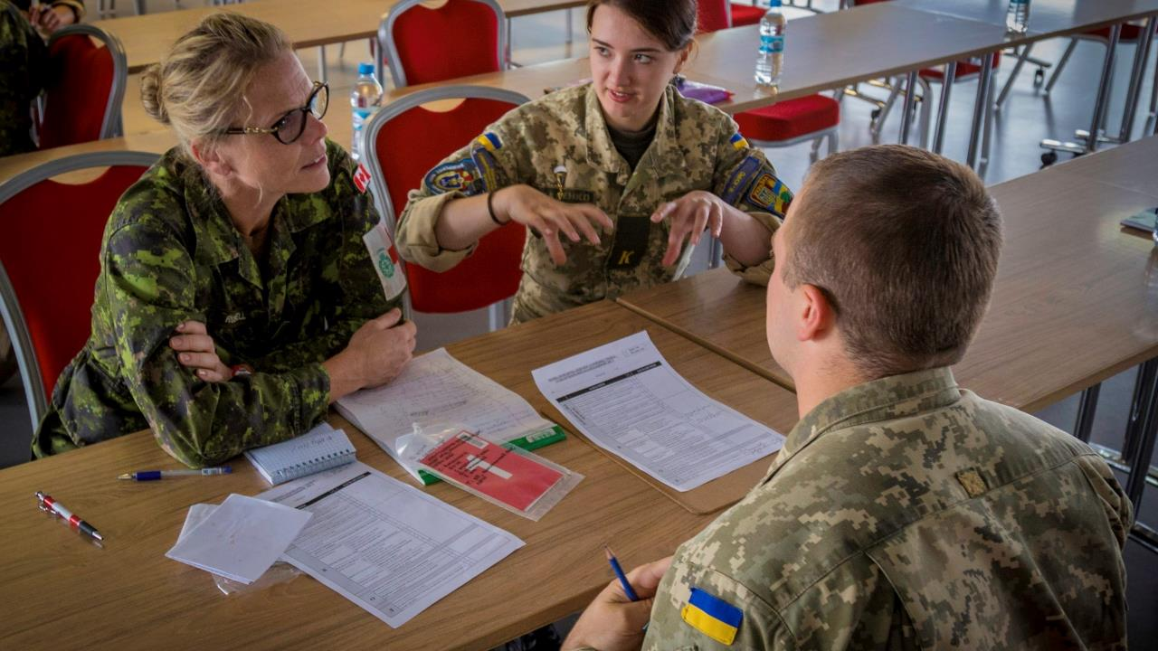
Step 3a
Interviews
Should employ a similar framework of four stages
Preliminaries
Review documentation:
  observations, concerns from other members,
  informal discussions with member.
Consult with MO, B/WAC, Mental Health and DMCA.
Create outline script to ensure that you cover key points.
Preliminaries
Opening
Problem-solving
Conclusion
Aide Memoire (pg. 8-10)
Notes:
In accordance with DND Policy, the supervisor will be required to intervene formally at the Initial Counselling, Recorded Warning, and Counselling and Probation stages.
All three interviews should employ a similar framework of four stages:
Preliminaries. Information gathering, consultation, and fact sheet preparation prior to interview.
Opening. Briefly greet, state purpose (discuss poor work), alcohol misuse, state goal, find acceptable solution.
Problem-solving. Discuss pattern of poor performance, problem areas (e.g. lateness, smell of alcohol), give exact examples of related incidents from fact sheet to illustrate each area, and discuss ways to resolve problem areas.
Conclusion. Restate key areas and what subordinate must change and even if they do not agree, offer help. Set a time to review progress (for initial and recorded warning interviews). For referral interview, stress that referral is a positive move designed to determine whether a different type of help is required.
In order to effectively respond to alcohol, other drugs, and gambling problems, supervisors must have good communication and interviewing skills.
These skills will not only help in dealing with problems, they will also help to prevent many problems from escalating in the first place through what is often referred to as supportive management. For example, in workplaces where employees feel heard and appreciated, there are half as many substance use problems.
Preliminaries. Information gathering, consultation, fact sheet preparation prior to interview.
It is necessary to emphasize the importance of preparation in order to keep the discussion focused and objective. For example, it is not enough to simply tell the member that you have noticed a deterioration of their job performance. You must be able to give concrete examples that include the date, behaviour and circumstances.
Refer to the document “Differences between Civilian and Military” ( found in activity folder) to highlight differences in interview approaches.
Here are a few things to keep in mind when conducting an interview.
Refer to “Interview Tips: How to Confront” (found in pre read ) for additional tips.
Source(s):
DFHP (2012), Aide Memoire, p. 8-10

Slide 14
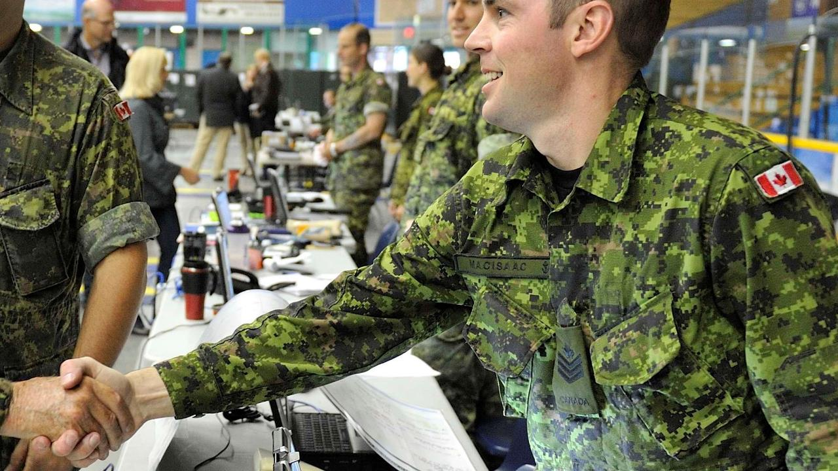
Step 3b
Interviews
Opening
Briefly greet.
  State purpose (discuss poor work performance) alcohol misuse.
  State goal.
  Stress confidentiality.
“Mary, I know work is busy, so I won’t take up too much of your time. I have a few concerns with your job performance that I wanted to chat with you about. I would like to discuss it with you so that we can work together to get it back to what it used to be.”
Notes:
Note: click to reveal each of the steps.
Opening.
Briefly greet, state purpose (discuss poor work performance), alcohol misuse, state goal, stress confidentiality.
It is important to begin with a statement of observation that is specific, concrete, and focuses on outward behaviour and job performance, and not on personal qualities. It is very important not to attempt to explain or “fix” the behaviour, but to express one’s concern and emphasize that the purpose of the meeting is to work together to find a solution, and that confidentiality will be upheld according to CAF policy.
Example:
Supervisor: ”Mary, I know you’re busy, so I won’t take up too much of your time. I have a few concerns regarding your job performance that I wanted to chat with you about. I would like to discuss it with you so that we can work together to get it back to what it used to be.”
Source(s):
DFHP (2012), Aide Memoire, p. 9.

Slide 15

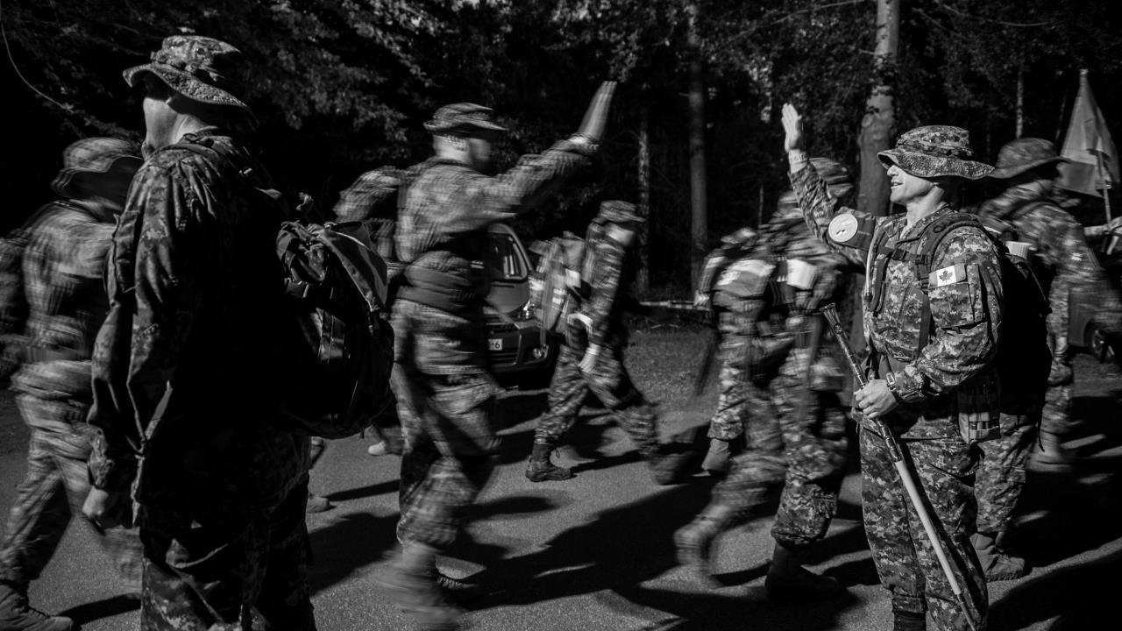
Step 3c
Interviews
Problem solving
Deal with one problem at a time.
Make your expectations clear.
Remind the employee/member that help is available.
Encourage the employee/member to brainstorm for solutions with you.
Document any decisions.
“I’ve noticed over the past few weeks that you appear to be more withdrawn. At our team meetings, it seemed to me that you’re not asking questions, like you usually do, or making some of your witty comments. Normally you never make mistakes and have one of the best attendance records, but lately I have noticed a few mistakes in your reports and an increase in absences from work, which is not like you. Can you tell me more about that?
Notes:
Note: click to reveal each of the steps.
Problem-solving.
The third stage is to find solutions. It is best if you can get the member/employee to come up with a solution, since they will be more likely to implement it if it is their own.
Discuss pattern of poor performance, problem areas (e.g. lateness, smell of alcohol), then give exact examples of related incidents from fact sheet to illustrate each area, and discuss ways to resolve problem areas.
It is important to balance clear expectations with understanding and support.
Example:
Supervisor: ”I’ve noticed over the past few weeks that you appear to be more withdrawn. At our team meetings, it seemed to me that you’re not asking questions, like you usually do, or making some of your witty comments. Normally, you never make mistakes and have one of the best attendance records, but lately I have noticed a few mistakes in your reports, and an increase in absences from work, which is not like you. Do you have any ideas why?”
Source(s):
DFHP (2012), Aide Memoire, p. 10

Slide 16
Step 3d
Interviews
Conclusion
Summarize what was agreed upon.
Schedule a follow-up interview to monitor progress.
Discuss indicators of improvement.
Agree to celebrate positive behaviour and not to make concessions
for negative behavior.
“I would like to schedule a follow-up meeting with you in two weeks to see how things are going. I will be looking for three areas of improvement: your attendance, your participation in team meetings, and your report errors. If there are any reasons why you are unable to improve in these areas, and you want to talk about any of this further, please connect with me at any time to chat.”
Notes:
Conclusion.
Restate key areas and what member/employee must change and even if they do not agree, offer help, and set a time to review progress (for initial and recorded warning interviews). For referral interview, stress that a referral is a positive move designed to determine whether a different type of help is required.
Example:
Supervisor: I would like to schedule a follow-up meeting two weeks from now to see how things are going. I will be looking for three areas of improvement: your attendance, your participation in team meetings, and your report errors. If there are any reasons why you are unable to improve in these three areas, and you want to talk about any of this further, you know that you can drop by my office at any time.
Source(s):
DFHP (2012), Aide Memoire, p. 10.

Slide 17
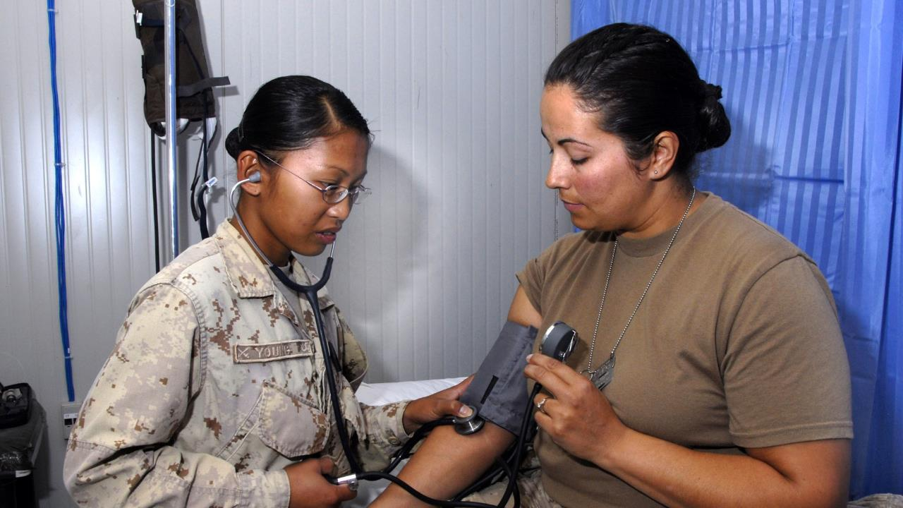
Step 4
Referrals
A CO shall refer the member for a medical assessment each time
an administrative action is taken.
A member can self-refer, if they are concerned about their use.
Aide Memoire (pg. 11-12)
Notes:
There are two types of medical referrals. A member may self-refer, or be referred by a CO.
A supervisor through the CO, shall refer the member for medical assessment each time administrative action is considered due to substance misuse. The member is required to attend the assessment; however is under no obligation to accept treatment.
It is essential for the immediate supervisor to document the history of the case in a written report to the CO, including the exact incidents) which have led to the referral and any help offered to the member. The CO will include this report in his or her referral to th MO, and it will become an important part of an accurate assessment of the case. Once the CO has ordered it, the supervisor’s role is to initiate or facilitate the member’s medical assessment.
A member may self-refer, if they are concerned about their alcohol and other drug use. As in the case with all other medical treatment, patient information will be treated as confidential.
Source(s):
DFHP (2012), Aide Memoire, p.10.

Slide 18

Step 5
Follow-up
If member does not give consent to disclose information, supervisor can
only monitor work performance.
Maintain an open-door policy.
Discuss work limitations with member.
Ask member how best to support them.
Discuss importance of follow up.
Follow up on agreed upon actions.
Aide Memoire (pg. 13-14)
Notes:
AAP relapse is common with other substances too –not just illegal
If the member does go into treatment, or on medical leave, it is important that the supervisor be supportive upon his/her return. Return-to-Work research emphasizes the importance of open communication between the employee, supervisor and if necessary the physician (with the member’s consent) and the member’s input into how best to support them, since they know their own triggers. Since recovery can be a life-long process, it is important to organize regular follow-up meetings and to keep an open door policy to address issues early on before they escalate.
Aftercare: Following treatment, a member will attend weekly aftercare follow-up meetings for one year. Supervisors should encourage and support this process, whenever possible.
NOTES:
Relapse is common and poses a serious problem with illegal drugs. Relapse is a concern especially when we consider the high rate of relapse among drug users in general:
25-35% return to treatment within 1 year, 50% within 2 to 5 years. The sooner people get into treatment and the more follow-up treatments they receive, the better the long-term outcome.
Given these statistics, it is important to encourage members to develop a post-treatment plan, and to ensure that you provide them with on-going support (refer to Aide Memoire under “Follow-up,” pages 13-14).
This one year of follow-up under medical treatment should be distinguished from six months of follow-up under “Counselling and Probation.”
Risk of Relapse can be reduced by:
Post-treatment Plan
Providing on-going support
Source(s):
“An experimental evaluation of recovery management checkups (RMC) for people with chronic substance use disorders,” Evaluation and Program Planning 26 (2003) 339-352

Slide 19

Activity
Supervisor Process
Case Studies
Based on the materials that we have covered concerning interviews and the supervisory process, using a flipchart, develop an outline of the process that you would take as supervisor to deal with this situation.
Be prepared to report back to the larger group.
Notes:
19
Small Group Activity (min 3 participants per group) (45 Min):
IMPORTANT: Remind people they should not share details for confidential reasons, especially if it concerns a small unit.
Ask for a few examples of what participants have learned. Emphasize that there is a great deal of wisdom among the supervisors and that they should consult with each other, particularly those who have extensive experience, when dealing with actual situations. There may also be an opportunity to share these learnings as they work through the case studies during the small group activity.
Group Activity (45 min):
Divide members into groups of 5-6 and assign a case study to each group (Found in Activity Folder). Make sure each group has a facilitator, flip chart and note taker.
Using a flip chart and referring back to the materials covered in the session and the 5 STEPS of the Supervisors’ Process and the 4 STAGES of Interviews (Stage 1 – Preliminaries; Stage 2 – Opening; Stage 3-Problem-Solving; Stage 4- Conclusion), have each group develop an outline of the process that they would take, as supervisor, in dealing with the situation in the case study.
Bring everyone back into the large group and have each facilitator report their action plan (25 min. based on approx. 4 groups).
Highlight the importance of supervisors being consistent and systematic, and that the CAF policies and five-step process can help guide their response.
Hand out Homework : “Are You an Active Listener?” ask them to complete before start of day 2.
Source(s):
Workplace Health Program, CAMH.

Slide 20
Case Study #1
You have been posted to the Maintenance section of your Squadron. As the recently promoted WO in charge of the section, you have worked with many of the members in the past.
Your section is very short handed when MCpl Bender phones in at 10:00 hrs to say that he wants the day off. He first says that he is hung over. He then tells you that his wife has the day off and he wants to spend the day at home.
You are aware that MCpl Bender has been late or has not shown up for work on several other occasions as you have heard others talk about this individual and state they are frustrated because the previous section WO minimized this behaviour each time. As the new section head and Supervisor you are in a position of leadership.
What would your next course of action be?
Notes:
Case Study 1 Response:
Recognition:
Determine if he is late (at what time does he start working?)
Was not consistent on the phone: hung over then wants to be with wife; which one is it?
Happened several times without any consistent intervention ( is there any documentation about prior lateness?)
Documentation
Review what/or if anything has/had been done for the other lates
Talk to COC – may have documentation
Details of current lateness
Observations and concerns from other members? Supervisors?
Read and understand the DAOD 5019-7: Alcohol Misconduct, Canforgen 148/10 and Canforgen 230/12 and DAOD 5019-4: Remedial Measures
Determine what remedial measures might be required for lateness
What resources might be appropriate for the member? Know resources.
Interview
Ask him to come in safely Example: Maybe tomorrow? Or later in afternoon?
Be clear and stand your ground; provide the facts and outline clear work expectations
Determine if there is anything else going on – communication skills come into play here.
Additional resources may be required.
Referral
To medical – Medical Officer
Addition referral may be required based on what is discussed in the interview
Follow-Up
Ensure MCpl Bender receives the support required while he is dealing with his issues
Ensure rumours are minimized in the workplace
Provide a supportive environment
Schedule follow-up interview to discuss whether the performance deficiencies have been corrected

Slide 21
Case Study #2
You are the supervisor of MCpl Nancy Drew. Recently, her husband called you and confided that his wife has been spending between $700.00 - $800.00 at the casino every month for the past year or so. She has been late for work twice in the past month.
Today you get a call from a creditor regarding MCpl Nancy Drew’s outstanding credit card debt.
What would your next coursed of action be?
Notes:
Case Study #2 Response
Recognition:
Late 2 times in the last month (what’s going on? “hearsay” can mean something is going on?)
May be spending $700-$800 at the casino every month for past year according to information given by Mr. Drew – doesn’t mean that’s happening
Call from creditor regarding credit card debt
Documentation:
Ensure you have recorded the details for her lateness; date, time etc.
Record the particulars of the phone call with Mr. Drew; date, time, etc.
Record the particulars of the phone call from the creditor, date; time, etc.
Read and understand DAOD 5019-8 : Private Debts and DAOD 5019-4: Remedial Measures
Determine what remedial measure might be required for lateness
Interview:
Be careful with family issues, not your area of expertise
Use caution about bringing information up to MCpl Drew about her husband's call
Be clear and stand your ground; provide the facts and outline clear work expectations
Determine if there is anything else going on – communication skills used here/active listening
Additional resources may be required
Determine nature of debt if appropriate
Focus on lateness - $$$ not your business
Referral:
To medical – MO
Additional referral may be required based on what is disclosed in the interview (social worker, SISIP, MFRC, CFMAP)
Notify CO of potential failure to settle private debt and nature of debt
Follow-up:
Be careful with family issues not your area of expertise
You are not certain the family dynamic (are they in the middle of divorce, familial issues/custody battle, is domestic violence involved etc?)
Can only follow up about performance issues
Ensure MCpl Drew receives the support required while she is dealing with her issues
Ensure rumours are minimized in the workplace
Provide a supportive environment
Schedule follow up interview to discuss whether the performance deficiencies have been corrected
Administrative action may be initiated if member fails to settle private debts

Slide 22
Case Study #3
You are WO Healthy and you have just been posted into the Unit. On morning parade, you notice that Cpl Hiding is not present. Cpl Hiding shows up at 10:00 and tells you that he slept in. The Sgt-major notifies you that this is the third time in the last two months.
While reviewing his Pers file you notice that he was placed on C&P for alcohol, two years prior to this incident.
An hour later Cpl hiding comes to you and admits that he has a problem with alcohol and asks for help.
What would your next course of action be?
Notes:
Recognition:
Late for parade
Notified by others that he has been late three times in the last 2 months
Documentation:
Details of the lateness
Review what/or if anything has/had been done for the other 3 lates
Determine why nothing had been done for previous lateness; who is enabling Cpl Hiding? What happened the other 2 times?
Review previous C&P – was treatment recommended? Was it accepted or not?
Read and understand the DAOD 5019-7 Alcohol Misconduct, CANFORGEN 148/10 & CANFORGEN 230/12 and DAOD 5019-4: Remedial Mesaures
Determine what remedial measures might be required for the lateness
Interview:
Be clear and stand your ground: provide the facts and outline clear work expectations
Determine if there is anything else going on?
Additional resources might be required
Admitting he has a problem does not absolve him of the remedial measures associated with the lateness
Referral:
To MO
Additional referral may be required based on what is disclosed in the interview
Follow up:
Ensure Cpl Hiding receives the support required while he is dealing with his addiction to alcohol
Ensure rumours are minimized in the workplace
Provide a supportive environment when Cpl Hiding returns
Schedule follow up interview to discuss whether the performance deficiencies have been corrected
Follow up with COC as well – not alone

Slide 23
Case Study #4
HMCS Never-home is away on another deployment. You have just joined the ship in Europe as a new MS. The morale on board isn't very high right now; this is due to the amount of time away from home. As a new Supervisor you have been watching your subordinates very closely. You notice something isn't right with S1 Stoner. You bring this concern to your boss, and he says that S1 Stoner is normally a strong worker and a very levelheaded leader, but his personality has changed, and it is starting to affect the rest of the department. He also states that S1 Stoner doesn't hang out or get along with his buddies anymore and that his attitude is undesirable.
As his Supervisor, you go to the shop's office and pull his file. You notice that there have been issues with substance use in the past?
What will your next course of action be?

Slide 24
Break

Slide 25

Large Group Role Play
Your facilitator will be your employee. As a group, you will be the supervisor.
What is the five-step process?
How can you be an active listener?
How would you reflect feelings?
What non-verbal behaviour can you watch for?
Notes:
25
Before participant go into small group role plays, demonstrate this via large group role play.
This large group activity will help to increase participation and understanding of the interviewing process.
As the facilitator, you will play the role of the employee in a round table format that is ‘witnessed’ by a larger group who have the opportunity for input and questioning.
The larger group will act as the supervisor and provide information on how to walk through the 5-step process learned from the previous day.
As the ‘employee’, you play a realistic situation that provides the ‘supervisors’ with an opportunity to practice what to say if an employee denies there is any problem, deflects or minimizes the impact of the substance misuse problem.
NOTE: Depending on the size of the group, you may not have time for everyone to play the role of supervisor. However, in order to develop these skills, it is highly recommended that everyone have an opportunity.
Alternative activity to role play - Apply other Interview Tips Use such as:
Active listening
Paraphrase
Reflect feelings
Be aware of non-verbal behavior

Slide 26
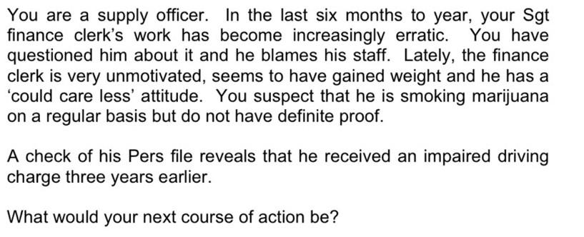
Your facilitator will be your employee. As a group, you will be the supervisor.
What is the five step process?
How can you be an active listener?
How would you reflect feelings?
What non-verbal behaviour can you watch for?

Slide 27
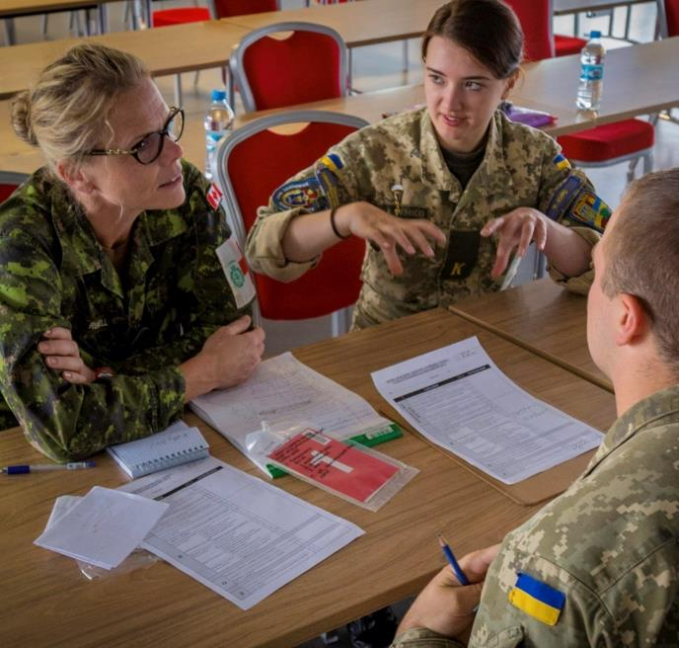
Role Plays
Let’s practice how to apply and reinforce your supervisor interviewing skills when addressing possible substance misuse within your unit.
You will each have a role:
Supervisor
Employee
Observer
Rotate through the roles.

Slide 28
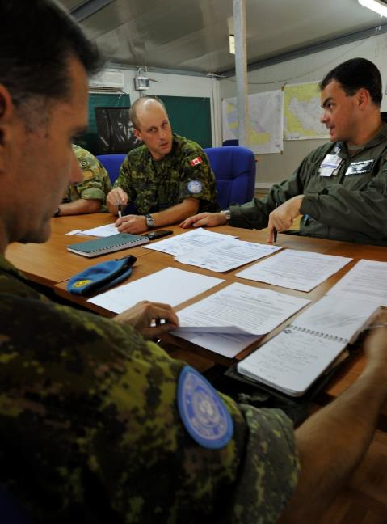
Small Group Role Play
Addressing Substance Misuse
in Your Unit
In your group of three, use the case studies completed. You will each have a role - as supervisor, employee and observer.
Apply your interviewing skills:
Use “I” statements.
Mention observable behaviour to be corrected
Be assertive, not aggressive.
Be firm, but fair.
Be open-minded.
Rotate through the roles.
Notes:
2) Small Group Activity Role Play (groups of 3)
Purpose of activity is to summarize the key aspects of the 5 step process to assist a member.
using case studies from Day 1 ask groups to role play the initial interview.
Allow time for each participant to play the role of supervisor and conduct and interview
Feedback questions:
Ask how they felt playing each of the roles.
Beginning with the “supervisor” role, and ask participants to share what they did well and where they could improve.
As participants to share how they felt as a “member,” what the supervisor did well and where they felt the supervisor could improve.
Ask participants what they noticed as “observers” that was not already said. It is important to highlight the differences between dealing with a member vs. a civilian.

Slide 29
Break

Slide 30
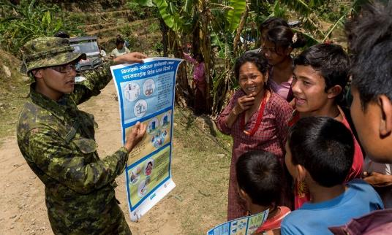


Culture
Culture is defined as unspoken beliefs, values and traditions that are common to a group of people. Culture can be used to control and reinforce those behaviours that are encouraged and censor those which are not.
How would you describe the culture of the CAF regarding substance use, gambling and gaming?
Notes:
Note: click to reveal the question, then the definition.
The term frequently used to describe the environment in which people work is called “culture.” Often we think of culture in terms of a particular ethnic or racial group, however the workplace can also be a culture.
Think for a minute about what culture or cultures you feel you belong to or that influence your life? (ask participants to identify cultures).
Work Culture
Although certain aspects of a work culture may be defined in policies and mission statements, it is the day-to-day practices, or “authentic” culture, that shapes people’s feelings about an organization and also determines the level of influence the culture has over its employees. In fact, if there is a conflict between formal statements and informal practices, employees will always describe their organization by the informal practices. These beliefs, values and practices reinforce certain behaviours and discourage others.
Healthy Workplace Culture
There is a strong connection between the health and well-being of people and their work environments. A workplace culture which promotes employee mental and physical health, as well as productivity and organizational effectiveness is a healthy workplace.
Source(s):
Kahn, Jeffrey, MD and Langlieb, Alan, MD, Eds. (2003), Mental Health & Productivity in the Workplace: A Handbook for Organizations and Clinicians. San Francisco, CA: Jossey-Bass.
https://www.ccohs.ca/newsletters/hsreport/issues/2016/09/ezine.html
Mental Health Commission of Canada (2010) The Shain Reports on Psychological Safety in the Workplace
Shain M, Kramer DM, Health Promotion in the Workplace: Framing the Concept: Reviewing the Evidence; Occupational and Environmental Medicine 2004;61:643-648.

Slide 31
MHCM Applied to Substance Use and Addiction
Chain of Command
Healthy
Reacting
Injured
Ill
Chain of Command
Chain of Command
Chain of Command
Chain of Command
Health Services
Health Services
Health Services
Health Services
How might CAF leaders discourage the culture of heavy drinking, substance use,
gambling and gaming?​
Adapted from the US Marine Corps
Notes:
31
Recent experiences have taught us that many CAF members have physical and mental health concerns that, if identified and treated early, have the potential to be temporary and reversible.
This model recognizes the spectrum of health concerns, be they mental or physical, that may impact CAF members during their careers. The model goes from healthy, adaptive coping (green), through mild and reversible distress or functional impairment (yellow), to more severe, persistent injury or impairment (orange), to clinical illnesses and disorders requiring more concentrated medical care (red).
The arrows under the four color blocks denote the fact that this is a continuum, with movement in both directions along the continuum, indicating that there is always the possibility for a return to full health and functioning. In this way, no one is ‘written off’ simply because they are showing symptoms of an illness, or are being treated for a disorder or disease. There is also a recognition that the earlier that intervention of some sort is provided, the easier it is to return to full health and functioning (green).
It is important to note one can go from green to orange or red instantly depending on the severity of the event and/or the person effected.
The health and well-being of CAF members is the shared responsibility of the member, the chain of command, and Health Services.
Leaders are responsible for their personnel and have a vital role to play in preventing and managing distress . As the severity of the illness increases, this results in a more robust Health Services intervention, but the Chain of Command never abdicates responsibility of the member. Leaders always have a role and responsibility to maintain contact and support their members throughout the continuum of mental health.
The actions of the chain of command also have an impact on the movement of the CAF member along the continuum. Significant life events certainly impact one’s mental health – however what is even more significant is the impact of small daily hassles that over time can cause distress. The leader has a role in affecting the little things in day to day work life that can cause distress in their troops.
Sources(s)
https://www.canada.ca/en/department-national-defence/maple-leaf/defence/2020/03/mental-health-covid-19.html
31

Slide 32

Request for your unit

Slide 33

What Is Your Action Plan?
Supervisors affect the day to day practices of a unit.
Notes:
Each unit and base/wing must take responsibility. Culture and the environment play a significant role in shaping attitudes and behaviours towards alcohol and other drugs. You can change the CAF culture through a comprehensive, incremental, leadership-focused and people-centered approach.
Individual Activity
Thinking back to the activators and possible strategies along with the discussion on cultural change:
What is your action plan?
Handout: Action Plan
Source(s):
Adapted from “Factors/Relationships Affecting Individual Stress Response,” in William White, The Incestuous Workplace: Stress and Distress in the Organizational Family, Minnesota: Hazelden, 1997:28. http://www.hrsdc.gc.ca/eng/lp/spila/wlb/ell/15linda_duxbury.shtml
https://www.camh.ca/en/health-info/workplace-mental-health-playbook-for-business-leaders

Slide 34
What Will You Do?

Slide 35

Questions?
Notes:
35

Slide 36



Acknowledgements
The Directorate of Force Health Protection would like to thank the following organization for assisting in the design/development of this program:
MPGG EPIC
We would also like to acknowledge our Health Promotion delivery partners:
CFMWS PSP

