Slide 1


Notes:
Hand out Program Cards
Have the group scan QR code to help with HP 101

Slide 2

What is Health Promotion?
The process of enabling people to increase control over, and to improve their health.
- Ottawa Charter of Health Promotion
Qu'est-ce que la promotion de la santé?
La promotion de la santé est le processus qui confère aux populations les moyens d'assurer un plus grand control sur leur propre santé, et d'améliorer celle-ci.
- Charte d’Ottawa pour la promotion de la santé
Notes:
What is Health Promotion?
Read out definition
Health being complete physical, mental, spiritual and social well-being
-
•Not about forcing change on anyone – Health Promotion is not something we do “to” people – we are a resource for people to use… smokers come to us when they are ready to quit- we don’t go hang out in smoking areas and pass out brochures.
•What we like to do: is raise awareness, educate and motivate for positive change
•Most of what we do centers around campaigns and courses, but we also advocate for policy and procedure changes that could promote the health of CAF personnel

Slide 3
The primary goal of HP in the CAF
To help CAF members become healthy to fulfill their Operational Madate AND to Maintain a high Quality of Life!
L'objectif principal de HP dans les FAC Est d'aider les membres des FAC à devenir en bonne santé pour réaliser leur opérationnel mandat et pour maintenir une bonne qualité de vie !
Notes:
Ultimately our Goal is to:
•Help CAF members become healthy so they can fulfill their operational mandate AND maintain a high quality of life.
Although our mandate targets Canadian Armed Forces personnel, all Strengthening the Forces programs and workshops are free and open to military personnel (Reg and Res Force), retired military personnel AND their spouses. Where space and resources allow, DND and NPF civilian employees are welcome to participate.
We use information from the Health and Lifestyle Information Survey to help drive our programming.

Slide 4


Supporting CAF members, veterans, family and civilian staff
Southen aux members des FAC, aux anciens combattants, aux familles et au personnel civil

Slide 5
What are the four main subject areas of Health Promotion in the CAF?
Notes:
Warm Up question

Slide 6

Social Wellness / Mieux-être social
Nutritional Wellness / Mieux-ête nutritionnel
Addiction Free Living / Sensibilisation aux dépendances et prévention
Active Living & Injury Prevention / Prévention des blessures et vie active
Notes:
We deliver services like courses, workshops, briefings and campaigns in:
i) Active Living & Injury Prevention
ii) Addiction Free Living
iii) Social Wellness
iv) Nutritional Wellness
Strengthening the Forces Unit Reps and other partners help promote programs and health promotion messaging across the Garrison.
Nous offrons des services comme des cours, des ateliers, des séances d’information et des campagnes en :
i) Vie active et prévention des blessures;
ii) Vie sans dépendance;
iii) Mieux-être social;
iv) Mieux-être nutritionnel.
Les représentants d’Énergisez les Forces au sein des unités, ainsi que d’autres partenaires, nous aident à faire connaître nos programmes et nos messages de promotion de la santé dans la garnison.

Slide 7
Guess the Health Promotion Program HP 101

Slide 8
HP 101
This program tests our ability to
RESPOND ASSERTIVELY rather than
REACT AGGRESSIVELY when we are involved in anger-generating situations.

Slide 9

1, 15, 22, 29 Oct, 5 & 12 Nov (Tuesdays 0830-1200)
Notes:
The course is for everybody – not specifically for “angry people”. Not geared for someone who has a history of violence.
As with all of our programs- this is an educational and skill bldg course to assist people in examining and addressing issues of anger while they’re still manageable in order to prevent the possibility of escalation to physical or verbal aggression.
In fact, if someone has to take a court-ordered anger management program- they would not be suitable for our program and sent to a more suitable one
MAM is an interactive program designed to help increase personal performance by identifying successful coping strategies that participants already use in anger–generating situations and by providing opportunities to learn and practice new skills. Discussions focus on understanding anger; identifying personal triggers; managing conflict with others; identifying and practising strategies that work for you, and learning how to manage your response for the long-term.

Slide 10
HP 101
We partner with Fitness & Sports Instructors, Base Physio and the Physical Exercise Specialist to deliver this practical workshop focused on exercise selection.

Slide 11

16-Oct, 1230-1600
Notes:
1) encouraging members to
maintain a healthy level of
activity
2) providing guidelines to prevent
overuse or repetitive strain,
sports or exercise related
injuries.

Slide 12
HP 101
Hydration and the importance of food as fuel is discussed in this one-day workshop.

Slide 13

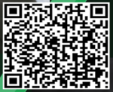
TBA
Notes:
Fuel for body and mind
Workshop date TBA
Often do this workshop by request from sports teams/clubs

Slide 14
HP 101
This MITE coded training explores warning signs of suicide and provides resources and tools to help those who may be thinking of suicide.

Slide 15

26 Sept, 23 Oct or 26 Nov
0800-1600
Other dates: 19 OCT, 30 NOV
Notes:
Focus on improving mental fitness – MFE’s
Taking care of self so you can best support others.
MHCM – recognize changes in behaviour and early intervention vital
This course is MITE coded. The purpose of MFSA is to prepare personnel in leadership positions to promote mental fitness and to lessen the incidence of mental health injuries including deliberate self-harm and suicide within the military community. Although this is a supervisor course, course is open and appropriate for all ranks, families and NPF/DND Civ Employees.

Slide 16
HP 101
This a Supervisor training that includes a partnership with our local Base Addictions Counsellor.

Slide 17

13 & 14 November
0800-1600hrs
Notes:
Alcohol not a healthy coping strategy – once in a while maybe one to unwind
Again get into habit of going to one of your healthy stress management strategies
Supervisors will learn to recognize the signs and symptoms of addiction and through practice, apply the DND policies around alcohol, other drugs, gambling and gaming. Supervisors will be given an opportunity to develop and practice strategies to promote an addiction-free work environment.

Slide 18
HP 101
This is a one day workshop which includes conversations and skill-building in the area of Bystander Intervention.

Slide 19

30 Oct and 19 Nov
0800-1600
Other dates: 26 OCT, 15 NOV, 6 DEC

Slide 20
HP 101
Thinking about quitting?
You can connect with Health Promotion to provide resources and support through this CAF program.
Notes:
Another stress management strategy – connect with us to assist but again a hard habit to break. Key is to find alternatives to the cigarette.

Slide 21

Self-Managed Program

Slide 22
HP 101
How can you improve your communication skills and deal effectively with conflict in your personal relationships?
Register for: ________________

Slide 23

28 Nov & 5 Dec
0830-1600
Notes:
Good communication can eliminate A LOT of stress especially in personal relationships.
Active listening is vital. Listen to understand not reply.

Slide 24
HP 101
Learn how to adopt healthy nutrition habits while trying new recipes in the kitchen!

Slide 25

6 December 0830-1200
Other dates: 21 OCT, 18 NOV, 2 DEC
Notes:
A healthy diet can work wonders on our mental health!
Eat well plate!

Slide 26
HP 101
One day workshop with a focus on relaxation techniques that are effective to manage stress.

Slide 27

7 November
0830-1600
Notes:
Focus on relaxation strategies and other skills to help cope with stress.

Slide 28
HP 101
This class is on the Garrison PT schedule on Fridays at 0730hrs at the Base Gym where you can join Health Promotion and exercise your mind.

Slide 29


Slide 30
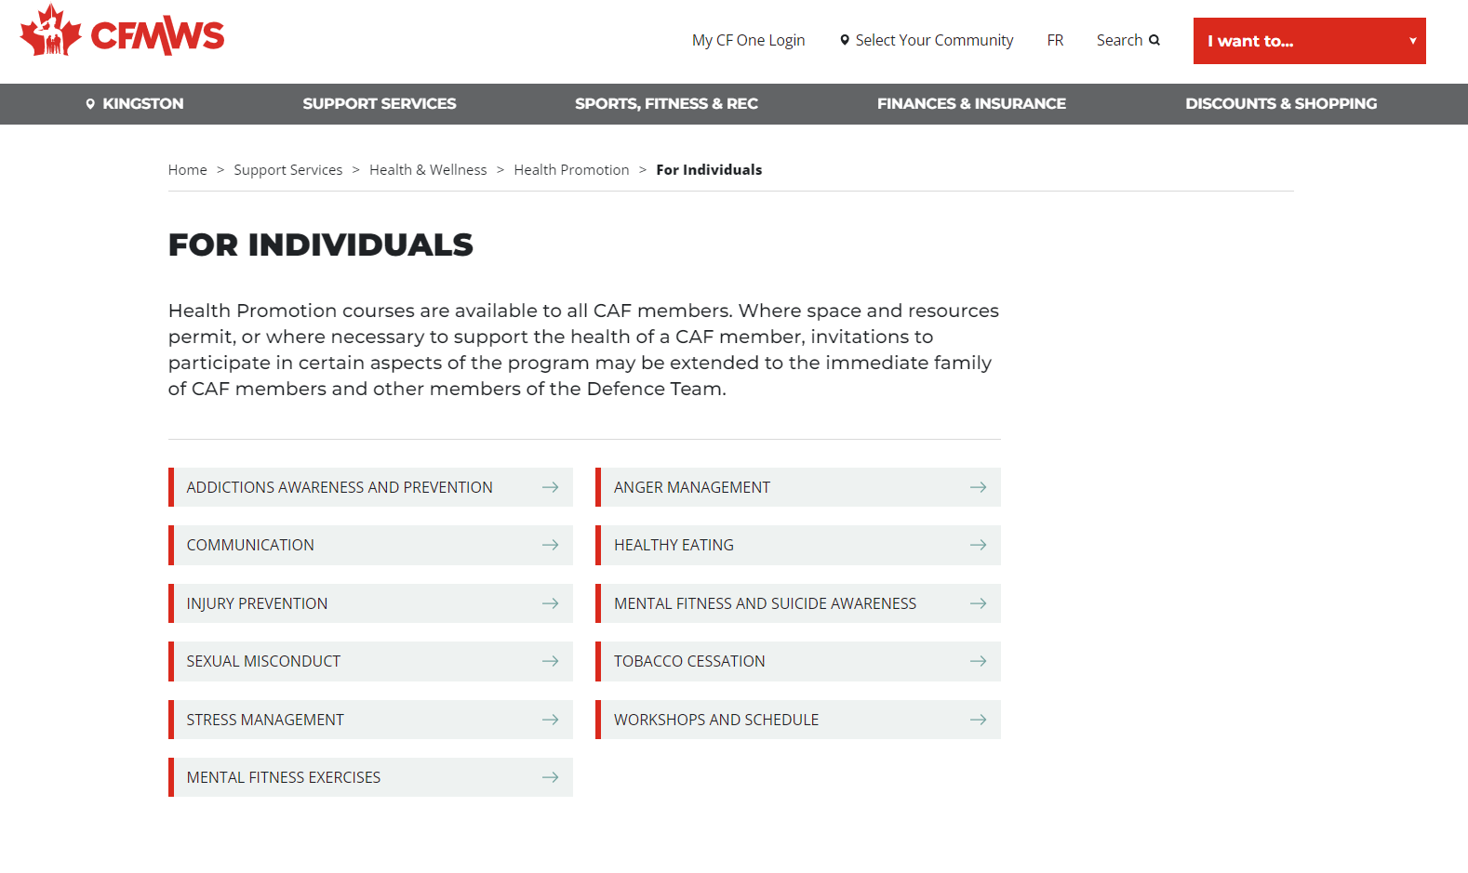
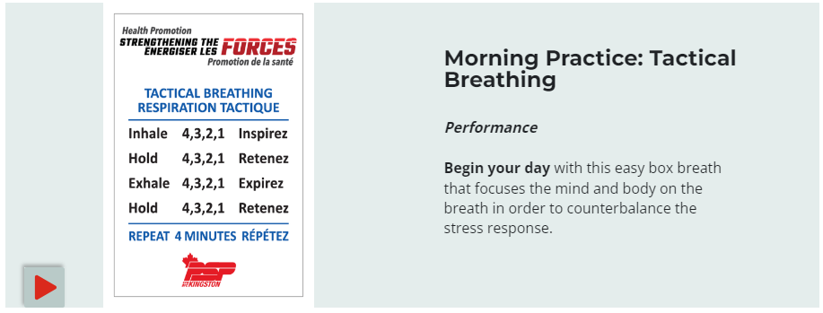

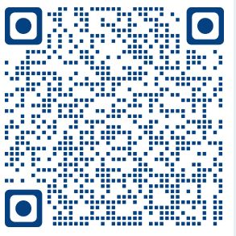
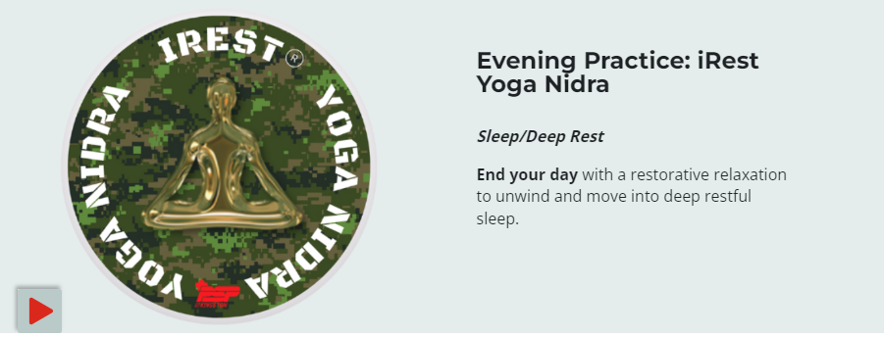

Slide 31
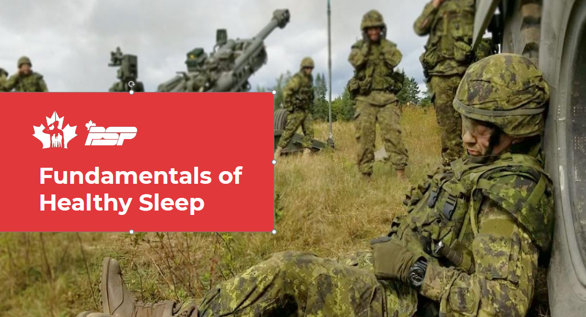


New in Health Promotion!
The Essential ​
Nutrition Course ​
10 October, 0830-1600hrs
Notes:
So when we think of health behaviours, we often think of ‘exercise’, ‘physical activity’, ‘balanced diet and proper nutrition’; but recently along with sedentary behaviour, sleep has received more attention both in the media and among researchers, as an important component for health – both physical and mental.

Slide 32
HP 101
You can find all local resources and support services at CFB Kingston and within the local Kingston community using this resource.

Slide 33

HP 101

Slide 34
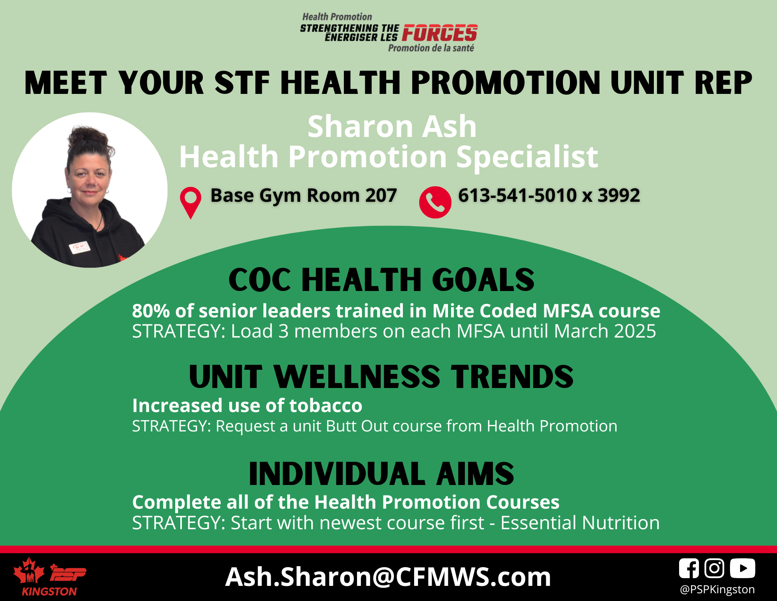
Meet Your STF HP Rep (add your slide here)

Slide 35
Notes:
Hand out Program Cards
Have the group scan QR code to help with HP 101

